Slide 1
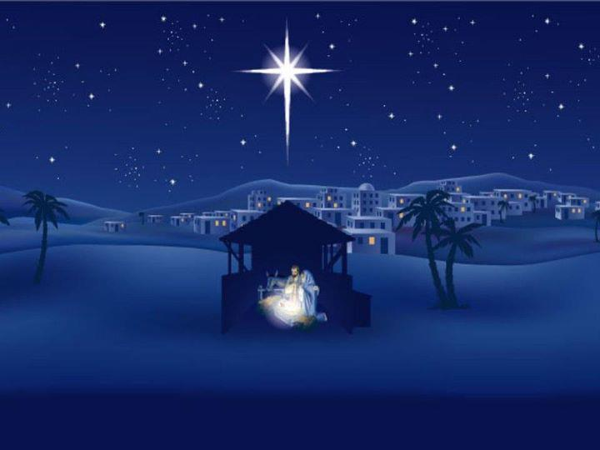
Following a Star
Bernard Sexton

Slide 2
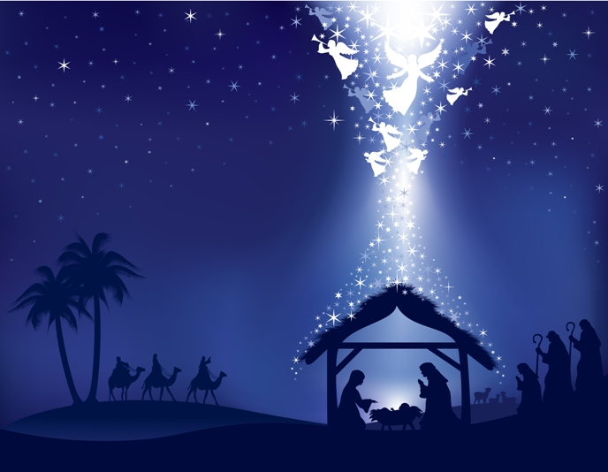
Why are we waiting here , why?
Why are we waiting here , why?
Waiting for the joy and hope the baby brings
to us and to the world

Slide 3
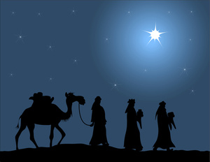
We are the wise-men
Caspar, Melchior and Balthasar
We are the wise-men following a star.

Slide 4
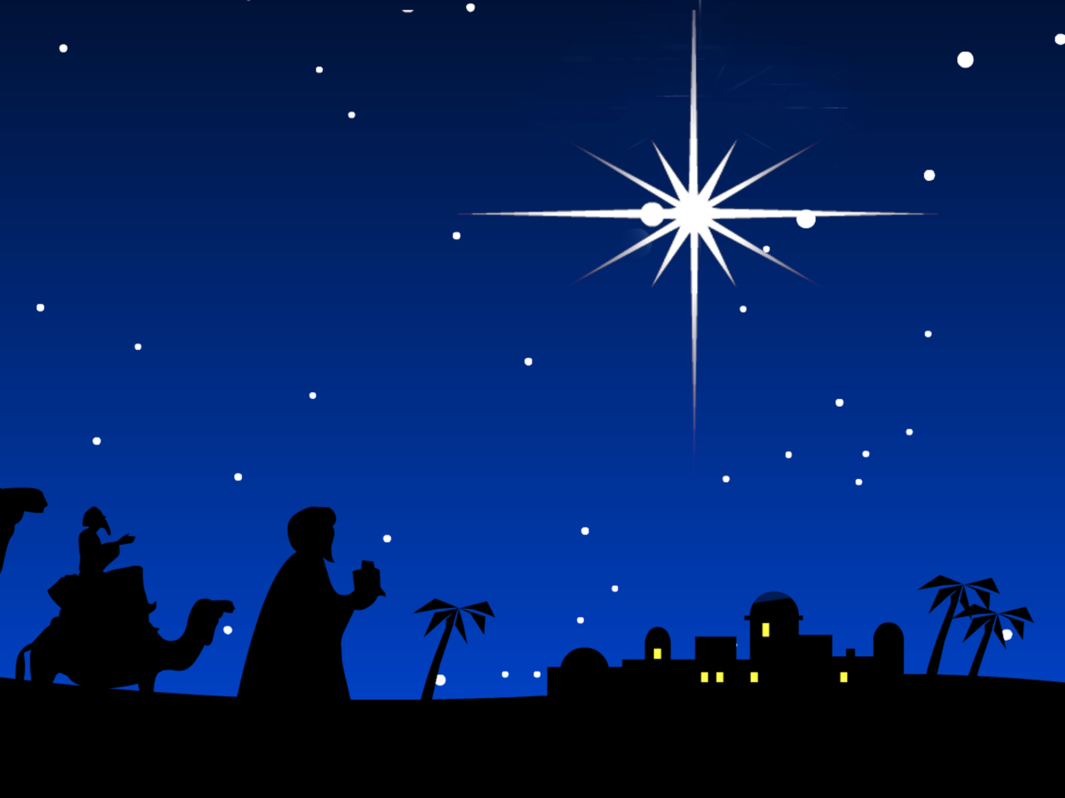
Why are we watching here, why?
Why are we watching here, why?
Watching for a new star in the sky above
To guide us on our way.

Slide 5
We are the wise-men
Caspar, Melchior and Balthasar
We are the wise-men following a star.

Slide 6
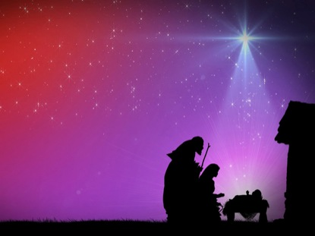
Why are we wondering here , why?
Why are we wondering here , why?
Wondering if the road we’re on will ever end
If the new King will be there.

Slide 7
We are the wise-men
Caspar, Melchior and Balthasar
We are the wise-men following a star.

