Slide 1
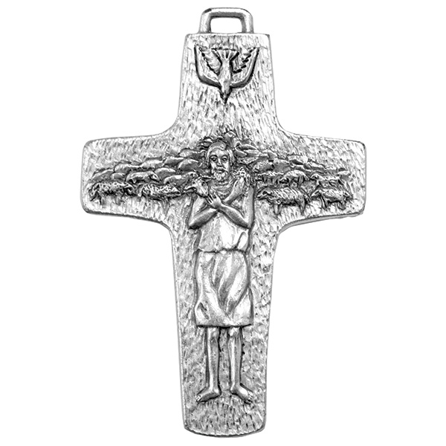
The Lord, He is My Shepherd (Psalm 23)
Bernard Sexton

Slide 2
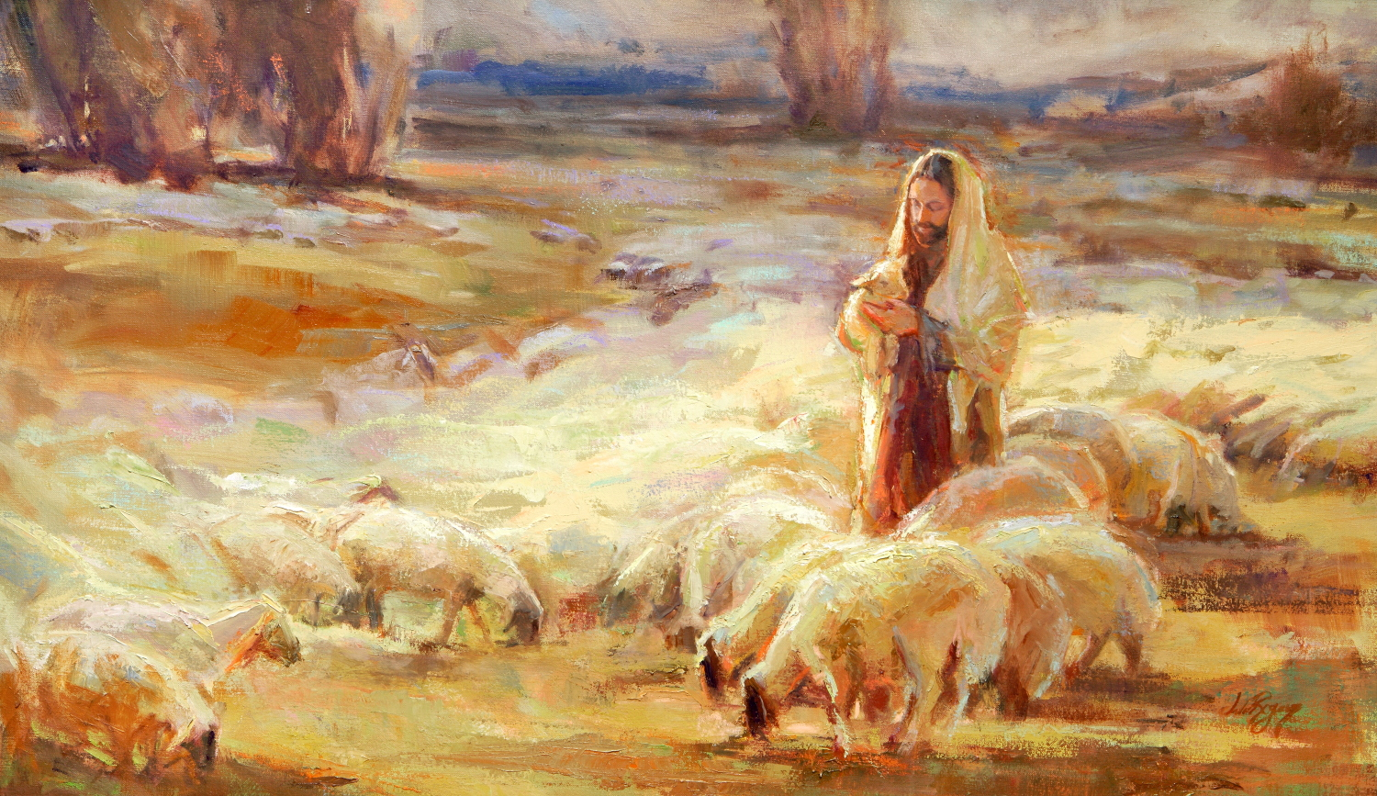
The Lord, he is my shepherd.
Nothing shall I need.

Slide 3
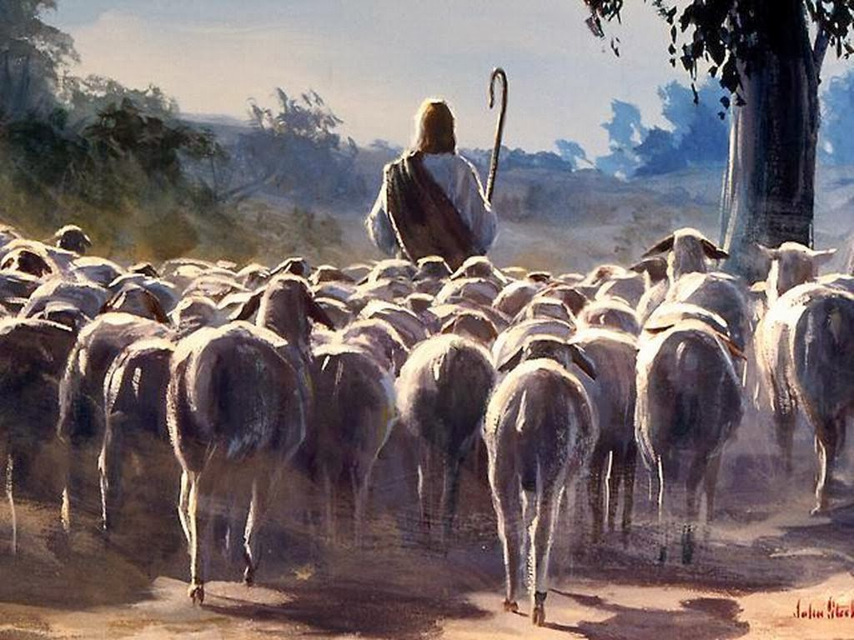
The Lord, he is my shepherd.
Nothing shall I need.
He leads me to walk in green pastures.
He restores, he restores my soul.

Slide 4
The Lord, he is my shepherd.
Nothing shall I need.

Slide 5
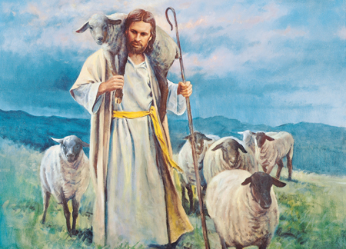
He keeps me on the right path
True to his name
He walks with me
when I’m in darkness
And protects me from all harm.

Slide 6
The Lord, he is my shepherd.
Nothing shall I need.

Slide 7
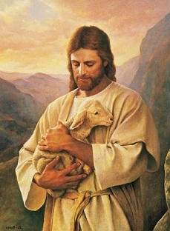
His goodness and his kindness
always, follow me.
And in God’s house, I will live
for endless, endless days.

