Slide 1
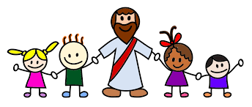
We come to you, Lord Jesus

Slide 2
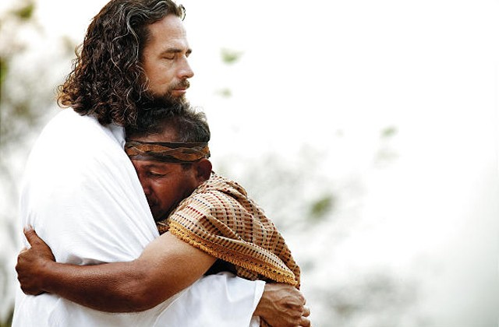
We come to you, Lord Jesus,
to say our thanks to you
And in our Mass
we bring ourselves
and everything we do.
We love you Lord Jesus,
Stay with us we pray
Help us to be more like you each day.

Slide 3

We bring the bread, we bring the wine
We bring them now to you
We bring our work,
we bring our play
And ev’ry thing we do.
We love you Lord Jesus,
Stay with us we pray
Help us to be more like you each day.

Slide 4

Your love for us, our love for you
We celebrate today
Oh fill our hearts with peace and joy.
Be with us Lord,
we pray.
We love you Lord Jesus,
Stay with us we pray
Help us to be more like you each day.

