Slide 1

I’m Sorry God
Mary Amond O’Brien

Slide 2

God wraps us in his love each day,
speaks gently to us on our way.
Even when we disobey,
God’s love is always there,
God loves us ev’ry day

Slide 3
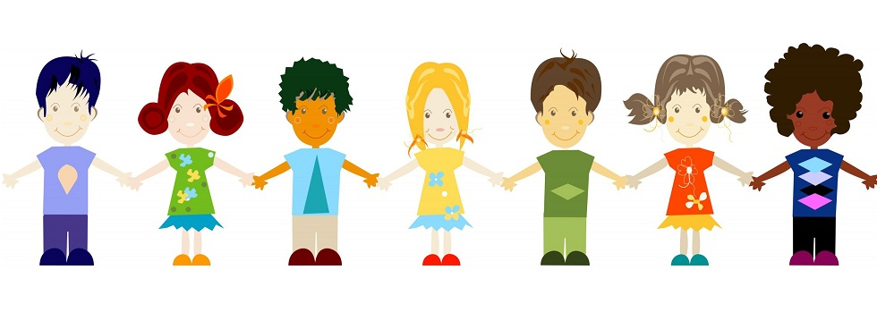
Sometimes God I do not care
I’m selfish and I do not share,
I’m sorry God

Slide 4
God wraps us in his love each day,
speaks gently to us on our way.
Even when we disobey,
God’s love is always there,
God loves us ev’ry day

Slide 5
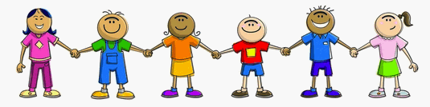
Sometimes I tell tales on you.
I make up stories that are not true.
I know I should not act this way.
That is why I’d like to say...

Slide 6
God wraps us in his love each day,
speaks gently to us on our way.
Even when we disobey,
God’s love is always there,
God loves us ev’ry day

Slide 7

Sometimes I won’t let you play.
I turn my back till you go away.
I know I should not act this way.
That is why I’d like to say…

