Slide 1

Alleluia, Alleluia! Give Thanks
Alleluia, Alleluia Give thanks to the risen Lord Alleluia, alleluia,
Give praise to His name.

Slide 2

Jesus is Lord of all the earth He is the King of creation.
Alleluia, Alleluia Give thanks to the risen Lord Alleluia, alleluia,
Give praise to His name.

Slide 3

Spread the good news o'er all the earth Jesus has died and has risen.
Alleluia, Alleluia Give thanks to the risen Lord
Alleluia, alleluia,
Give praise to His name.

Slide 4
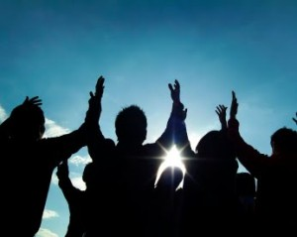
Come, let us praise the living God; Joyfully sing to our Saviour.
Alleluia, Alleluia Give thanks to the risen Lord Alleluia, alleluia,
Give praise to
His name.

