Slide 1
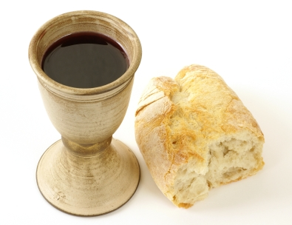
Eat This Bread
Jaques Berthier

Slide 2
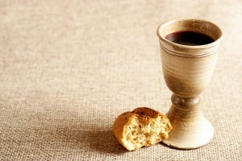
Eat this bread, drink this cup,
come to me and never be hungry.
Eat this bread, drink this cup,
trust in me and you will not thirst.
Anyone who eats this bread, will live forever.

