Slide 1
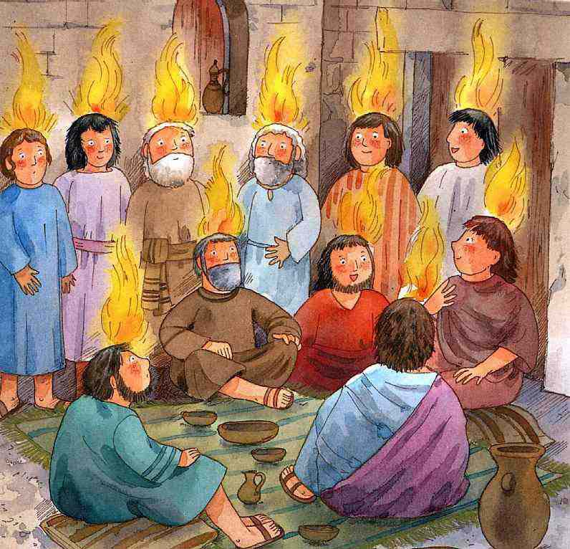
The spirit of God is upon us.
Jesus has brought us good news.

Slide 2
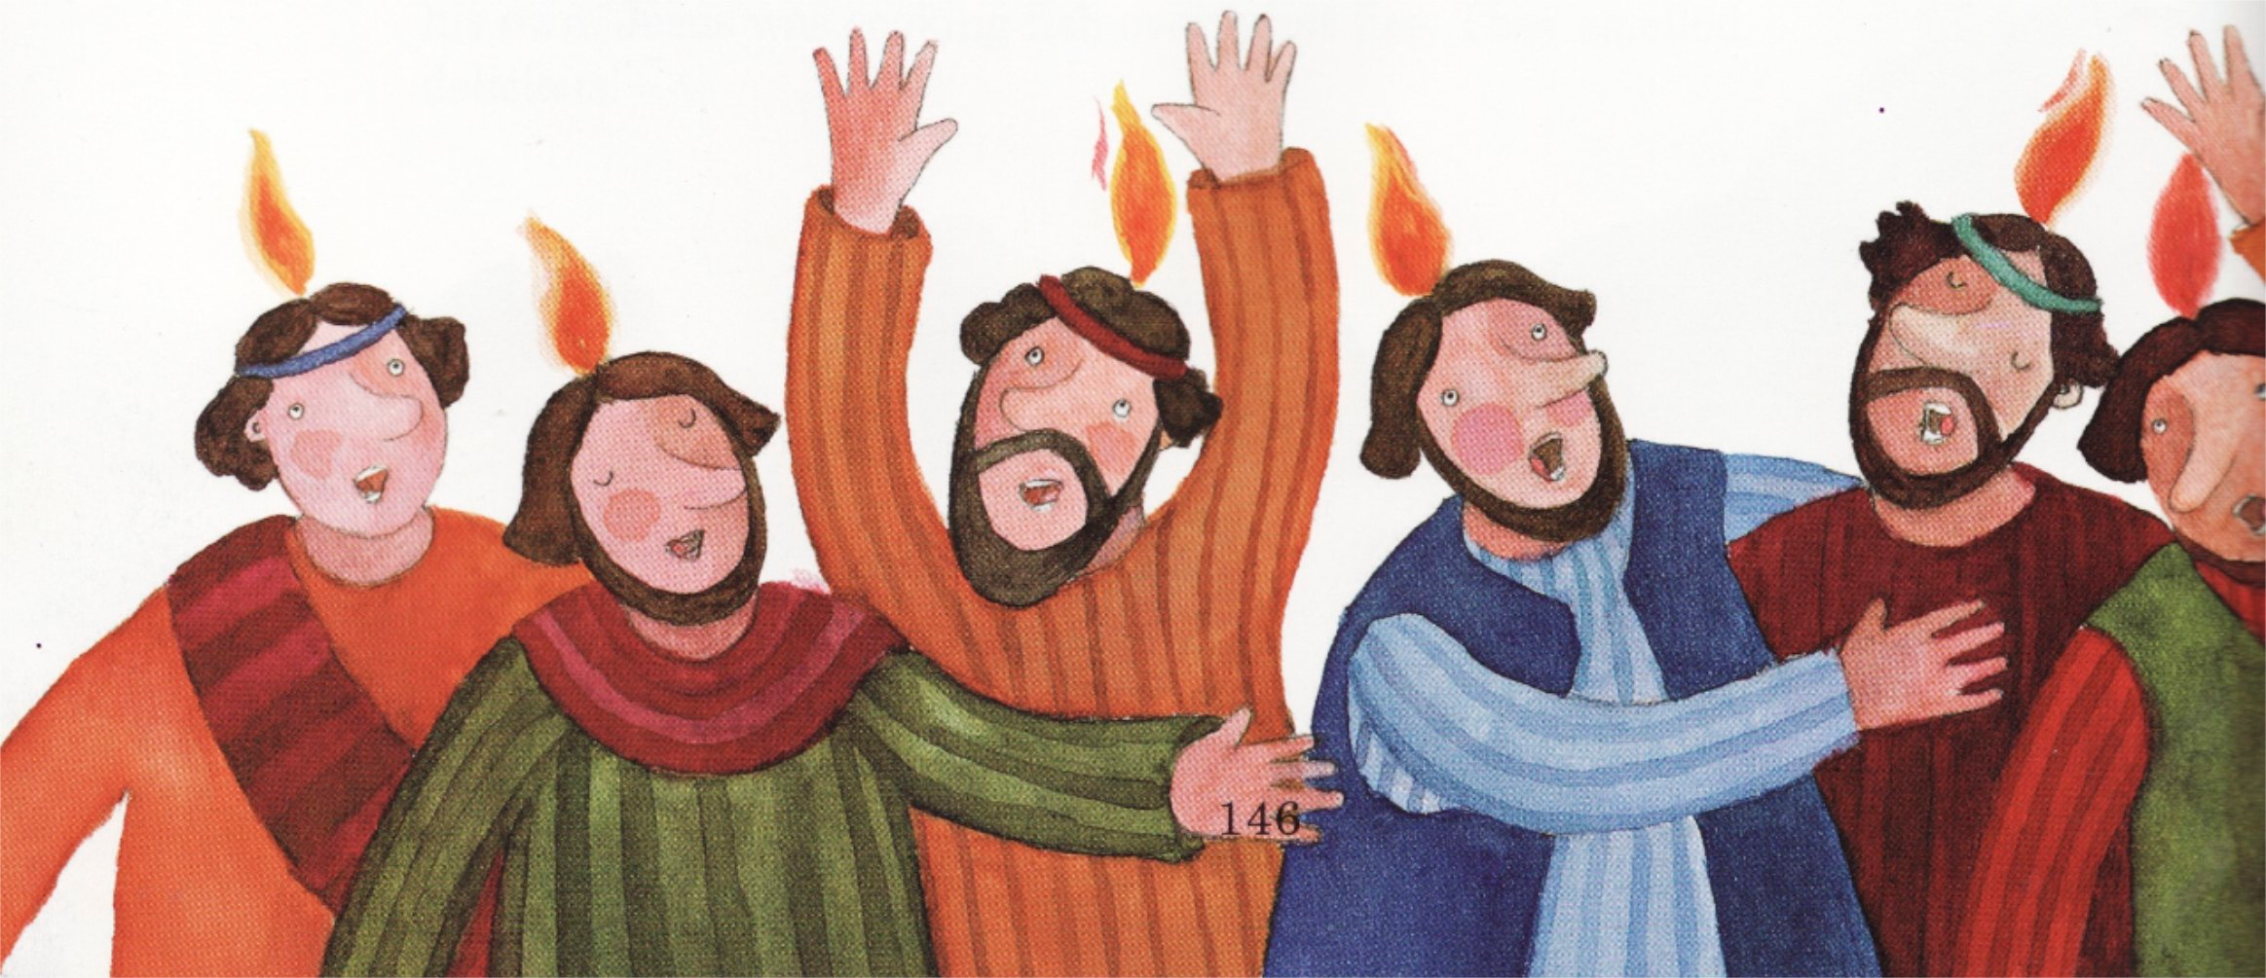
May God bless you,
may God bless you.

Slide 3
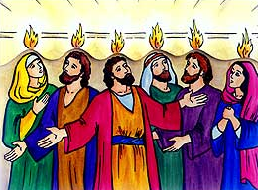
We move on now to share the news.

