Slide 1

This is the day
Mary Amond O' Brien

Slide 2
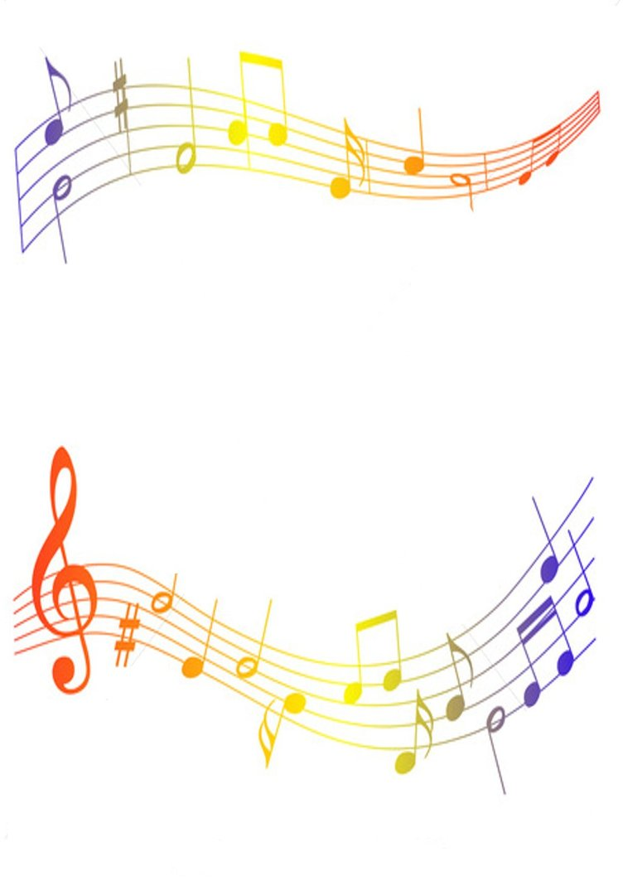
Sing! Sing! Sing alleluia.
This is the day the Lord has made.
Dance! Dance! Dance alleluia.
This is the day the Lord has made

Slide 3

Let us rejoice and be glad,
This is the day the Lord has made.
Let us rejoice and be glad,
This is the day.

Slide 4
Sing! Sing! Sing alleluia.
This is the day the Lord has made.
Dance! Dance! Dance alleluia.
This is the day the Lord has made

Slide 5
Play music to honour His name
This is the day the Lord has made
Sing psalms and songs of praise
This is the day.

