Slide 1
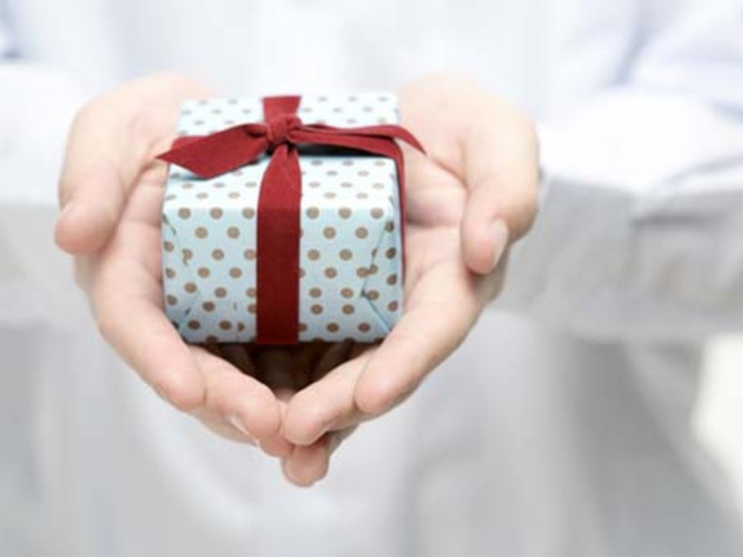
Gifts from God

Slide 2
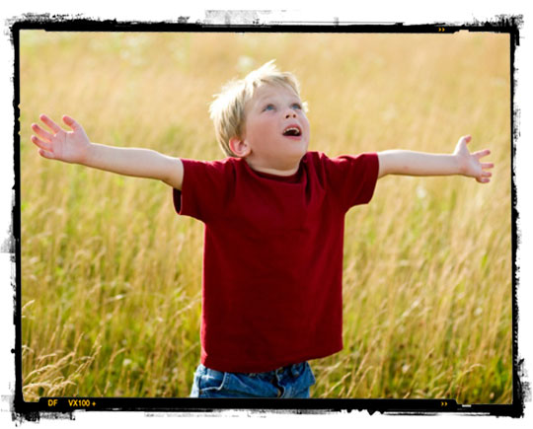
We have been called to love the Lord, our God.
We have been called to glorify his name. (x2)

Slide 3
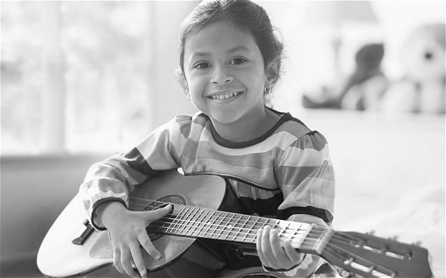
Use your skills, use your talents, use the gifts you have been given.
We’re all diff’rent, we’re all special in this world.
Use your skills, use your talents, use the gifts you have been given.
Give God glory, love all others, love our world.

Slide 4
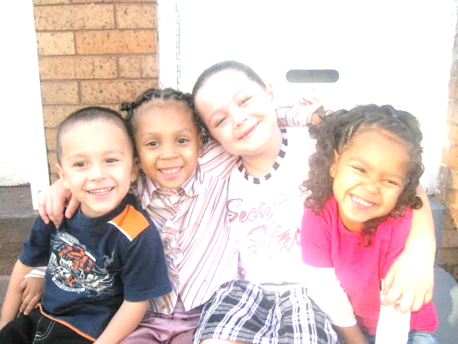
We have been called to care for all our friends.
We have been called to watch for everyone. (x2)

Slide 5
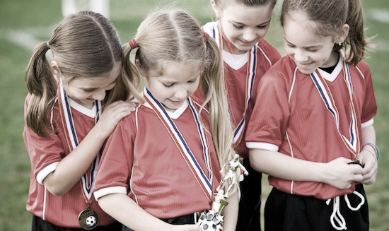
Use your skills, use your talents, use the gifts you have been given.
We’re all diff’rent, we’re all special in this world.
Use your skills, use your talents, use the gifts you have been given.
Give God glory, love all others, love our world.

Slide 6
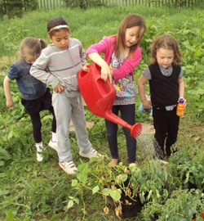
We have been called to care for this, our world.
We have been called to marvel at God’s work. (x2)

Slide 7
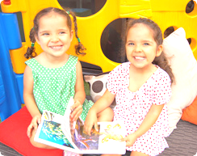
Use your skills, use your talents, use the gifts you have been given.
We’re all diff’rent, we’re all special in this world.
Use your skills, use your talents, use the gifts you have been given.
Give God glory, love all others, love our world.

