Slide 1

The Spirit of God is upon Us
Fr. Peter O’Reilly

Slide 2
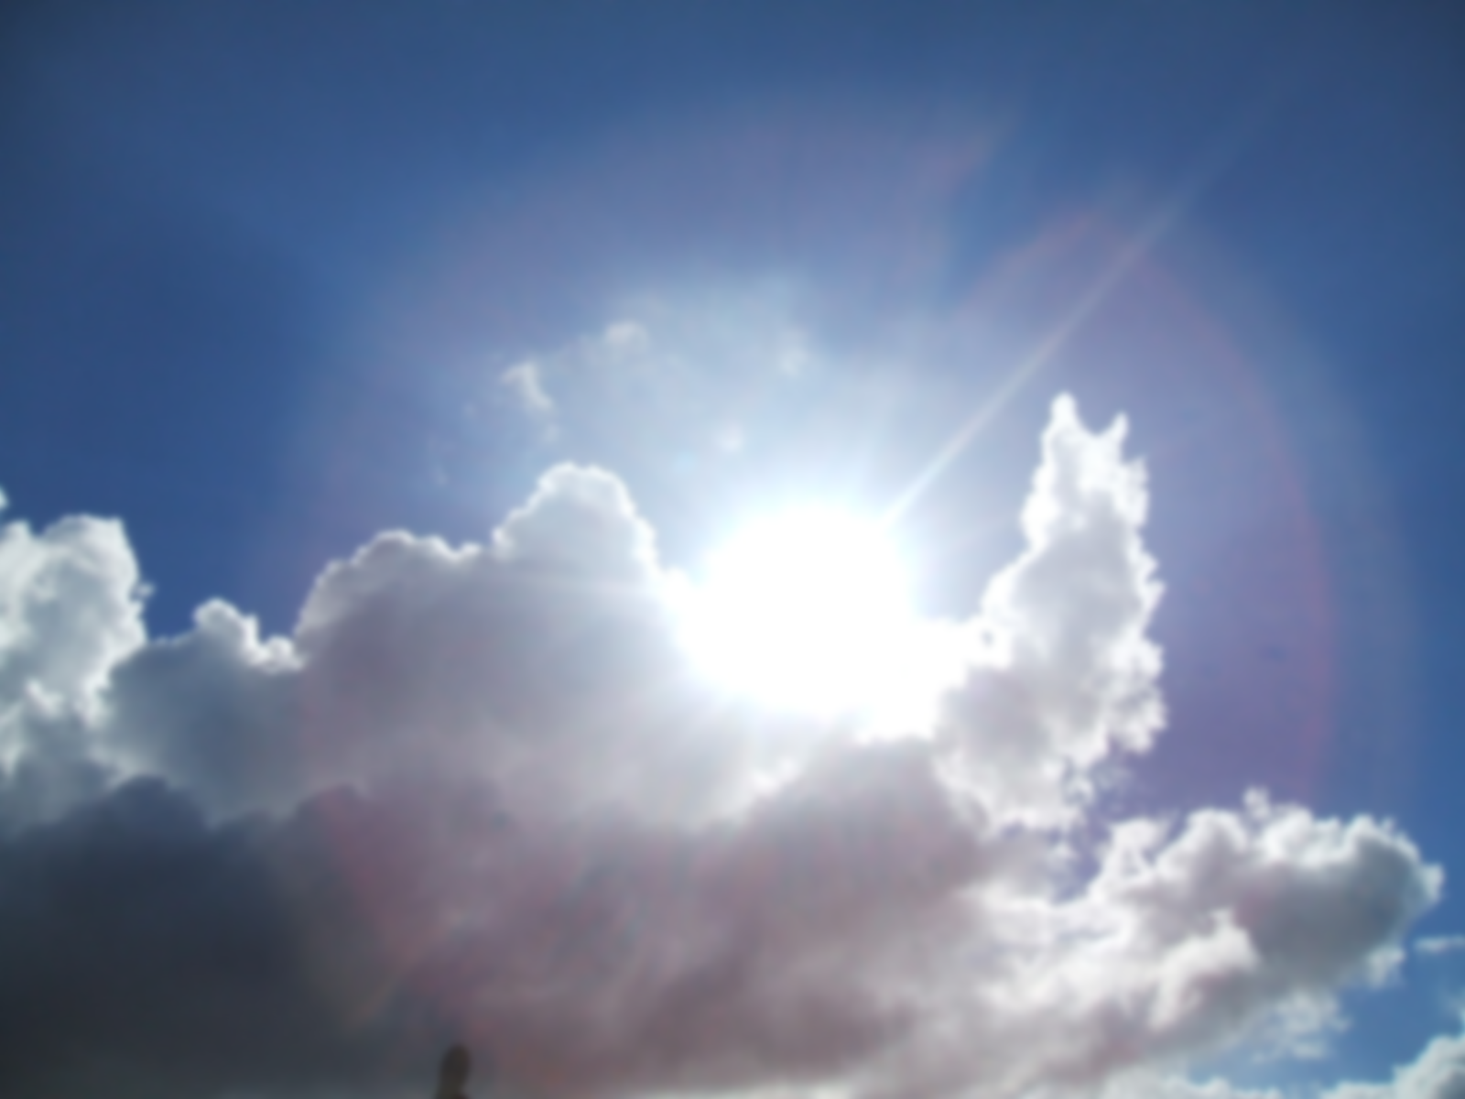
The spirit of God is upon us.
Jesus has brought us good news.
May God bless you, may God bless you.
We move on now to share the news.

