Slide 1
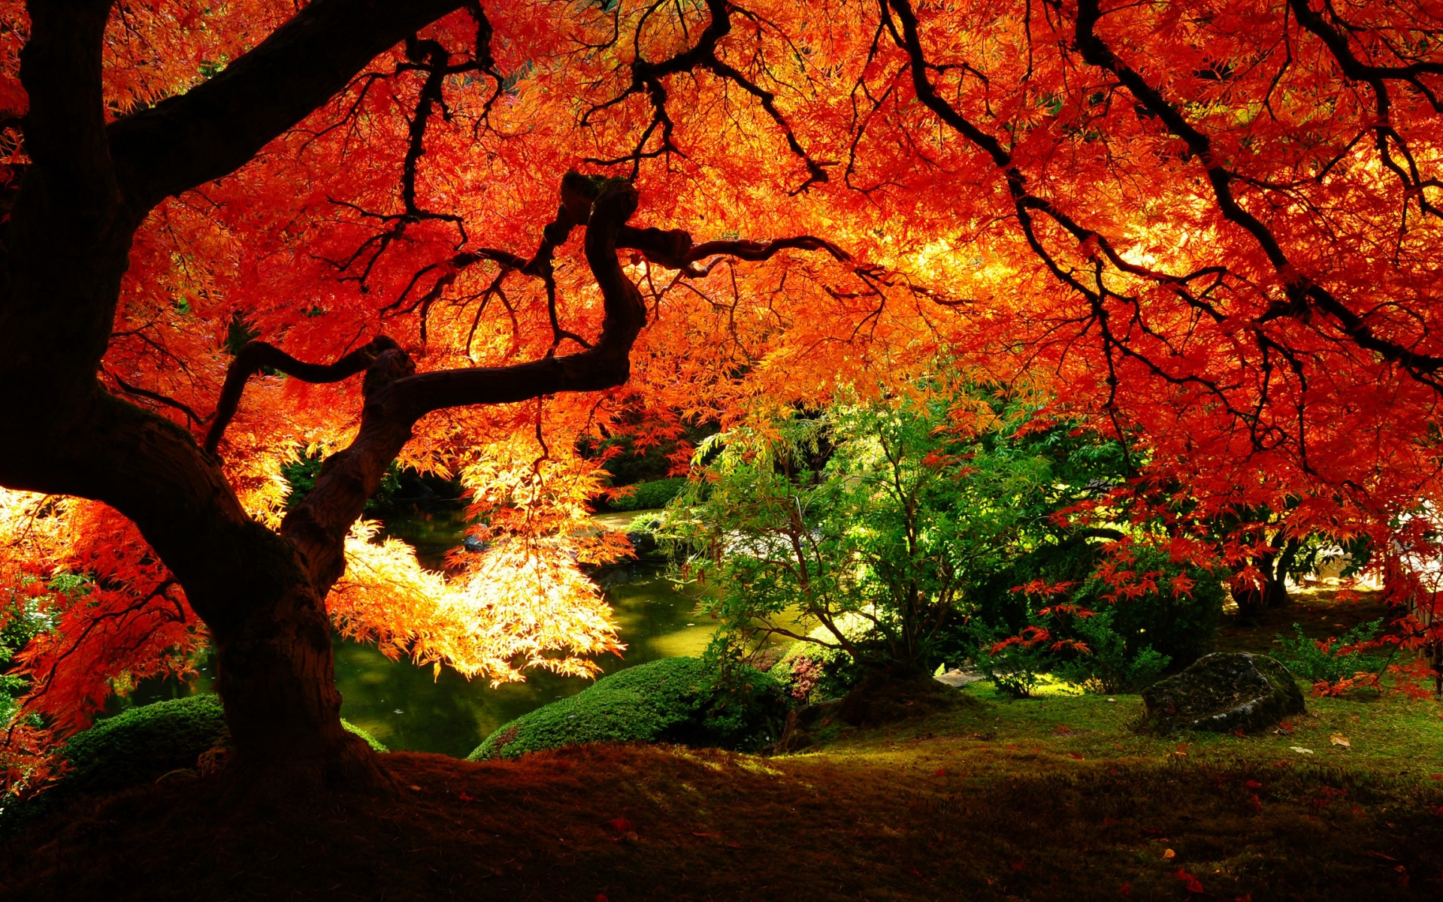
Gifts from God
Bernard Sexton

Slide 2
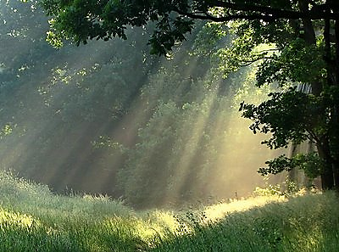
We have been called to love the Lord, our God.
We have been called to glorify his name.
We have been called to love the Lord, our God.
We have been called to glorify his name.

Slide 3

Use your skills,
use your talents,
use the gifts you have been given.
We’re all different,
we’re all special in this world.
Use your skills,
use your talents,
use the gifts you have been given.
Give God glory,
love all others, love our world.

Slide 4

We have been called to love the Lord, our God.
We have been called to glorify his name.
We have been called to love the Lord, our God.
We have been called to glorify his name.

Slide 5
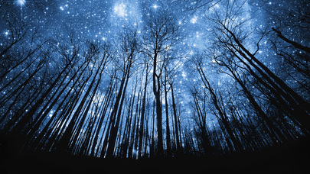
We have been called to care for all our friends
We have been called to watch for everyone
We have been called to care for all our friends
We have been called to watch for everyone

Slide 6

We have been called to love the Lord, our God.
We have been called to glorify his name.
We have been called to love the Lord, our God.
We have been called to glorify his name.

Slide 7
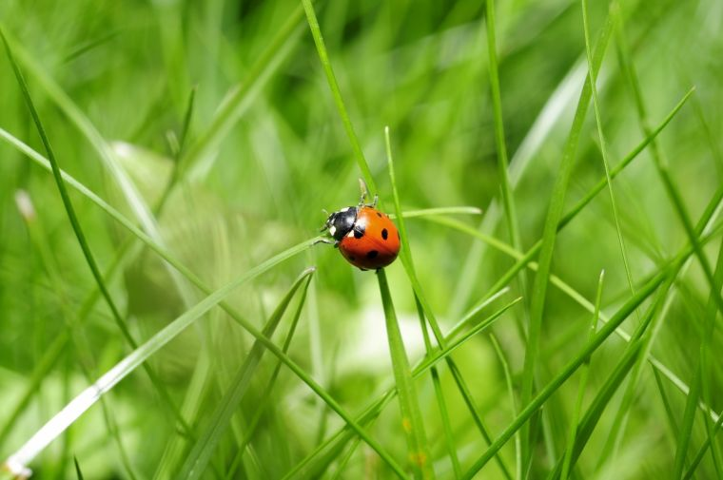
We have been called to care for this, our world
We have been called to marvel at God’s work
We have been called to care for this, our world
We have been called to marvel at God’s work

Slide 8
We have been called to love the Lord, our God.
We have been called to glorify his name.
We have been called to love the Lord, our God.
We have been called to glorify his name.

