Slide 1
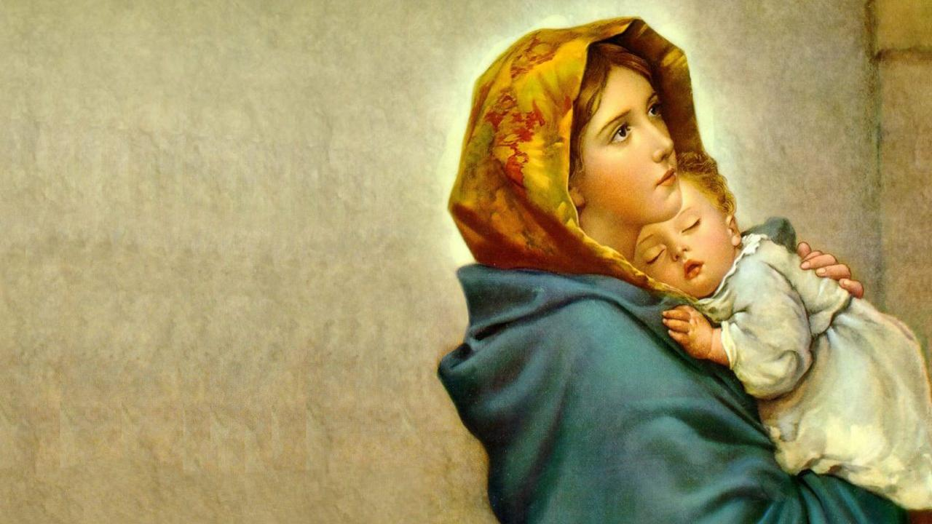
Mary, Our Mother
Patricia Hegarty

Slide 2
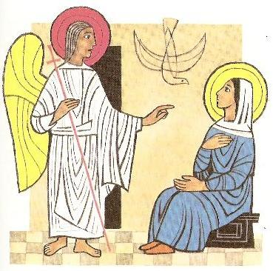
Mary, our mother, the Lord is with you.
Guide us, protect us in all that we do.

Slide 3
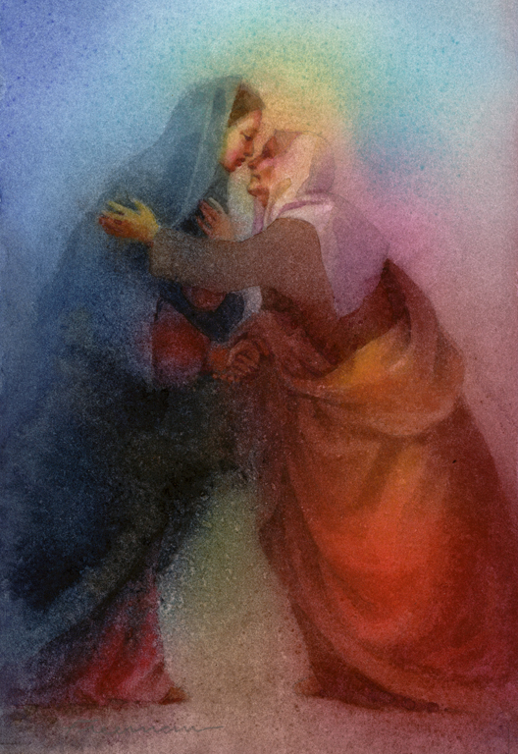
With Elizabeth you rejoiced,
‘I will be mother of Jesus’

Slide 4
Mary, our mother, the Lord is with you.
Guide us, protect us in all that we do.

Slide 5
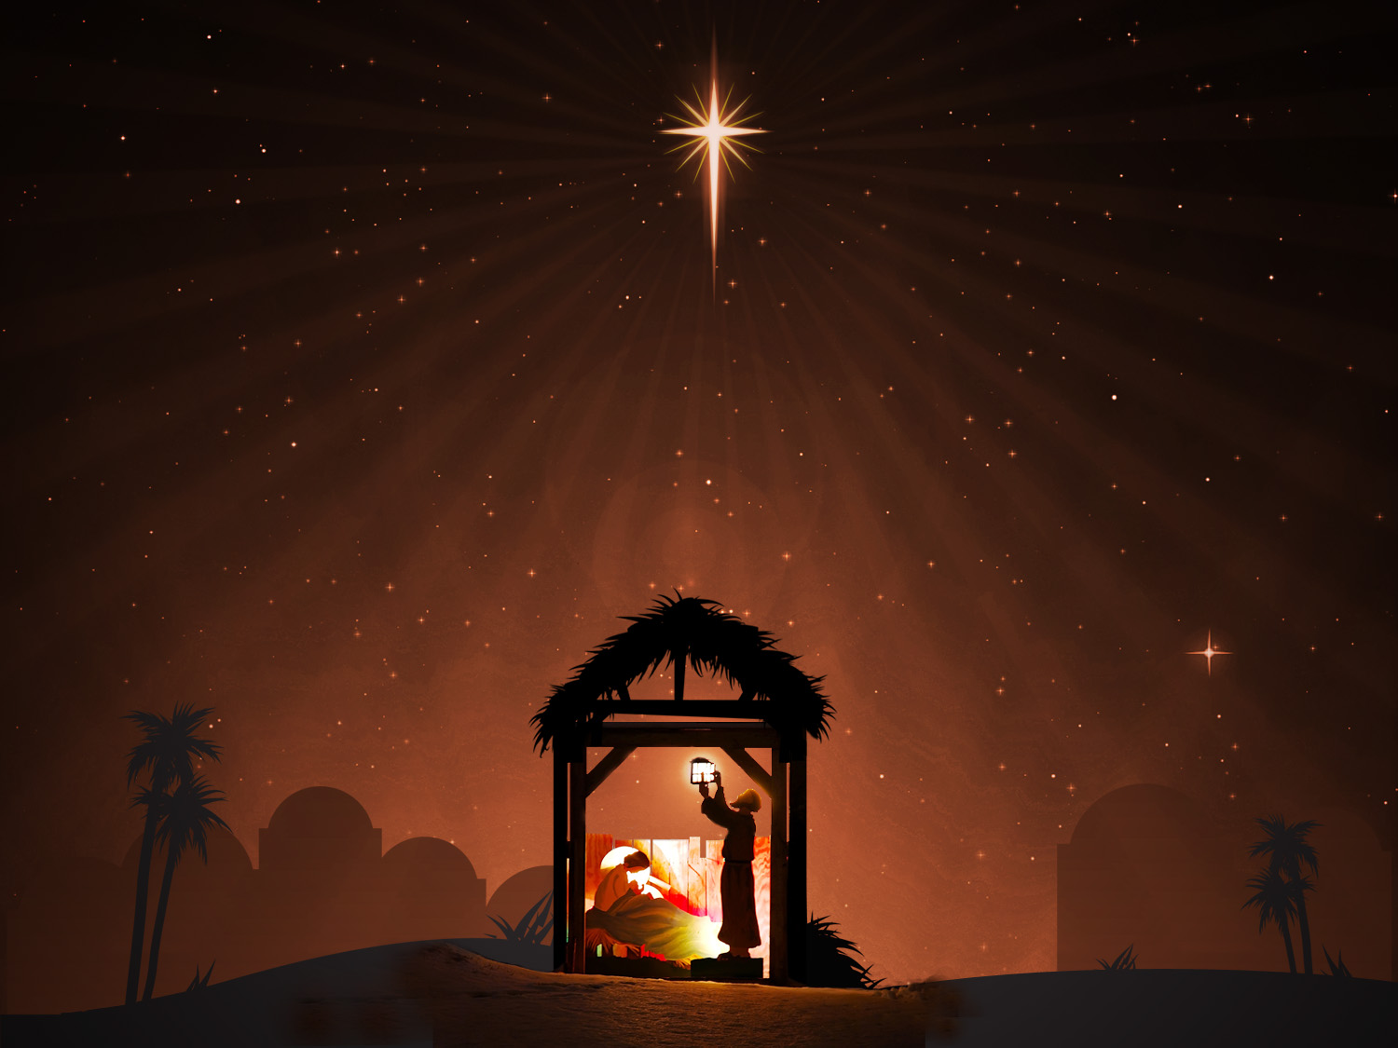
In a manger in Bethlehem
you became mother of Jesus

Slide 6
Mary, our mother, the Lord is with you.
Guide us, protect us in all that we do.

Slide 7
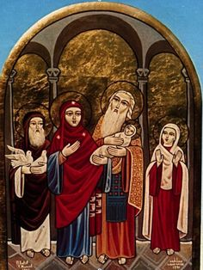
In the temple your baby was blessed,
glad to be mother of Jesus

