Slide 1
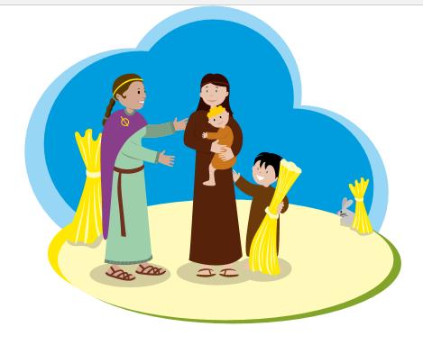
We Sing a Song to Brigid

Slide 2
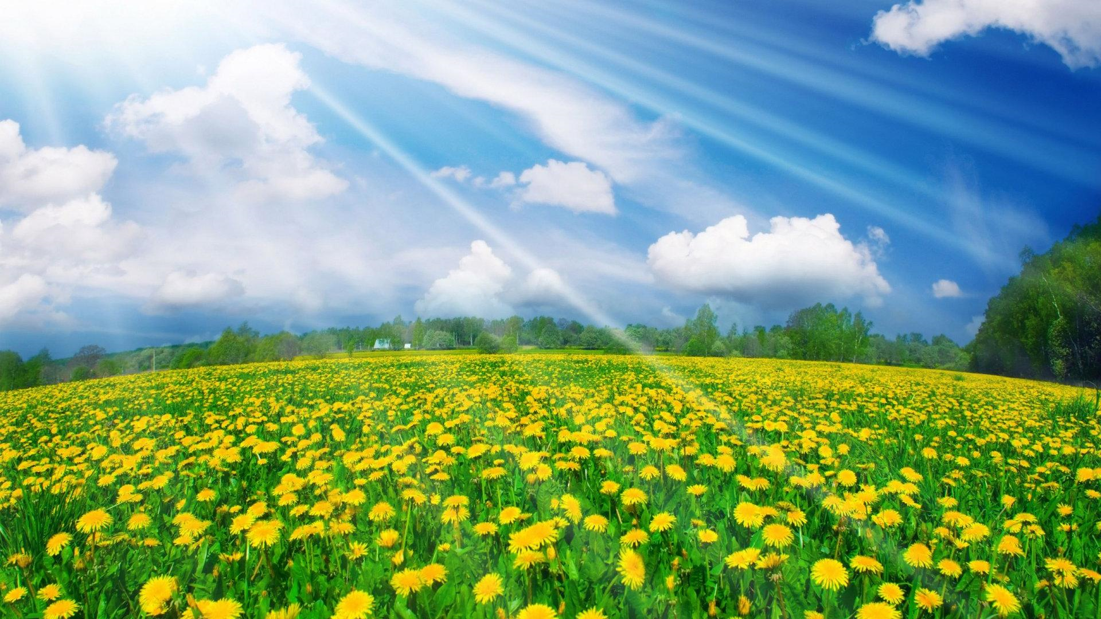
We sing a song to Brigid. Brigid brings the spring.

Slide 3
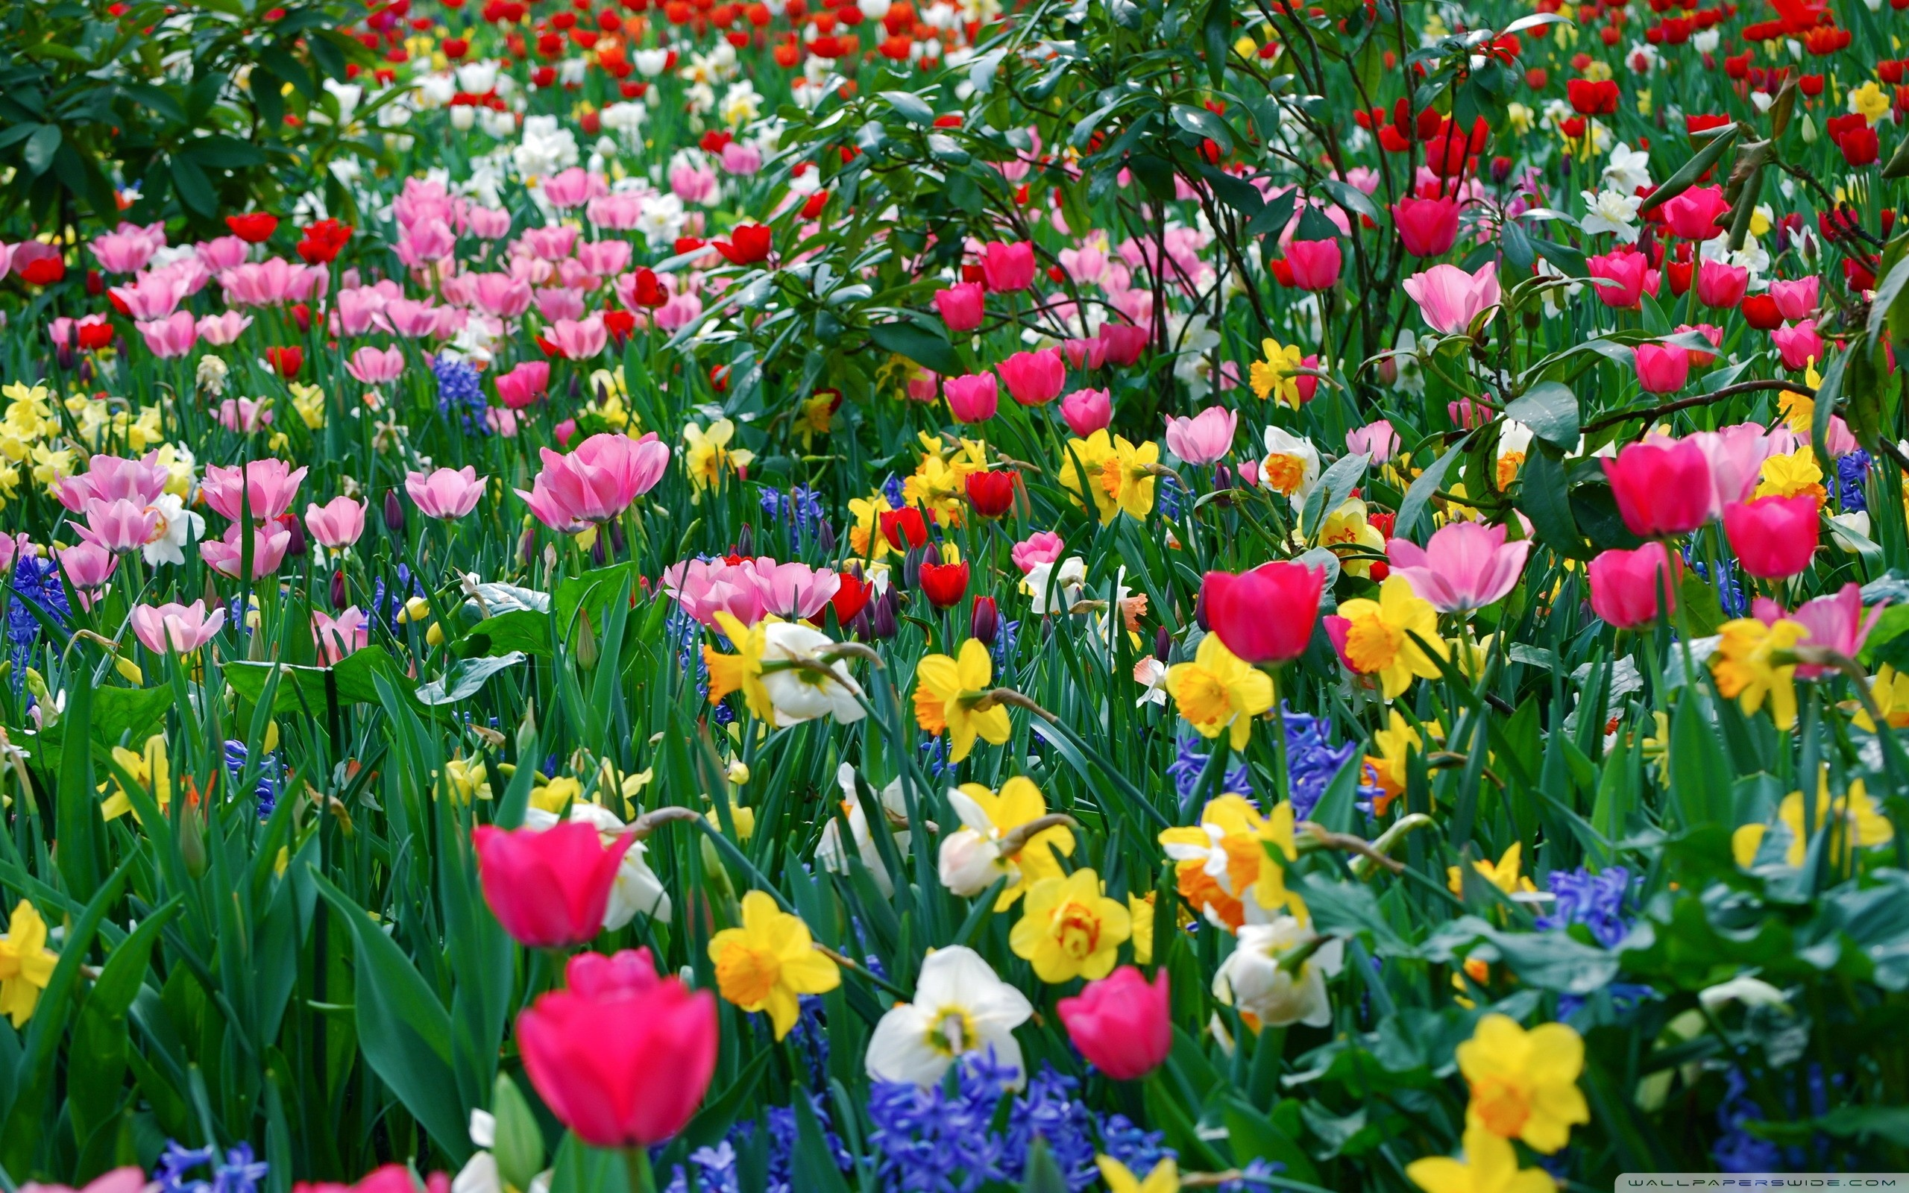
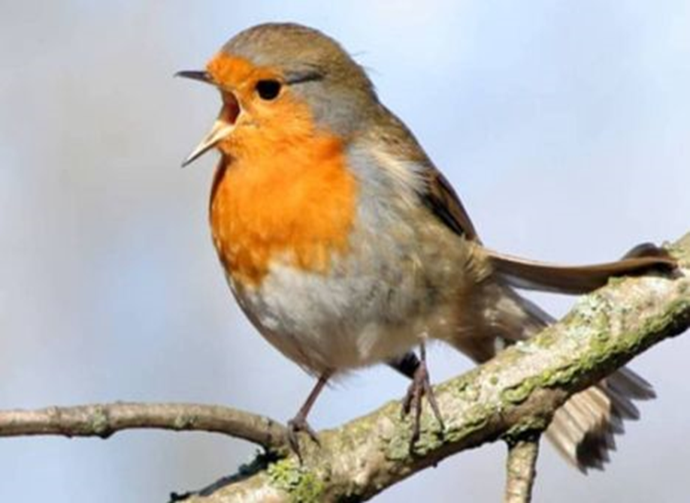
Awakens all the fields and the flowers
and calls the birds to sing.

Slide 4
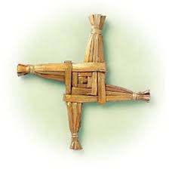
All were welcome at her door.
No-one was turned away.

Slide 5
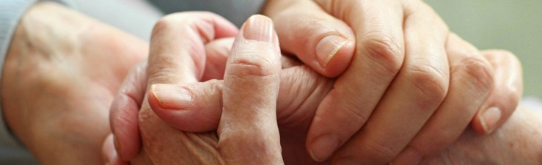
She loved the poor, the sick and the sore,
she helped them on their way

Slide 6
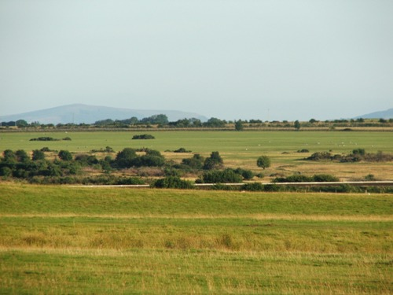
She laid her cloak upon the ground and
watched it grow and grow.

Slide 7
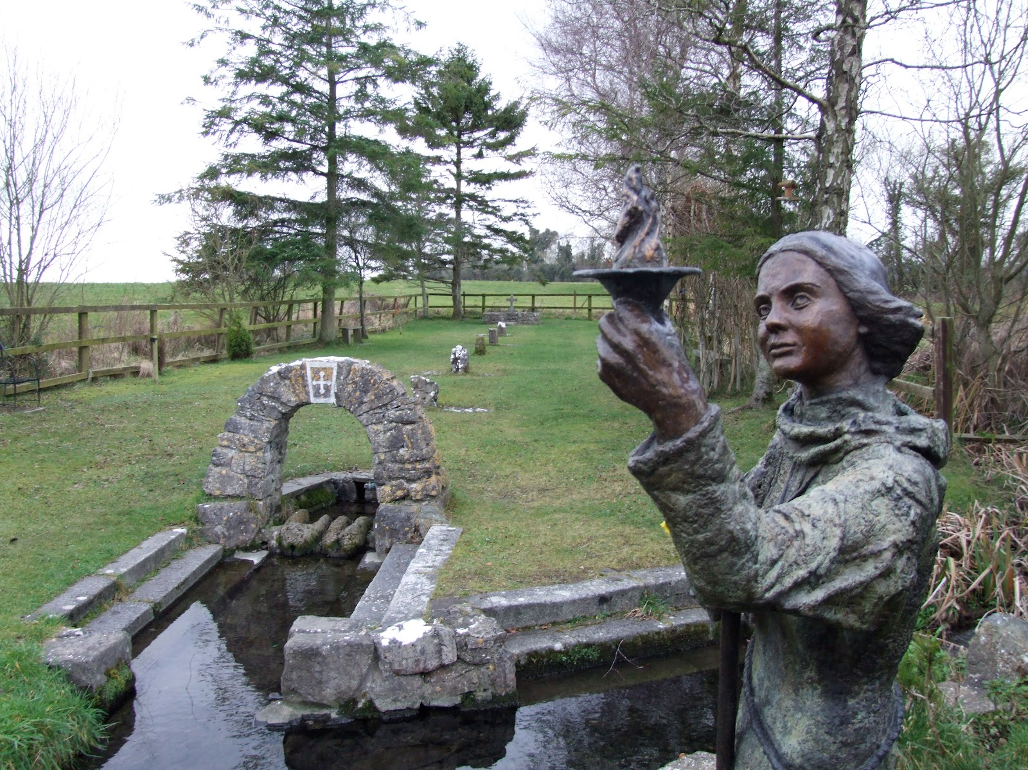
In wells and streams and fields of green
Saint Brigid's blessings flow.

