Slide 1

Baruch Atah
Clare Maloney

Slide 2
Baruk ata Adonai eloheinu,
eloheinu, Adonai.
Baruk ata Adonai eloheinu,
eloheinu, Adonai.

Slide 3
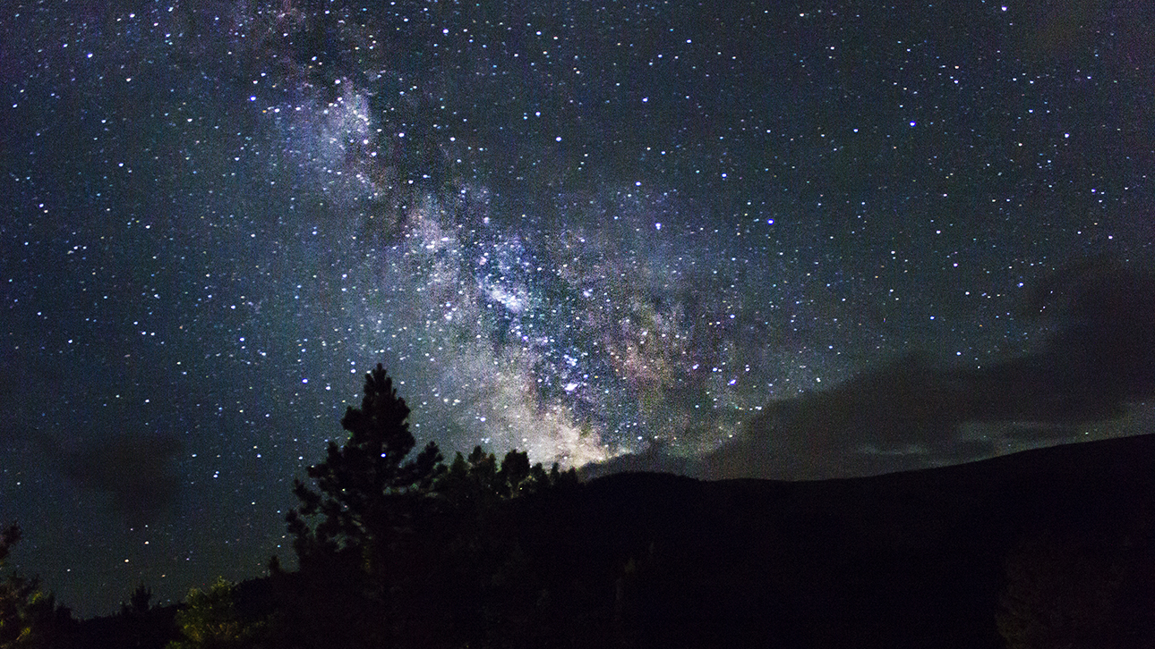
All praise to you our God,
The God who will last forever,
The God who rules over all the earth,
And all the planets high up in the sky.

Slide 4
Baruk ata Adonai eloheinu,
eloheinu, Adonai.
Baruk ata Adonai eloheinu,
eloheinu, Adonai.

Slide 5
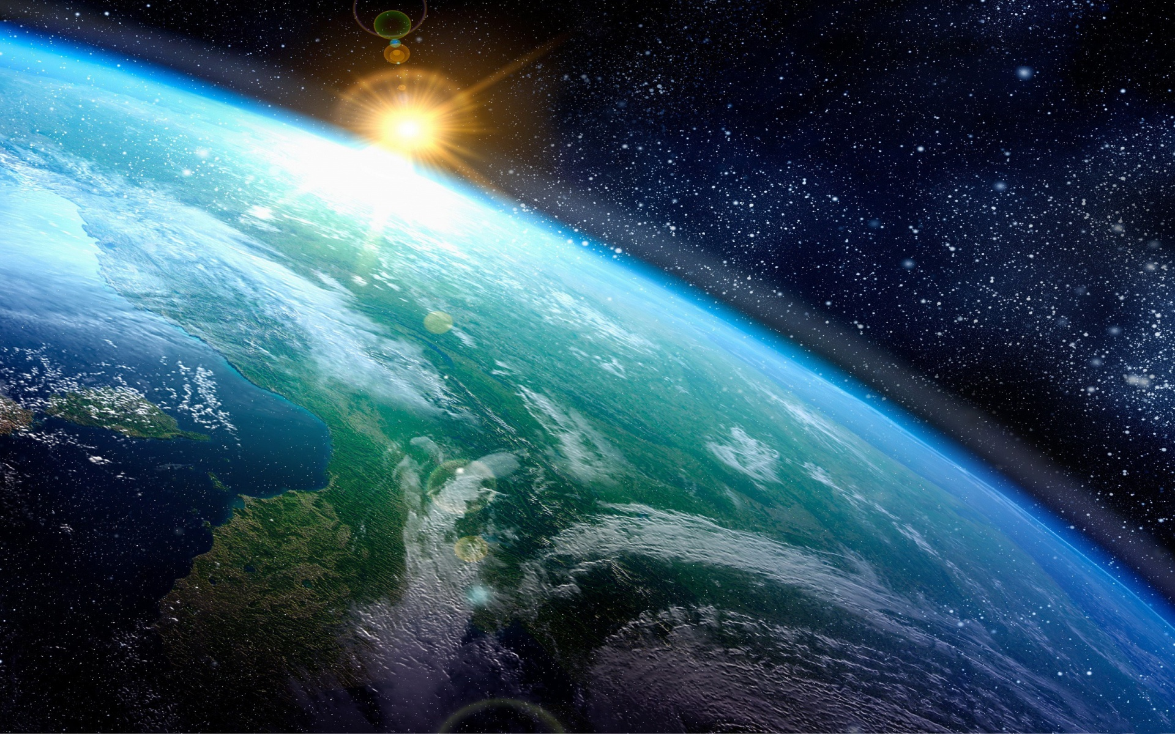
All praise to you our God,
The God who gave us our lives,
The God who protects us as we live
And helps us to be who we are today.

Slide 6
Baruk ata Adonai eloheinu,
eloheinu, Adonai.
Baruk ata Adonai eloheinu,
eloheinu, Adonai.

