Slide 1
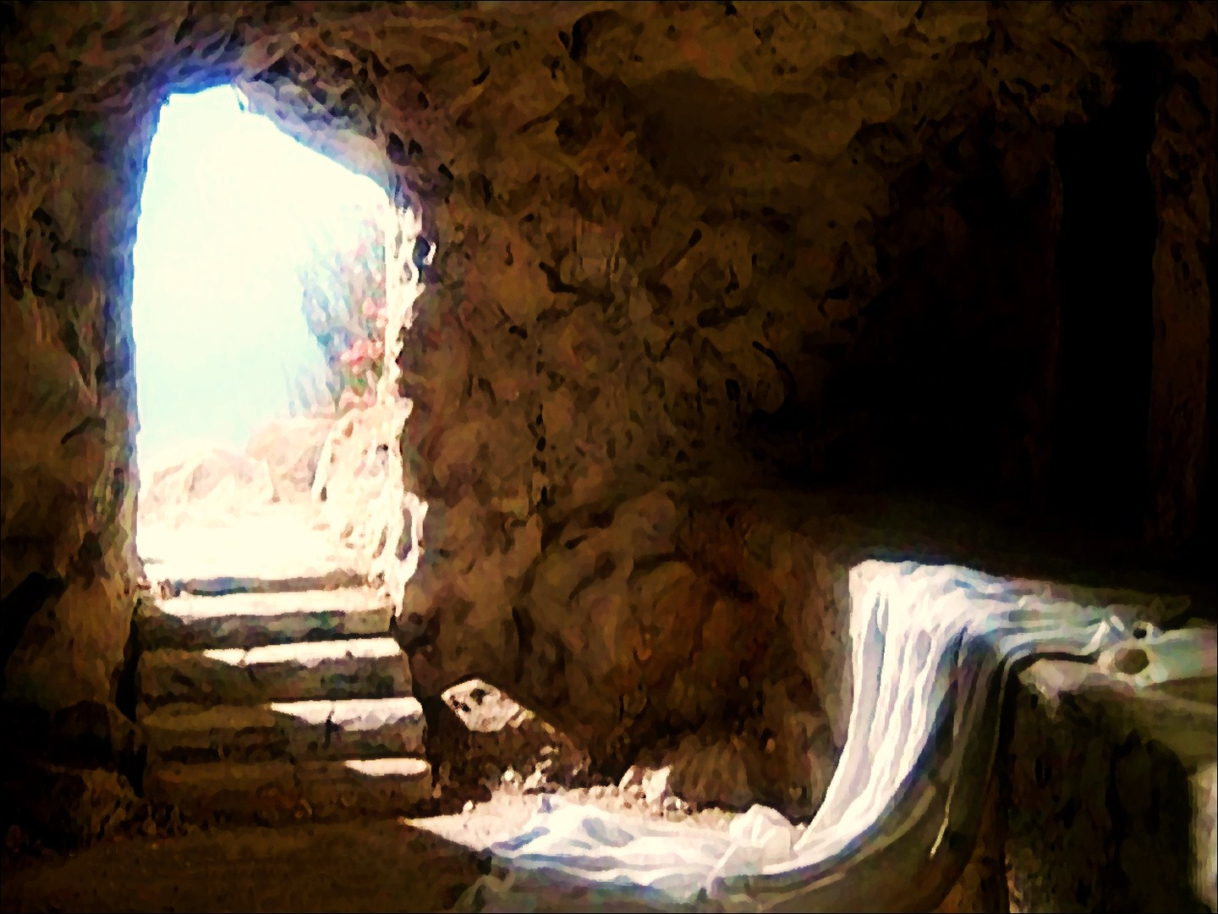
Mystery of Faith
Bernard Sexton

Slide 2
The mystery of faith.
We proclaim your Death,
O Lord,
and profess your Resurrection
until you come again.

