Slide 1
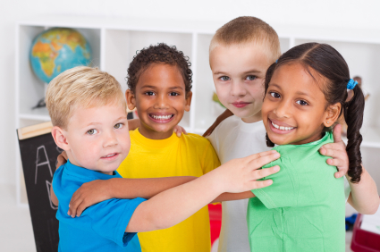
Together Again

Slide 2
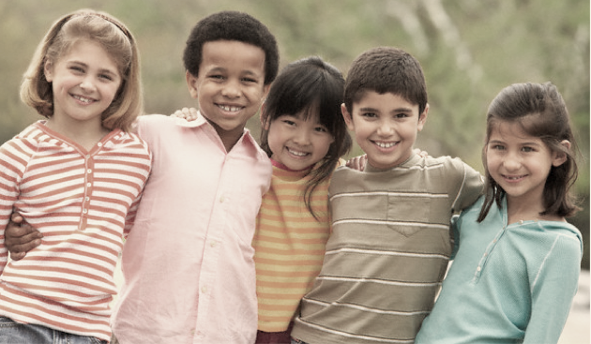
Together again, together again. We’re back! Together again. With each new day we shout, ‘Hurray!’
It’s good to be together again.

Slide 3
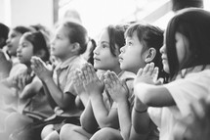
We’re starting on a new adventure together every step of the way.
So much to learn, so much to say,
and God is with us we pray.

Slide 4
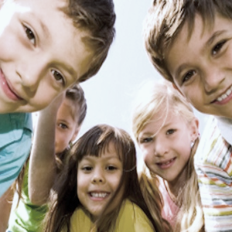
Together again, together again. We’re back! Together again. With each new day we shout, ‘Hurray!’
It’s good to be together again.

Slide 5
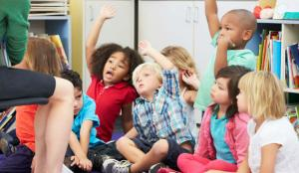
There’s me and you, there’s teacher too, We work together all the day through,
With songs to sing and games to play, and God is with us as we pray.

Slide 6
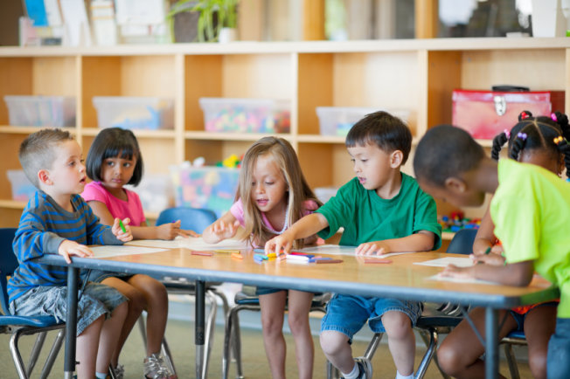
Together again, together again. We’re back! Together again. With each new day we shout, ‘Hurray!’
It’s good to be together again.

