Slide 1
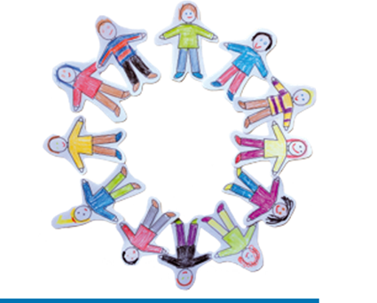
Circle of Friends
Finbar O’Connor

Slide 2
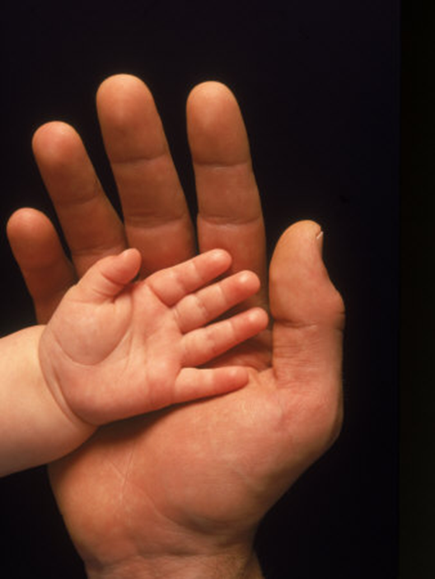
You have friends, you are not alone.
Thanks to them, you’re not on your own.
You are strong even when you feel small.

Slide 3

From the rain, they will shelter you.
In your pain, they will comfort you.
They will always pick you up when you fall.

Slide 4

Circle of friends all around you.
Circle of friends, strong and true.
Circle of friends, always there for you.

Slide 5

Even when you are far apart
To your friends you’re joined heart to heart
Far away you are not on your own..

Slide 6
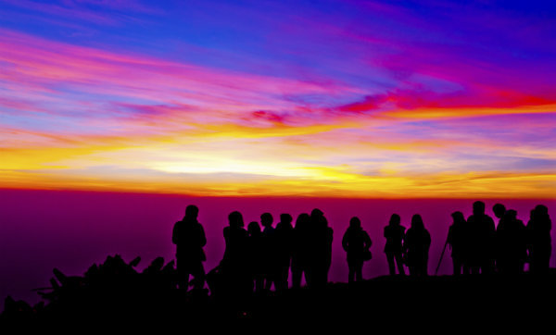
You’re not there, but they think of you
In their prayers they remember you
You are never ever truly alone.

Slide 7
Circle of friends all around you.
Circle of friends, strong and true.
Circle of friends, always there for you.

