Slide 1
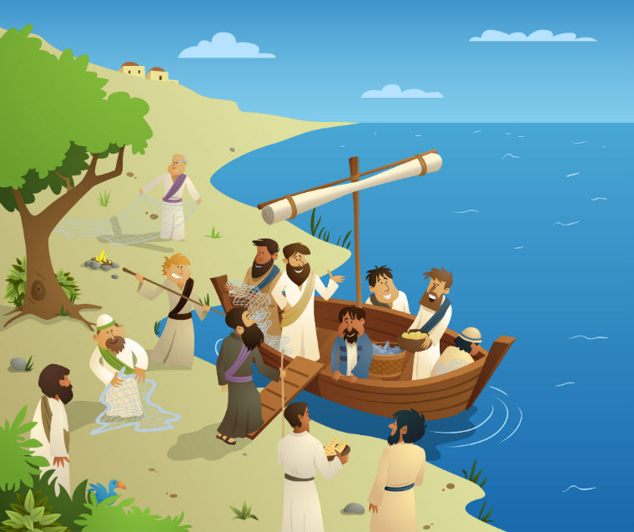
The Apostles
Ivor Redmond

Slide 2
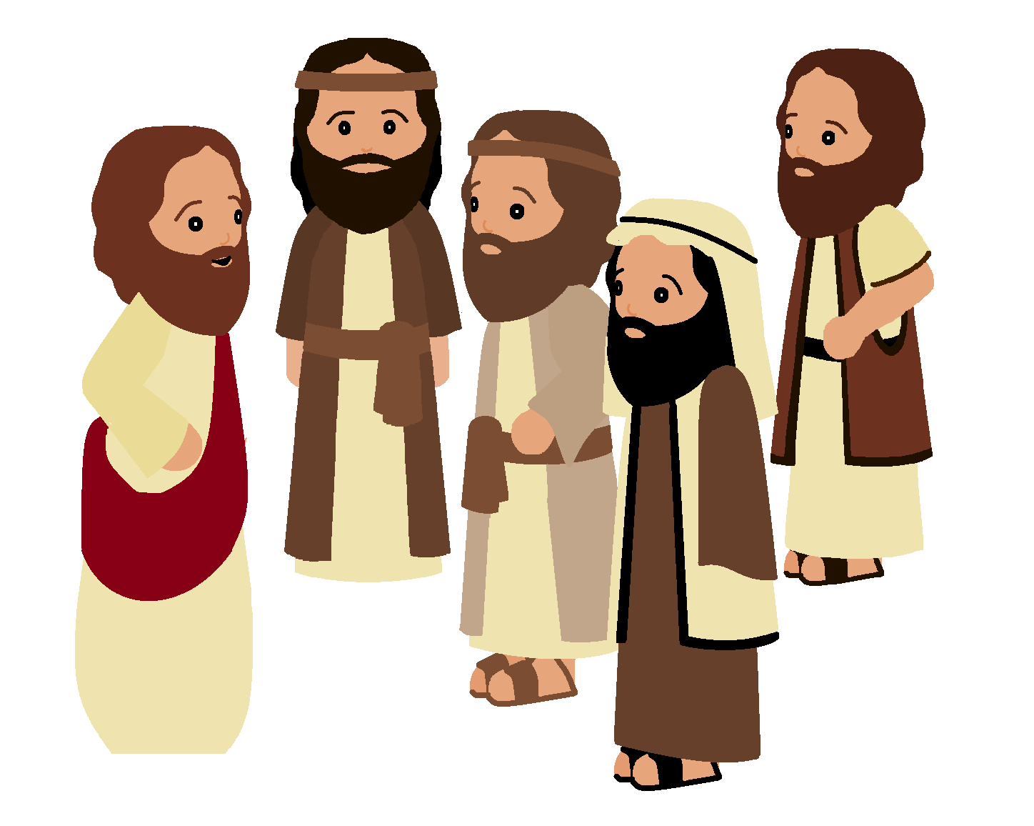
Jesus had a special
job,
to show the
world the love
of God,
But wondered if
when he
was gone someone
would carry on.

Slide 3
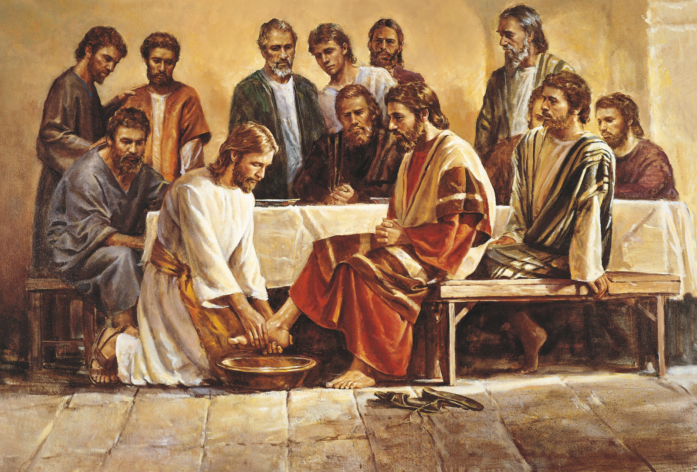
So Jesus chose
some of his friends,
and all on whom
he could depend.
He chose them
from his followers
and there were
twelve of them.

Slide 4
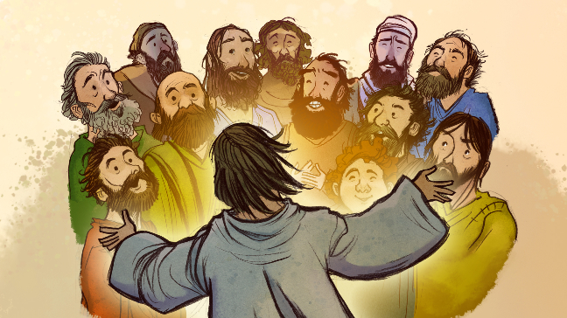
There was Peter
and Andrew,
James and John,
James the less
and his brother Jude.
There was Philip
and Bartholomew,
there was Simon
and Matthew too.
There was Judas Iscariot,
there was Thomas
and that’s the lot!

Slide 5
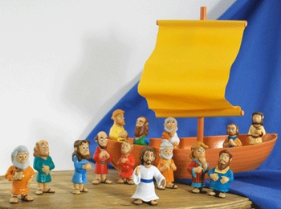
Once while out upon
the sea
a storm blew up
so suddenly.
The apostles thought
that they might drown
But Jesus calmed
them down.

Slide 6
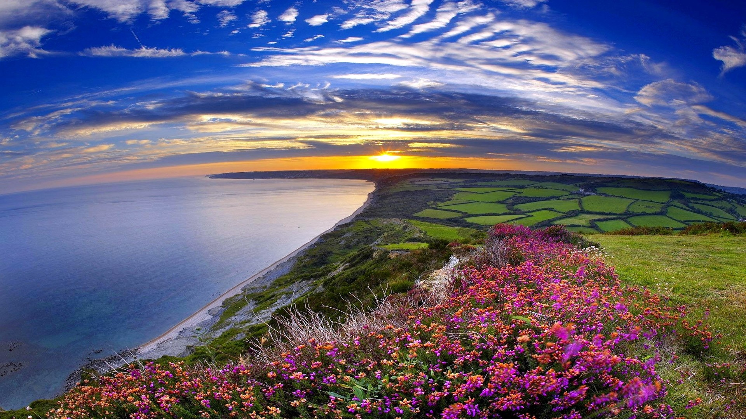
He showed them what the flowers were worth
And all the beauty of the earth
And how he cared for it with love
With nothing else but love

Slide 7
There was Peter
and Andrew,
James and John,
James the less
and his brother Jude.
There was Philip
and Bartholomew,
there was Simon
and Matthew too.
There was Judas Iscariot,
there was Thomas
and that’s the lot!

