Slide 1
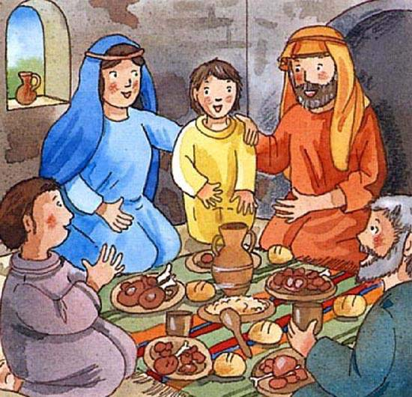
When Jesus Was a Boy

Slide 2

When Jesus was a boy,
A child like you and me,
He loved his Mum and Dad.
He was as happy as can be

Slide 3
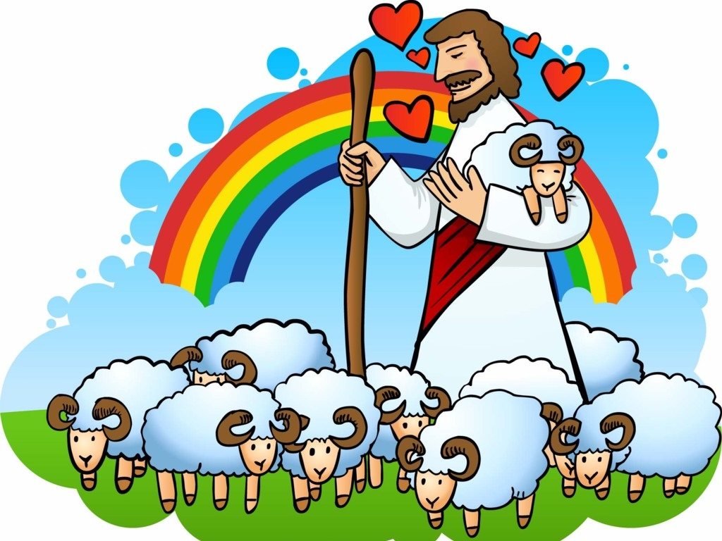
I’ll try then ev’ry day
In all I have to do,
To be like Jesus Christ.
To be kind and loving
too.

Slide 4
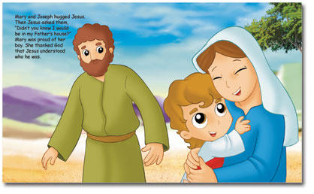
When Jesus was a boy,
A child like you and me,
He was good and kind to all
As a little child should be

Slide 5
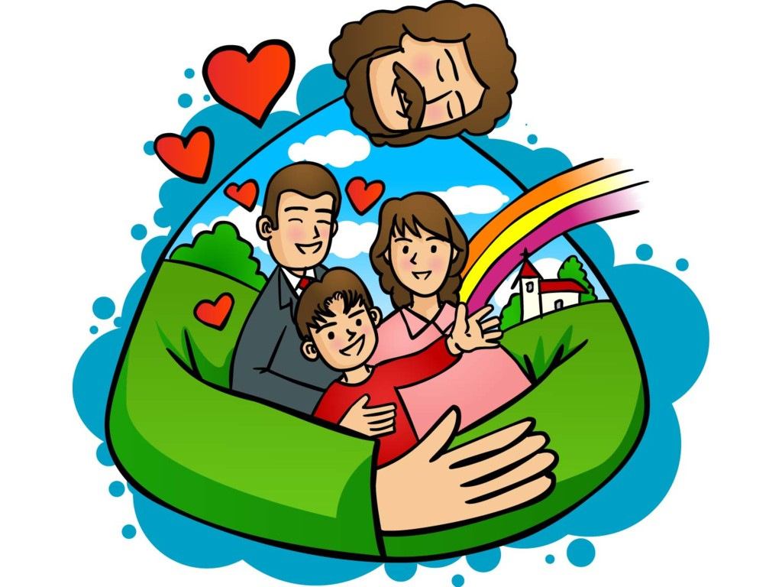
I’ll try then ev’ry day
In all I have to do,
To be like Jesus Christ.
To be kind and loving
too.

