Slide 1
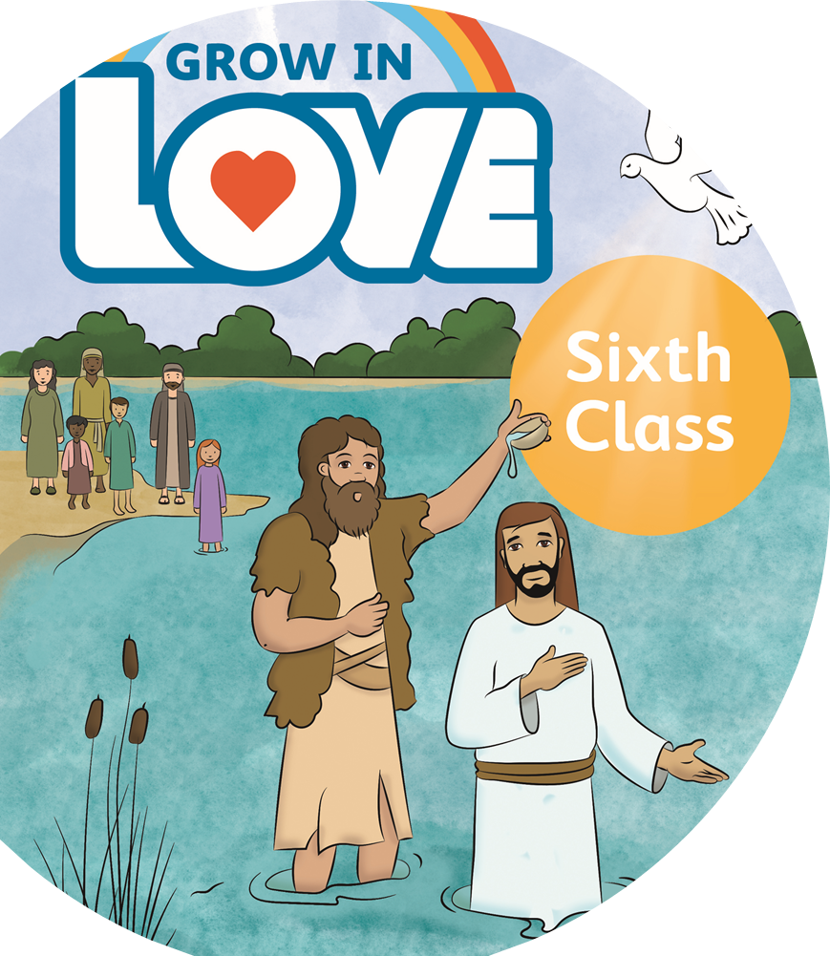


The Sacrament of Confirmation in 6th Class

Slide 2
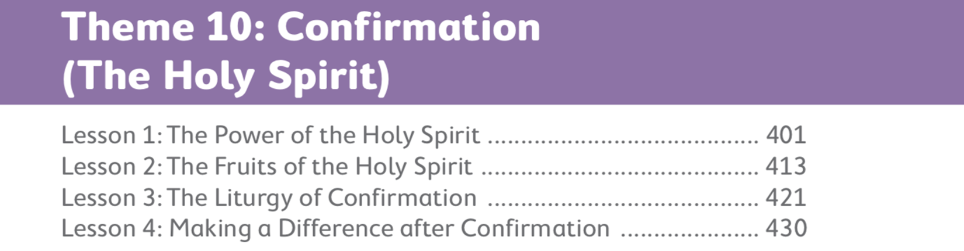

Slide 3

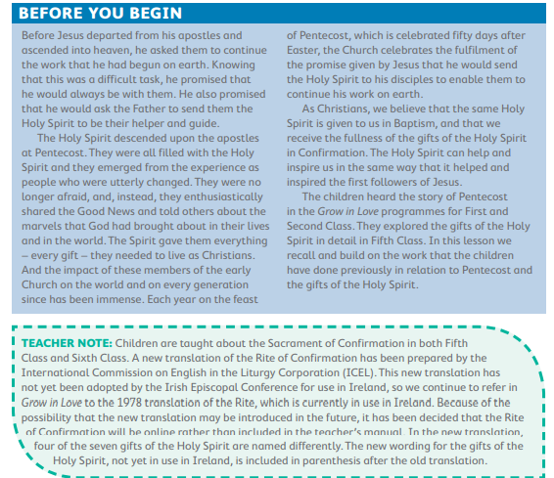
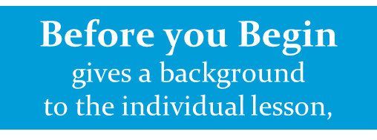

Slide 4
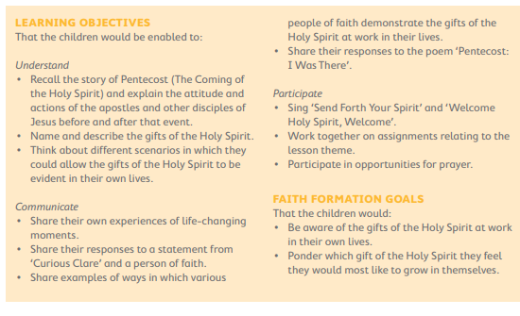

Slide 5

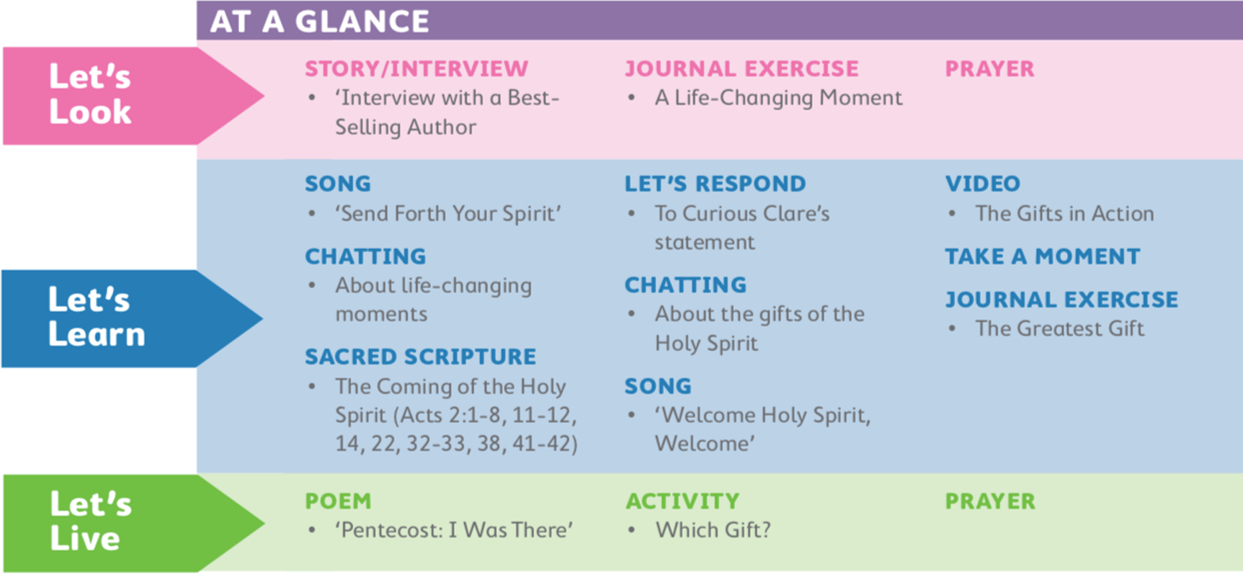

Slide 6
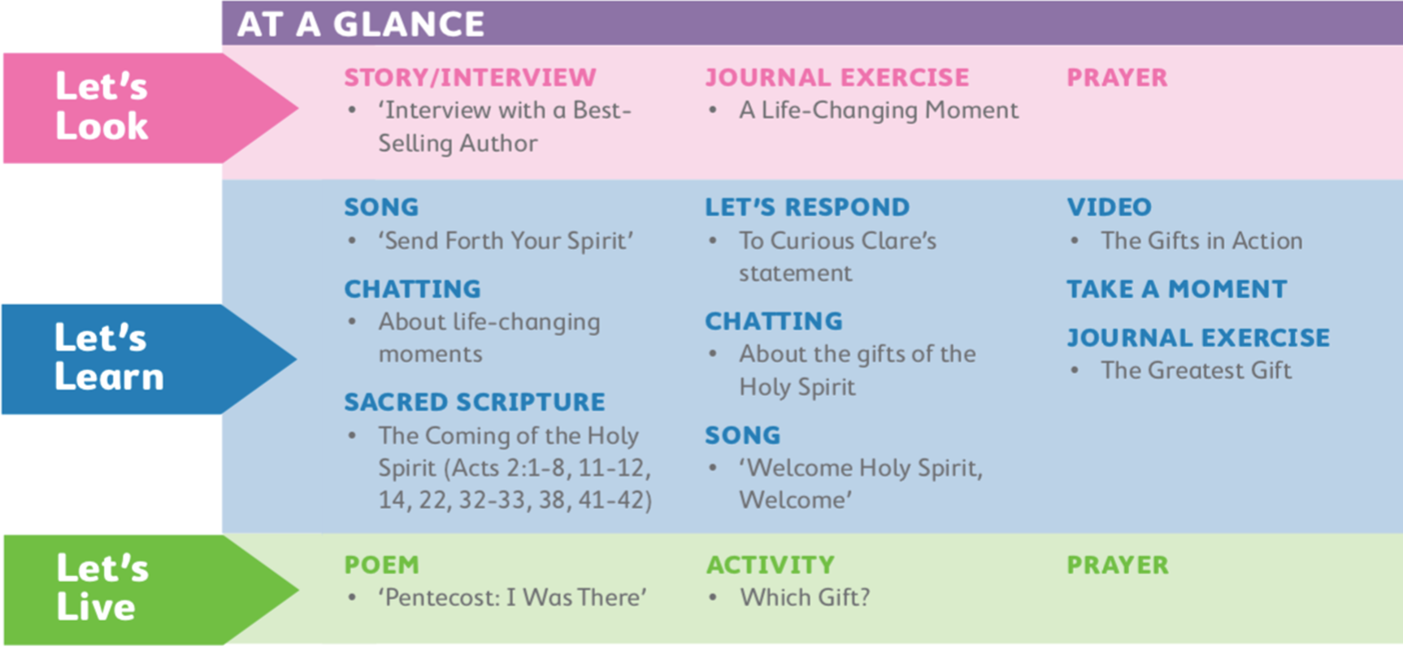
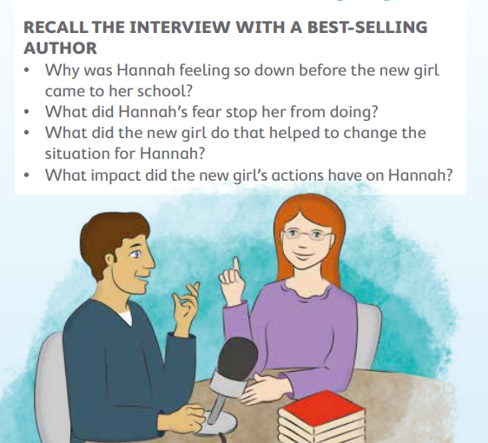
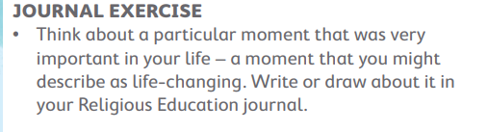
Prayer
Loving God, we thank you for being with us always. May we never forget that, during our best days and our worst, our happiest and our most difficult times, you are there. We ask this through Christ our Lord. All: Amen.

Slide 7
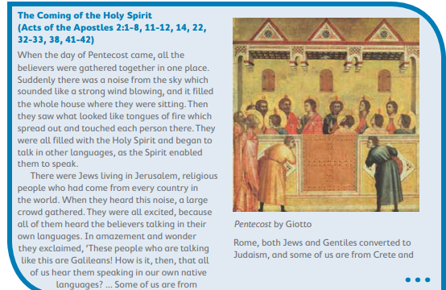



Curious Clare statement
‘I’m not sure anything extraordinary happened in that room on the first Pentecost. Perhaps it was all just a hoax!’
Gifts of the Holy Spirit

Slide 8
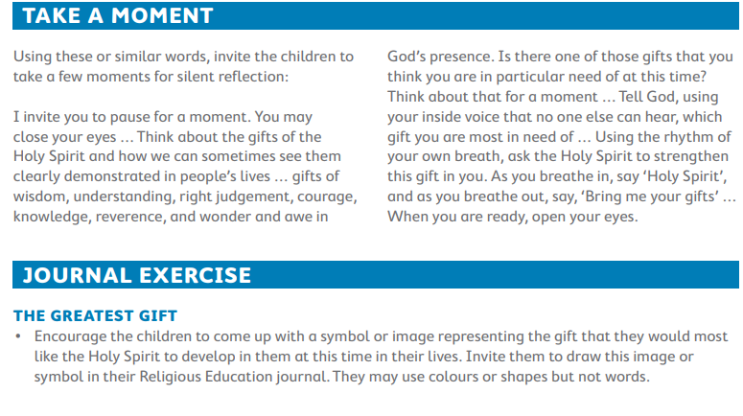

Slide 9
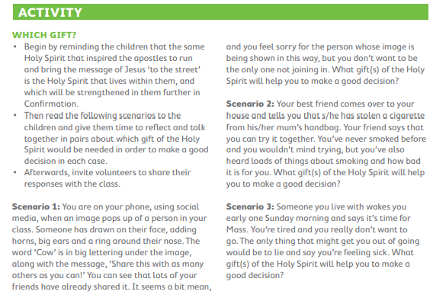
Poem- Pentecost:
I Was There I was there when Peter barred the door. I watched the others silent in the gloom, Each pair of eyes so sad and far away, Each saddened heart remembering the tomb. Then Andrew said, ‘Remember on the lake, Remember how he called my brother out’; And Peter said, ‘My heart was light and free, And half way there it sank with fear and doubt’; And now the voices rang around the room As others told a tale from days gone by Of lepers healed, the mad man soothed and stilled, A new day dawning in a blind man’s eye, Of children loved, a Roman soldier’s hope, A lame man filled with joy at new-found feet. And with their hearts brim full of joy and peace They ran and brought that message to the street. I was there when hearts were closed and sad, When hearts were opened, gladdened and set free. I sat in silence in the upper room. Yes I was there that day, and so was he.
Christy Kenneally

Slide 10
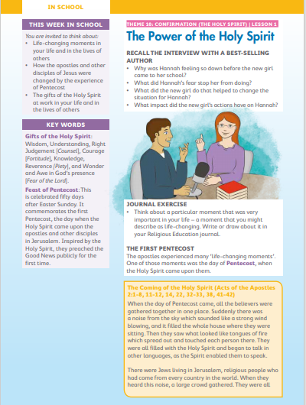
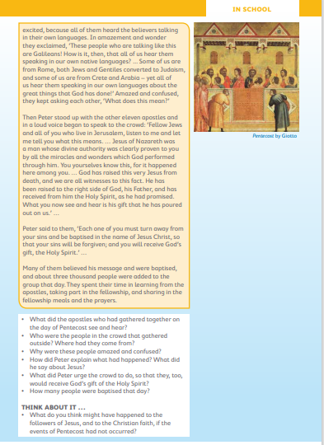
Pupil Book

Slide 11
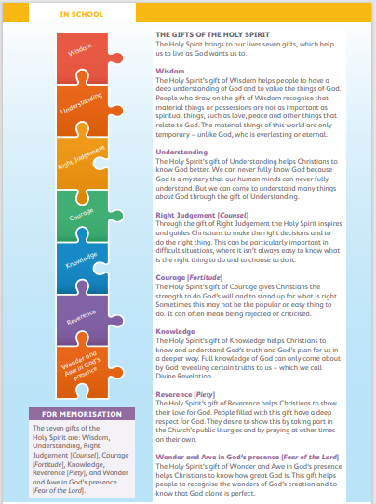
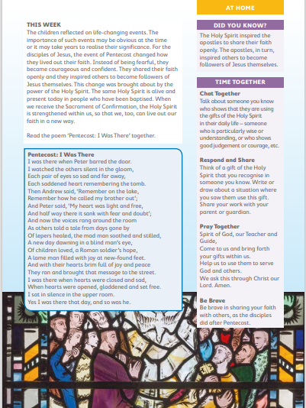
Pupil Book

Slide 12

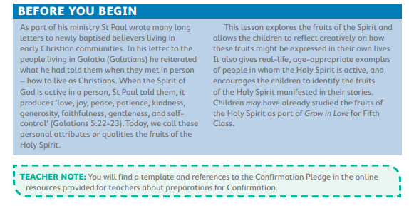

Slide 13
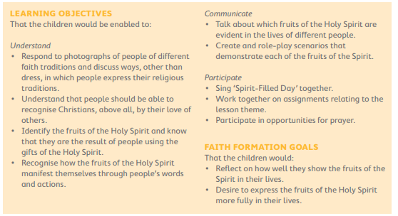

Slide 14

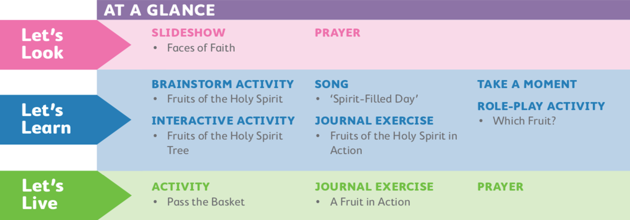

Slide 15


Prayer
Spirit of God, come to us. Help us to show by our words and our actions that you are alive in our hearts. May our lives be an example to others, and may we be inspired by the lives of other Christians. We make this prayer through Christ, our Lord. Amen.

Slide 16


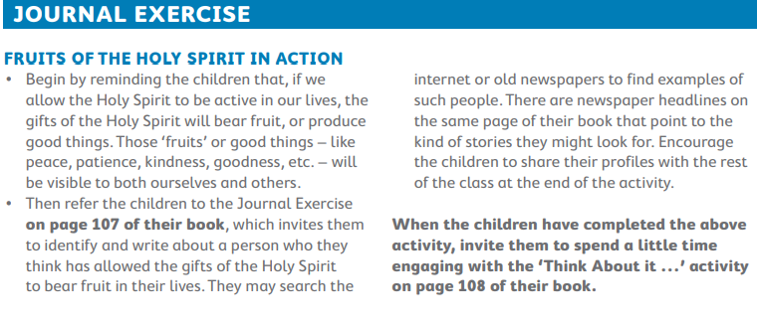
Interactive activity

Slide 17
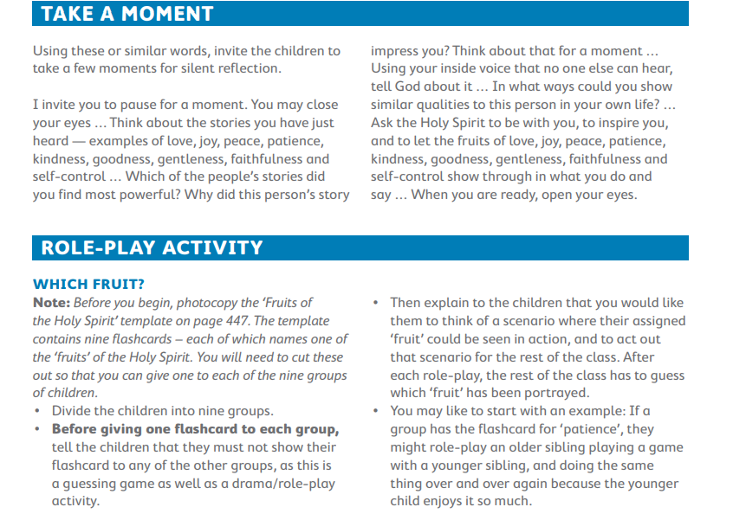

Slide 18
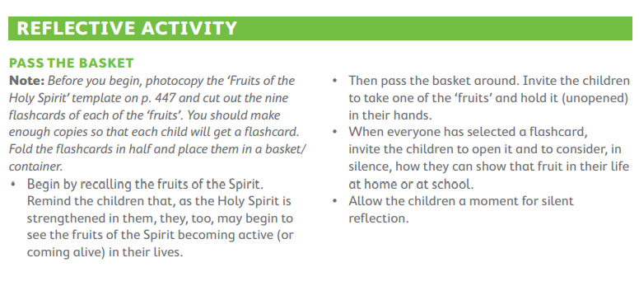

Slide 19

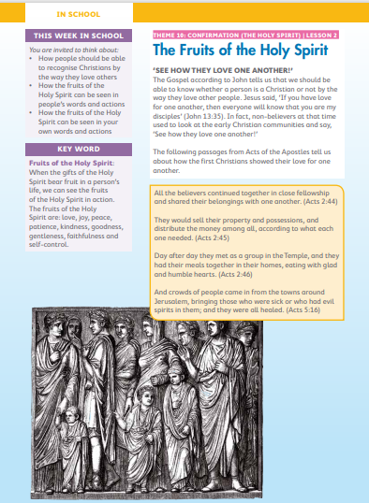
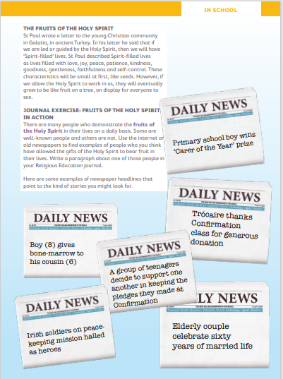

Slide 20
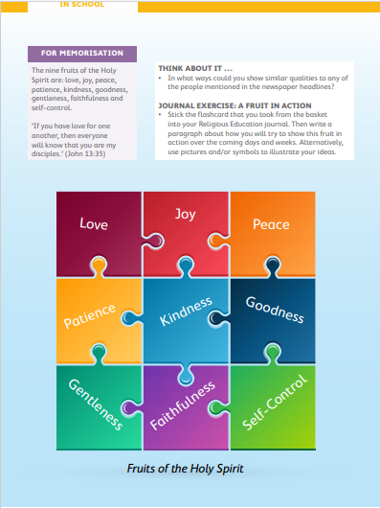
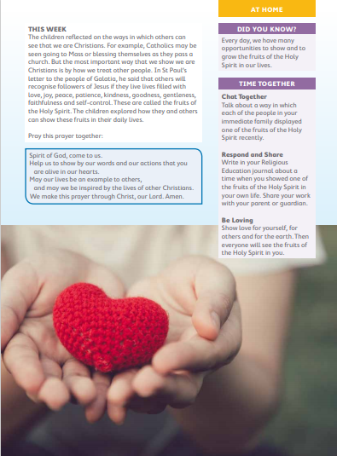

Slide 21

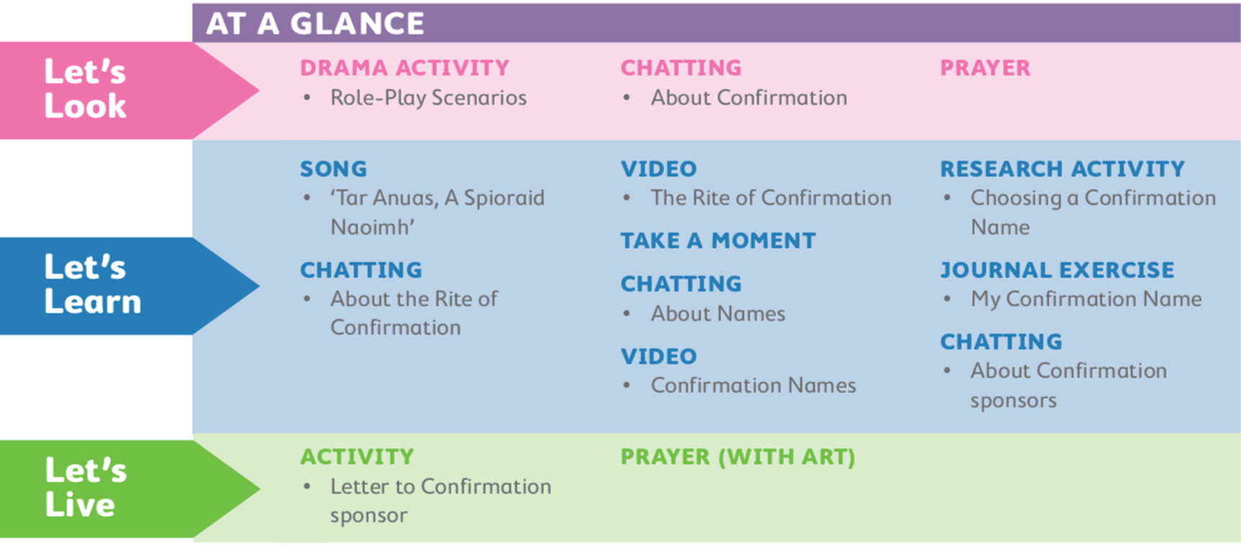

Slide 22

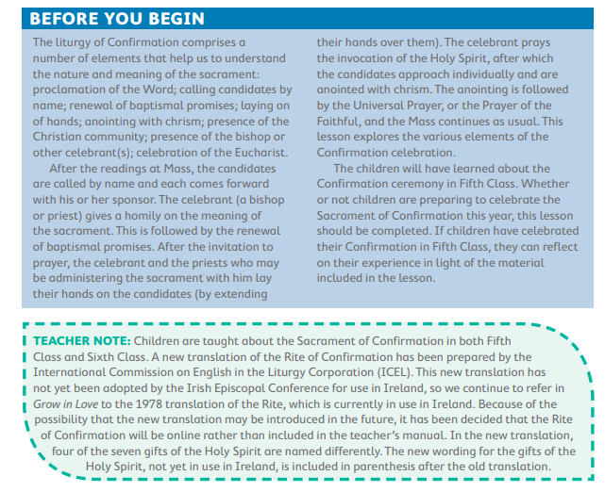


Slide 23
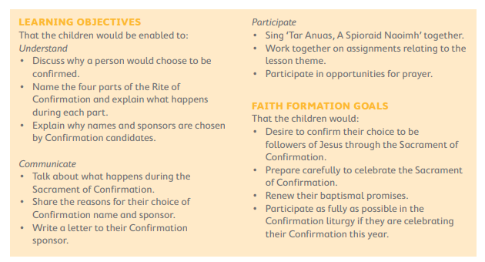

Slide 24

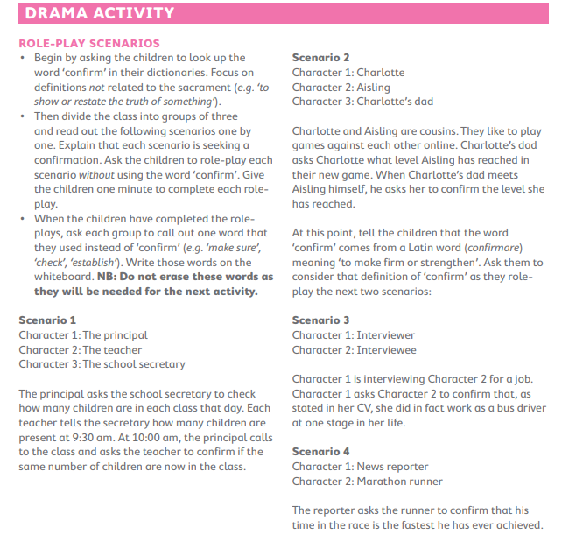
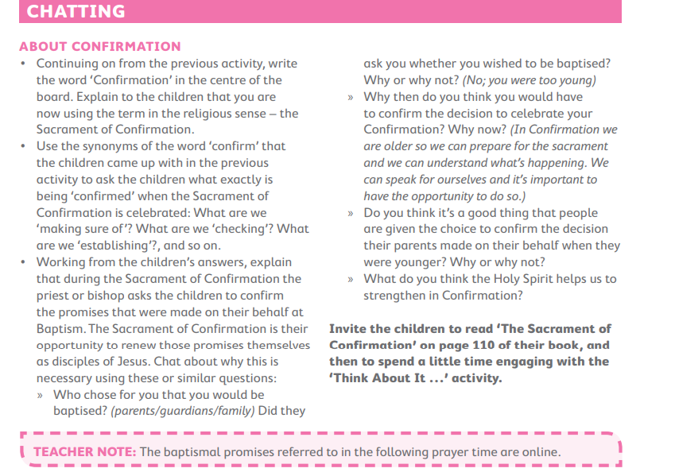

Slide 25
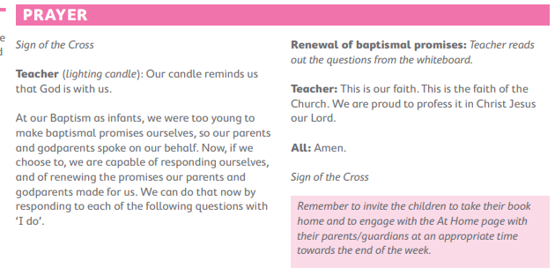

Slide 26
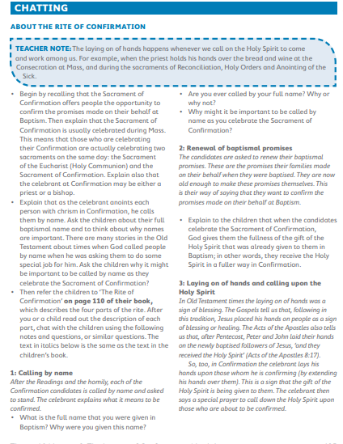

Slide 27
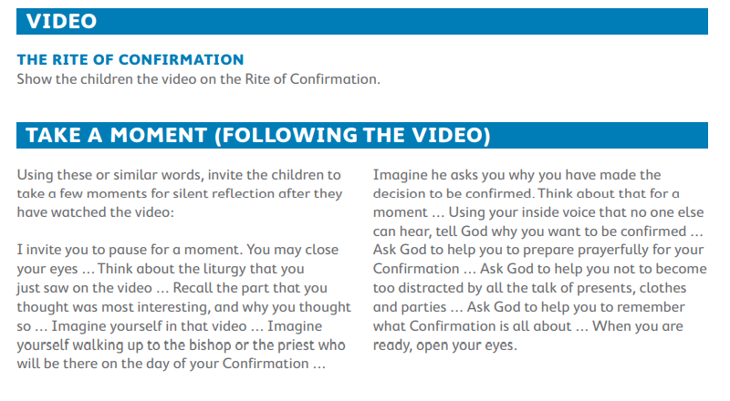
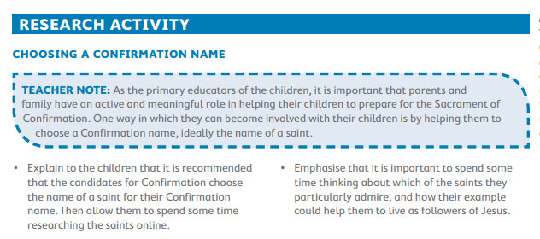

Slide 28
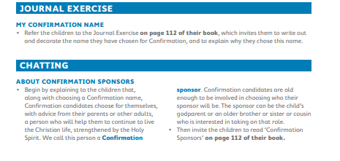

Slide 29
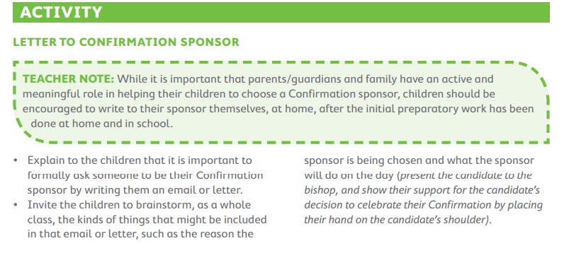
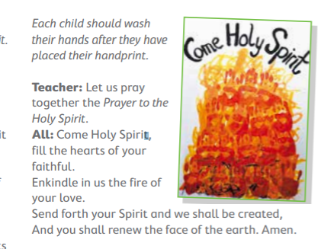

Slide 30

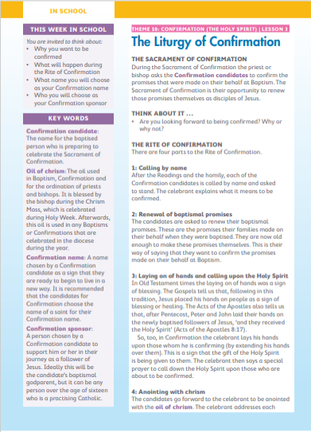
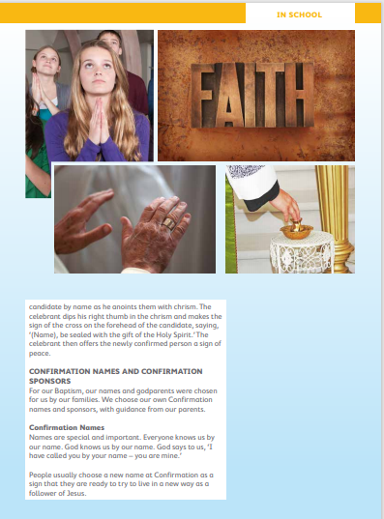

Slide 31
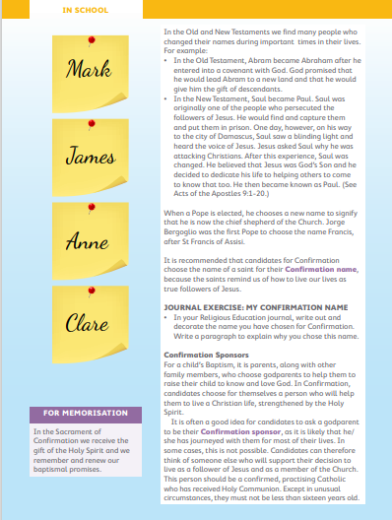
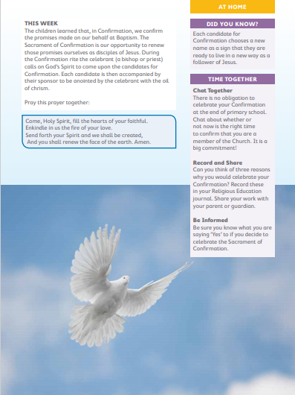

Slide 32

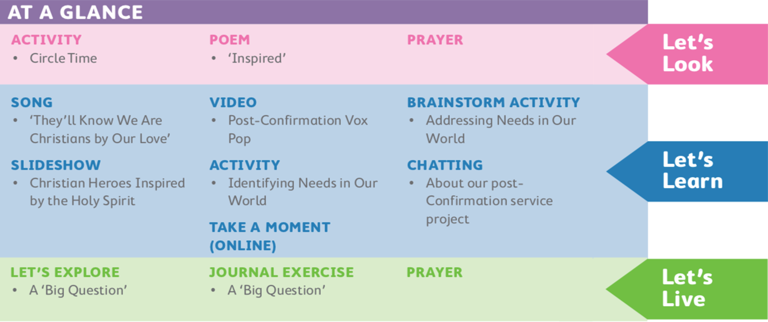

Slide 33

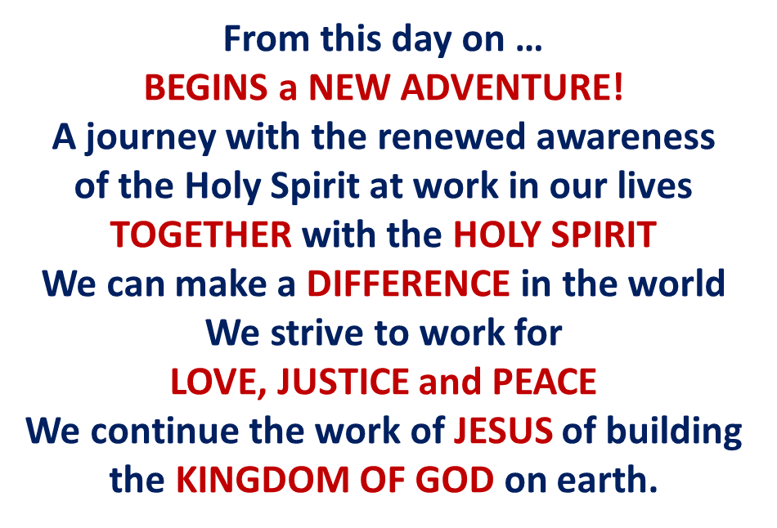

Slide 34
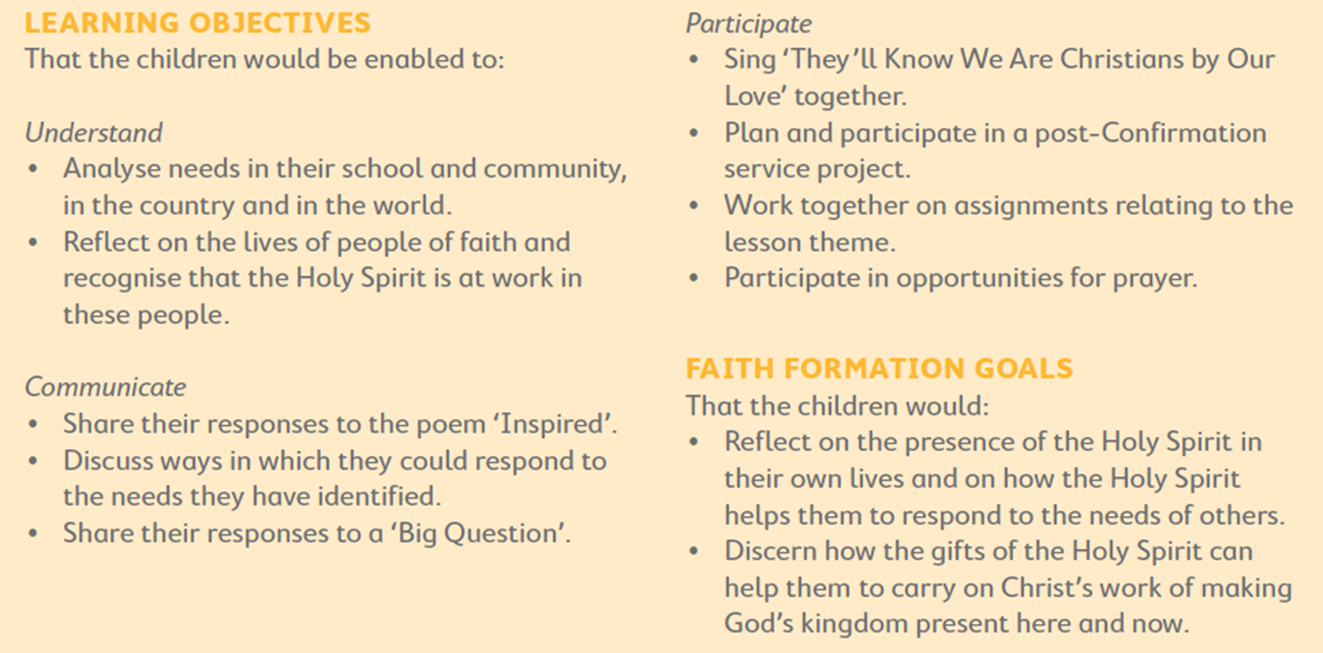

Slide 35

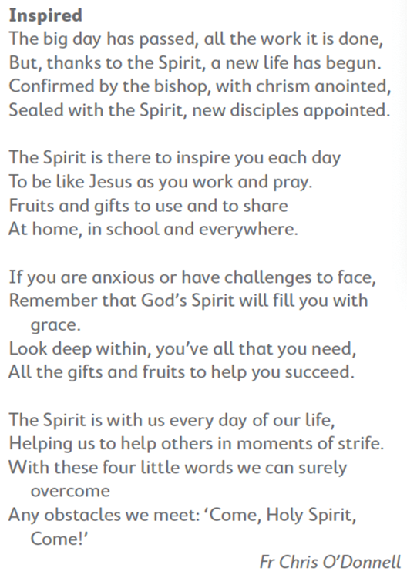


How does
the Holy Spirit
INSPIRE us
in our lives?
Memories of
their Confirmation day?
Spirit of God,
confirmed in us,
thank you for all the gifts
you have sealed in us.
May we continue to live
as followers of Jesus
and allow your gifts
to bear fruit in our lives.
Amen.

Slide 36

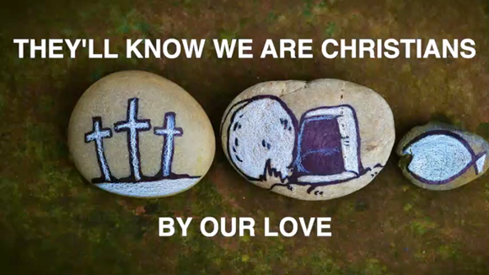



Slide 37


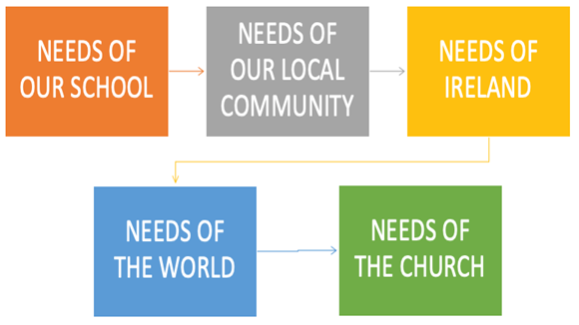

Slide 38

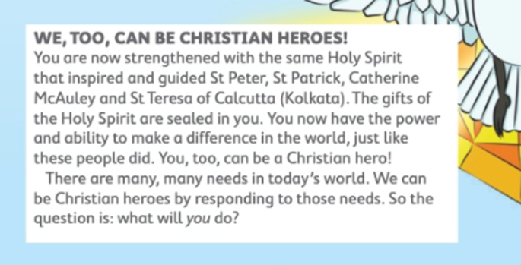


Slide 39



If there were no Holy Spirit,
would it make a difference?
Holy Spirit,
help us to use your gifts,
now sealed within us,
to bring about
a world of justice and joy.

Slide 40
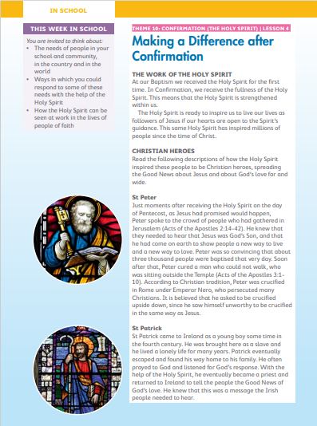


Slide 41



