Slide 1
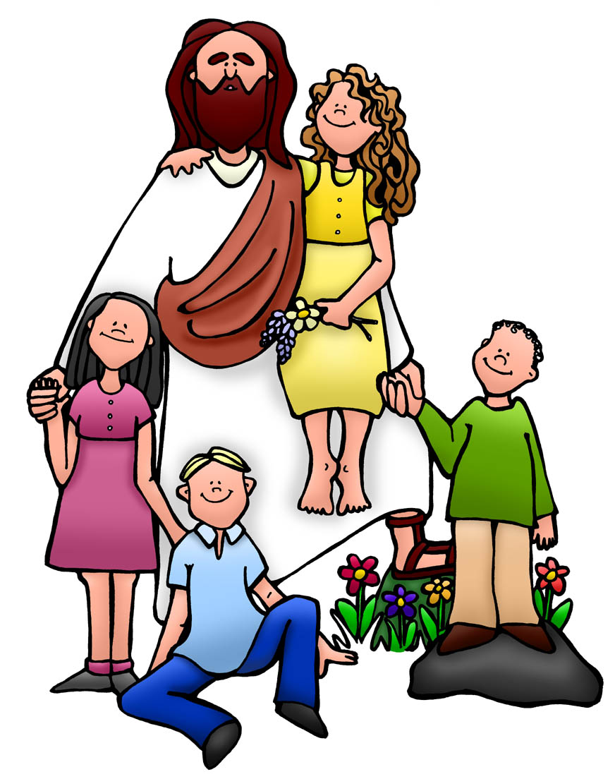
Lay Your Hands
Carey Landry

Slide 2
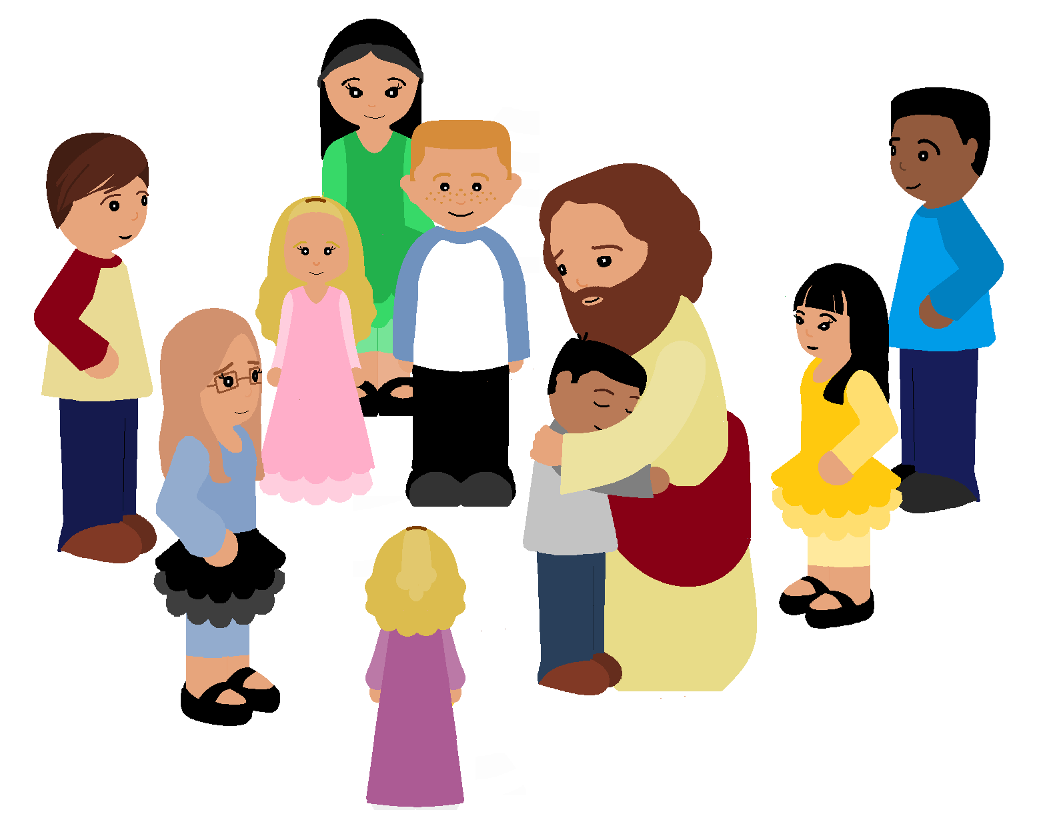
Lay your hands gently upon us.
Let their touch render your peace.
Let them bring your forgiveness and healing.
Lay your hands, gently lay your hands

Slide 3
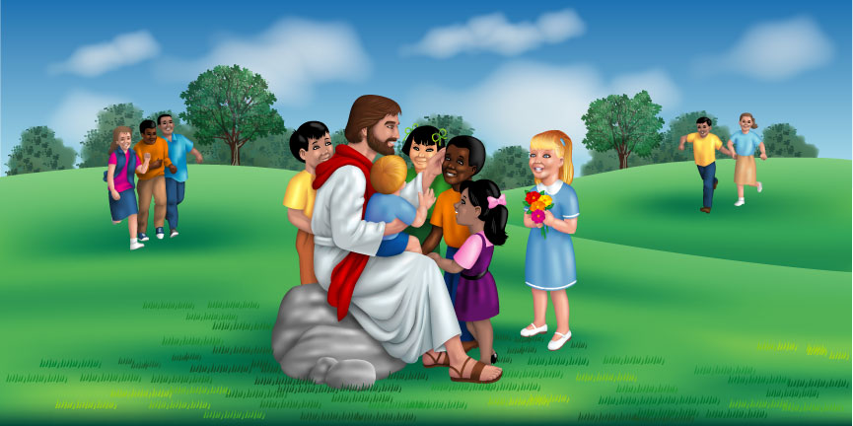
You were sent to free the broken hearted.
You were sent to give sight to the blind.
You desire to heal all our illnesses.
Lay your hands, gently lay your hands.

Slide 4
Lay your hands gently upon us.
Let their touch render your peace.
Let them bring your forgiveness and healing.
Lay your hands, gently lay your hands

Slide 5

Lord, we come to you through one another.
Lord, we come to you in all our need.
Lord, we come to you seeking wholeness.
Lay your hands, gently lay your hands.

Slide 6
Lay your hands gently upon us.
Let their touch render your peace.
Let them bring your forgiveness and healing.
Lay your hands, gently lay your hands

