Slide 1
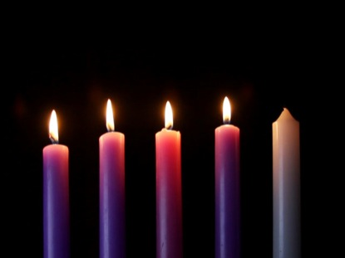
Advent Song
Mary Lou Walker

Slide 2
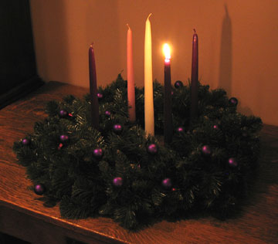
Light the Advent candle, one:
Now the waiting has begun;
We have started on our way,
Time to think of Christmas day.

Slide 3
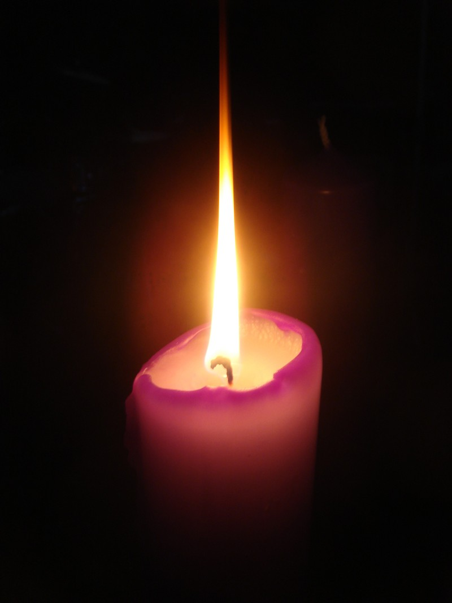
Candle, candle, burning bright,
Shining in the cold winter night;
Candle, candle, burning bright,
Fill our hearts with Christmas light.

Slide 4
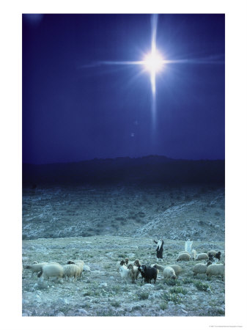
Light the Advent candle two Think of humble shepherds who
Filled with wonder at the sight
Of the child on Christmas night.

Slide 5
Candle, candle, burning bright,
Shining in the cold winter night;
Candle, candle, burning bright,
Fill our hearts with Christmas light.

Slide 6

Light the Advent candle three
Think of heavenly harmony
Angels singing ‘Peace on Earth’
At the Blessed Saviour’s birth.

Slide 7
Candle, candle, burning bright,
Shining in the cold winter night;
Candle, candle, burning bright,
Fill our hearts with Christmas light.

Slide 8

Light the Advent candle four
Think of Joy forever more
Christ child in a stable born
Gift of love that Christmas morn.

Slide 9
Candle, candle, burning bright,
Shining in the cold winter night;
Candle, candle, burning bright,
Fill our hearts with Christmas light.

