Slide 1
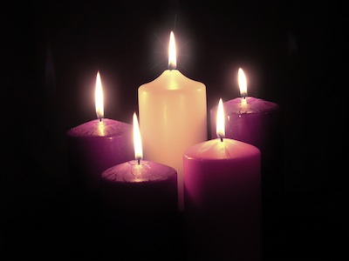
Prepare Ye
Bernard Sexton

Slide 2

Prepare ye the way of the Lord.

