Slide 1
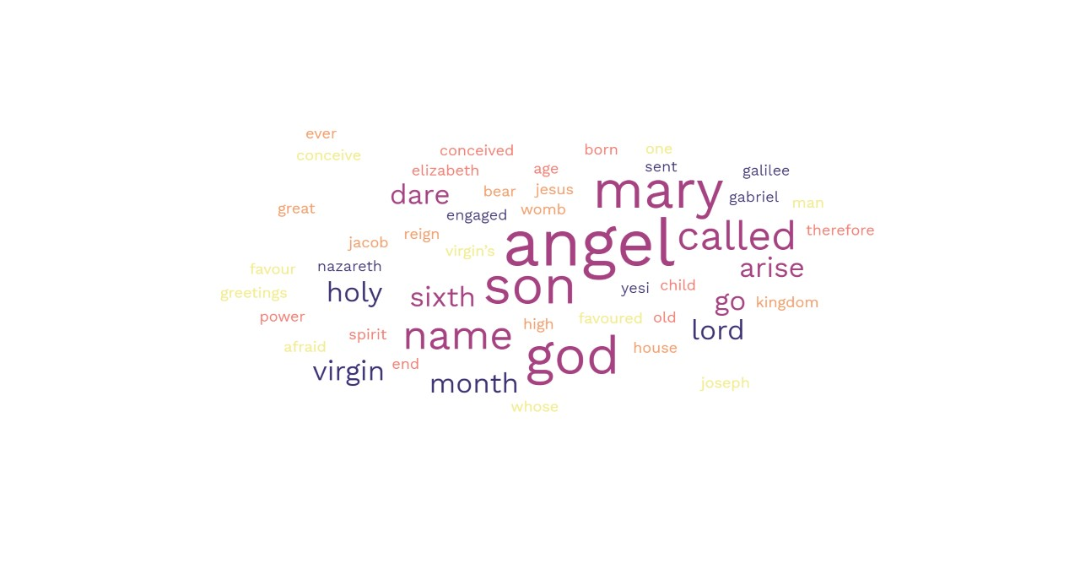
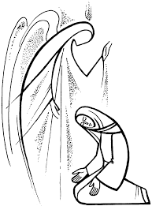
The Annunciation – Matthew 1:26-38

Slide 2
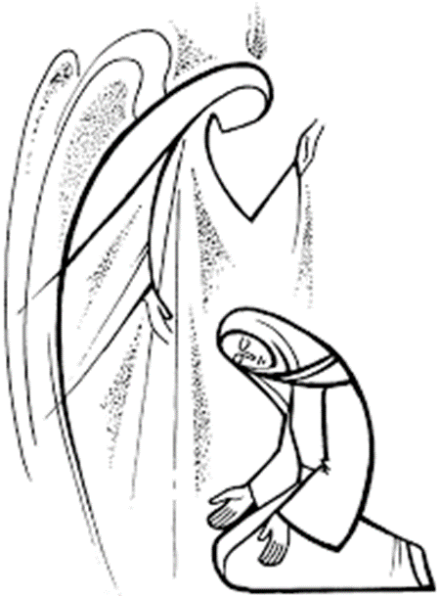
Read
In the sixth month the angel Gabriel was sent by God to a town in Galilee called Nazareth, to a virgin engaged to a man whose name was Joseph, of the house of David. The virgin’s name was Mary. And he came to her and said, ‘Greetings, favoured one! The Lord is with you.’ But she was much perplexed by his words and pondered what sort of greeting this might be. The angel said to her, ‘Do not be afraid, Mary, for you have found favour with God. And now, you will conceive in your womb and bear a son, and you will name him Jesus. He will be great, and will be called the Son of the Most High, and the Lord God will give to him the throne of his ancestor David. He will reign over the house of Jacob for ever, and of his kingdom there will be no end.’ Mary said to the angel, ‘How can this be, since I am a virgin?’ The angel said to her, ‘The Holy Spirit will come upon you, and the power of the Most High will overshadow you; therefore the child to be born will be holy; he will be called Son of God. And now, your relative Elizabeth in her old age has also conceived a son; and this is the sixth month for her who was said to be barren. For nothing will be impossible with God.’ Then Mary said, ‘Here am I, the servant of the Lord; let it be with me according to your word.’ Then the angel departed from her.

Slide 3

Reflection – Dare to Say Yes – Arise and Begin…
Are you more inclined to say ‘yes’ or ‘no’ to a request? Sometimes our responses are both immediate and instinctive – we do not have to think very hard about how we will reply.
Mary, we are told, was ‘disturbed’ by what the angel had told her. Being afraid is natural when something unexpected happens. Nobody expects God to send an emissary to them with such astounding news. Mary did not anticipate a message being sent by God. However, as she quickly reflected on this new invitation, new challenge, she stepped into the unknown. Her gut feeling was her God feeling. Mary said, ‘yes’ to God. Saying ‘yes’ to God is important because we know that God will only ask us to do something that we are capable of doing. God’s revelation to Mary was indeed a new stage in her relationship with God. God is constantly revealing himself to us, in words, deeds, messages and signs. Look around you today to see what God is calling you to be. Do you dare to say ‘yes’? Arise and begin. A new journey is ahead of you.

Slide 4

Respond….
Take time today to reflect on a time you felt inclined to say yes to something or someone.
God sent Gabriel to Mary. Did you ever have an angel moment when someone like Gabriel surprised you?
The Angel Gabriel calmed Mary’s fear. If you are anxious or fearful invite God’s messengers to take care of you.

