Slide 1
Catholic Schools:
Communities of
Faith and Resilience
2. Hope

Slide 2

Nature teaches us that growth can happen in the most unlikely places. Hope can help our personal growth, our growth in faith, our growth in community.
Notes:
Image by S. Hermann & F. Richter from Pixabay https://pixabay.com/photos/daisy-shell-nature-moss-close-up-5009527/

Slide 3
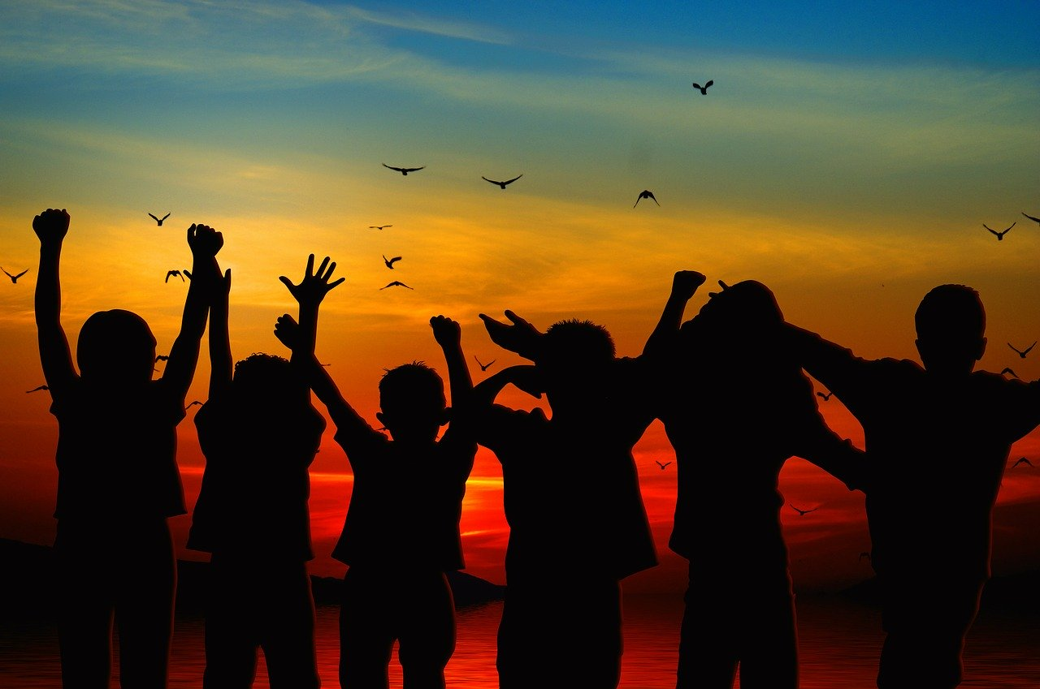
Hope can be infectious − we can catch it from others, but we can also be the ones that pass it on!
Notes:
Image by Gerd Altmann from Pixabay https://pixabay.com/photos/children-silhouette-cheers-positive-479692/

Slide 4

Hope − a word with which we can score highly. Hope is supportive, not competitive. Hope motivates, strengthens and encourages. It is forward looking.
Notes:
Image by Wokandapix from Pixabay https://pixabay.com/photos/hope-word-letters-scrabble-1804595/

Slide 5

Hope has a can-do attitude. It cuts through obstacles; it points the way; it makes it easy to get a grip.
Notes:
Image by mohamed Hassan from Pixabay https://pixabay.com/illustrations/cant-can-self-motivation-4505837/

Slide 6

If hope is at the centre of our lives, faith and love will be close. How can we make hope central?
Notes:
Image by Gerd Altmann from Pixabay https://pixabay.com/illustrations/faith-love-hope-wave-clouds-sea-4411141/

Slide 7

Hope keeps good company. Hope is good company … for any journey.
Notes:
Image by Gerd Altmann from Pixabay https://pixabay.com/illustrations/board-blackboard-equality-freedom-1815982/

Slide 8
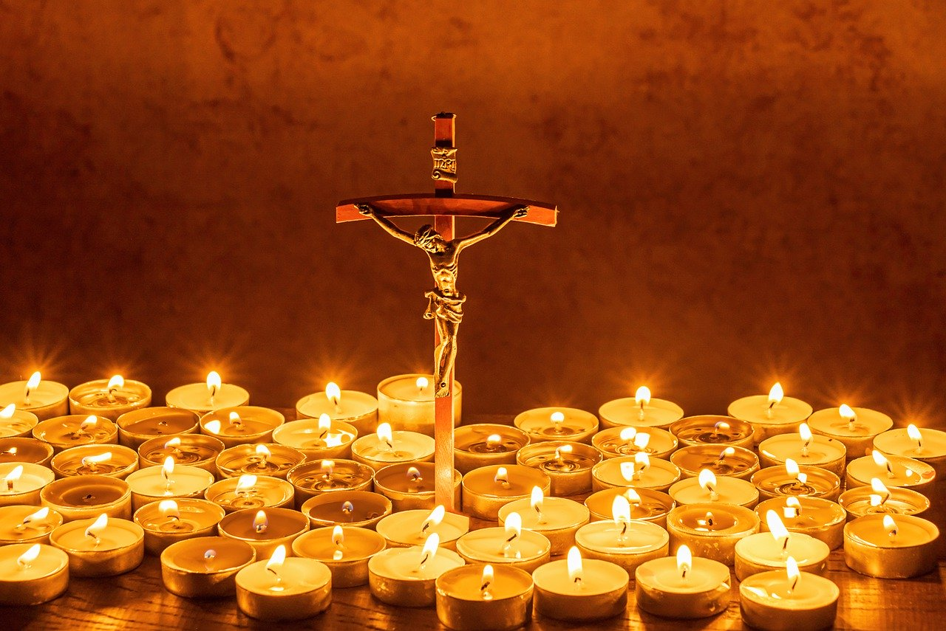
Hope radiates. Hope throws light on the most challenging of circumstances.
Notes:
Image by Myriam Zilles from Pixabay https://pixabay.com/photos/cross-jesus-believe-church-4941685/

Slide 9
‘I wait for the Lord,
my soul waits,
and in his word I hope.’
(Ps 130:5)

