Slide 1
Catholic Schools Week 2021
Catholic Schools: Communities of Faith and Resilience
Thursday
CHALLENGES

Slide 2

Come to me, all you who are weary and heavy-burdened, and I will give you
REST
Matthew 11:28

Slide 3
Students will learn examine various challenges in life. They will look at how faith can affect how we face up to challenges
Learning Intention

Slide 4

Success Criteria:
Students will be able to explain the word challenge and identify different examples of challenges.
Students will be able to describe how members of the Christian faith have been challenged and how they met those challenges.

Slide 5


Look at these two images. Which one do you think is the best image to represent what a challenge is? Discuss your answer as a class or in pairs.
As individuals or as a class, come up with a different image that expresses what a challenge is. You may want to doodle or draw it in your copy or journal.

Slide 6
In your copy or journal, name the challenges you feel that young people face and then vote as a class for which one is a) most common b) most difficult.
List the challenges have been faced by the whole world in the past year.
In both lists, highlight the challenges which are likely to affect a) young people b) the world in general for the foreseeable future.

Slide 7
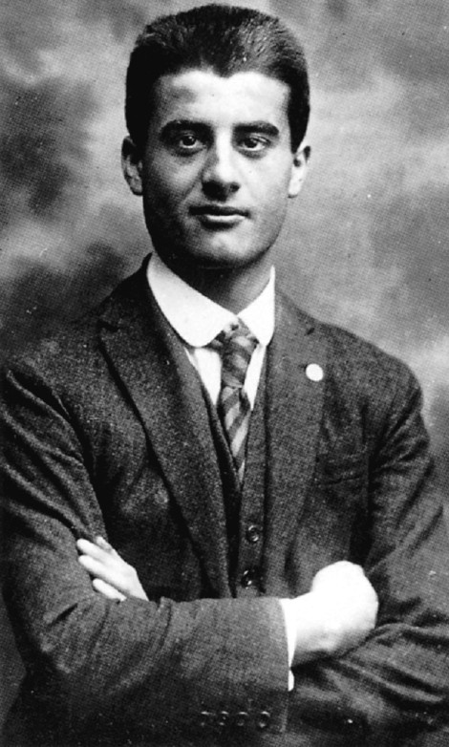
Watch this video (5 mins) about the challenging life of Blessed Pier Giorgio Frassati, a privileged young Italian man who developed a profound love for the poor because of his deep faith. He died very young, probably because he contracted polio from his work with the poor.
https://youtu.be/1mBpkj_ftKU

Slide 8
What challenges did Pier Giorgio face as a young boy with his parents?
What happened to him in school?
What qualities did Pier Giorgio have that we might not normally associate with a saint?
How do you think Pier Giorgio’s faith in God might have helped him overcome various challenges?
In today’s world, are you aware of any people who might have overcome challenges because of their faith?

Slide 9
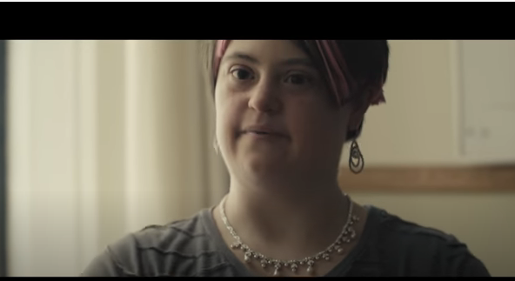
Watch the video of the hymn ‘Christ has no body now but yours’. The words of the prayer by Teresa of Avila on which it is based are found on the next page.
https://www.youtube.com/watch?v=w7ymxW3rndk

Slide 10
‘Christ has no body now but yours. No hands, no feet on earth but yours. Yours are the eyes through which he looks compassion on this world. Yours are the feet with which he walks to do good. Yours are the hands through which he blesses all the world. Yours are the hands, yours are the feet, yours are the eyes, you are his body. Christ has no body now on earth but yours.’
― Teresa of Avila

Slide 11
What do you think Teresa of Avila means when she says ‘Christ has no body now but yours’?
Can you give examples of people that you know that do good things because of their love of God?
What are some ways that we can act as the hands and feet of Jesus in the lives of others?

Slide 12
Numeracy Moment: Look up the following verses: Romans 8:28 and Philippians 4:13.
Write out the verses in your copy or journal.
What do they say to us about challenges in our lives?
How would our lives be different if we really lived according to the spirit of these verses?

Slide 13
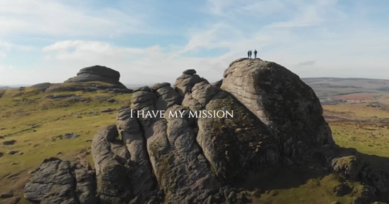
Watch the short video (2:05 mins) below, which visualises the prayer of St John Henry Newman.
How do you think this video relates to the theme of challenges, and to the prayer of St Teresa of Avila? Does it tell us something about how we can help others with challenges?
https://www.youtube.com/watch?v=oyBStFF-rdk

Slide 14
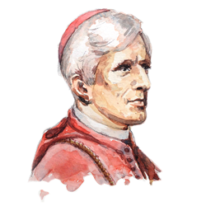
I am a link in a chain,
a bond of connection between persons.
He has not created me for naught.
I shall do good; I shall do his work.
Therefore I will trust him.
Whatever I do, wherever I am,
I cannot be thrown away.
If I am in sickness,
my sickness may serve him.
If I am in sorrow,
my sorrow may serve him.
He does nothing in vain.
He knows what he's about.
Saint John Henry Newman
God has created me to do him
some definite service.
He has committed some work to me
which he has not committed to another.
I have my mission.
I may never know it in this life,
but I shall be told it in the next.

Slide 15
Credits
Orange Bullseye: https://www.nextpng.com/en/transparent-png-nimbf/download
Dead End road sign Black and White: https://publicdomainvectors.org/en/free-clipart/Dead-end-vector-silhouette/80047.html
Sisyphus Black and White: https://publicdomainvectors.org/en/free-clipart/Sisyphus-silhouette/78907.html
Round picure of Pier Giorlgio: https://www.cleanpng.com/png-pier-giorgio-frassati-world-youth-day-2016-pollone-5313615/download-png.html
All other images of Pier Giorgio courtesy of Frassati USA – used with permission.
Image of John Henry Newman: https://www.limerickdiocese.org/news/john-henry-newman-the-greatest-catholic-theologian-since-aquinas/

