Slide 1
Catholic Schools Week 2021
Catholic Schools: Communities of Faith and Resilience
Tuesday - Community

Slide 2
Learning Intention
To explore our understanding of the word ‘community’ and how COVID-19 has impacted on that understanding.

Slide 3
Success Criteria
Define
Define the word ‘community’
Identify
Identify ways in which our understanding of ‘community’ has changed since the beginning of the COVID-19 crisis
Examine
Examine the features of an Irish community
Discuss
Discuss ways in which we connected with members of our community during lockdown
Identify
Identify the challenges that the older members of our community faced during lockdown
Explore
Explore the recent increase in the viewing of religious services on RTÉ
Look
Look at the ways in which a Catholic community overcame the COVID-19 restrictions in order to connect with members of their community in their grief

Slide 4
Keywords
Community
Common Interests
Values
Customs
Identity
Religious Beliefs
Being Connected
Global Pandemic

Slide 5
Activity 1
Examine the list of keywords
1
In class, discuss the meaning of each word (3 minutes)
2
Give an example for each type of community on your worksheet
3

Slide 6


Community
Group of people
Living in the same place
Sharing common interests
Sharing values
Sharing customs
Sharing identity
Sharing religious beliefs

Slide 7

Reflective Task 1
Take a moment to think about the communities to which you belong
Now, take a moment to think about the communities to which you belong that are unable to operate the way they used to because of COVID-19. What are the differences?

Slide 8
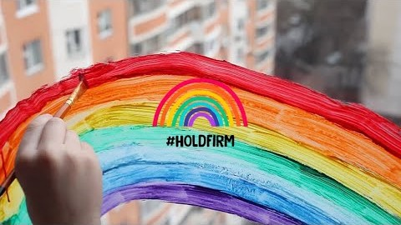
#holdfirm – Stay Safe, Protect Each Other

Slide 9
Discussion: This Isn’t Us
What is meant by the statement ‘This isn’t us’?
Discuss what the statement ‘But this IS us’ means.

Slide 10
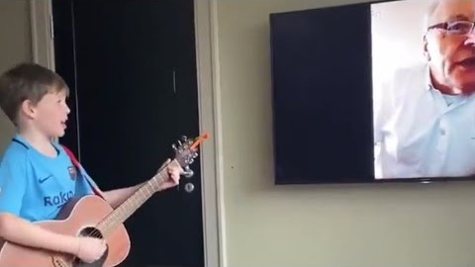
An example of how ‘community’ changed

Slide 11
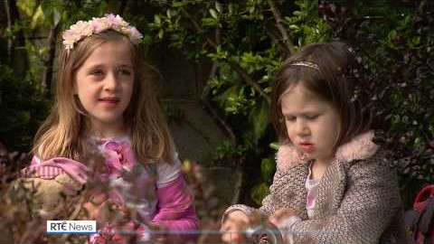
Another example of how ‘community’ changed

Slide 12

Reflective Task 2
List some of the things you did during lockdown to continue being connected to your communities
List some of the things you did during lockdown to make sure other people felt connected to your communities

Slide 13
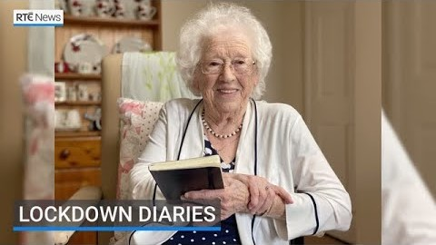
COVID-19 Notebook Project

Slide 14

Activity 2
What challenges did older people face during lockdown?
Give an example of a sign of hope mentioned in the video.
Describe the role of the diary during lockdown for the older people that took part in the COVID-19 Notebook Project.

Slide 15

Activity 3
Taoiseach – 17th March
On the feast of St Patrick, our Taoiseach stated that we should ‘come together as a nation by staying apart’. Explain the importance of delivering the phrase on the feast of St Patrick.
Create a meme/phrase that delivers a message to the people of our Irish community during this global pandemic.

Slide 16
Is Ireland turning to religion during the Covid-19 crisis? (9 April 2020)
Source: https://www.rte.ie/brainstorm/2020/0408/1129276-ireland-religion-coronavirus/
‘Ireland has experienced a rapid decline in religious practice since the 1990s, converging with wider European trends of secularisation. Even so, there is evidence that at least in the first few weeks of the pandemic, the Irish are tuning in to religion to a remarkable degree. With Government restrictions on public gatherings, religion has moved online and people have followed. Many parishes and congregations are holding Sunday gatherings, prayer meetings and even parents and toddlers’ groups online. Providers like ChurchServicesTV have reported a surge in demand.’

Slide 17
Is Ireland turning to religion during the Covid-19 crisis? (9 April 2020)
Source: https://www.rte.ie/brainstorm/2020/0408/1129276-ireland-religion-coronavirus/
‘On March 19th, RTÉ began airing the 10.30am daily Mass … In the first two weeks, the daily Masses attracted an average weekday audience in the upper 30,000s, comparable to a usual Sunday mass on RTÉ One. More than 48,000 watched the Pope’s Urbi et Orbi Message and Prayer for Humanity on RTÉ on March 27th. In addition, 142,000 people watched at least part of mass on St Patrick’s Day (a 20% audience share), compared to 60,000 (14% share) in 2019. The first Sunday after churches closed, the usual viewing figures for RTÉ’s Sunday services were four times higher than usual.

Slide 18
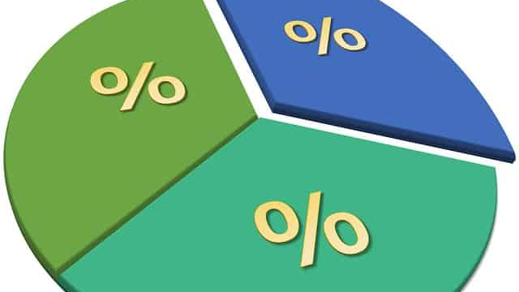
Numeracy Task
If 60,000 people watched Mass for the feast of St Patrick in 2019, and 142,000 people tuned in for Mass on the feast of St Patrick in 2020, what was the percentage increase in viewing in 2020?
On a usual Sunday morning, 30,000 people view Mass on RTÉ. How many people tuned in for Mass the first Sunday after the Churches closed due to COVID-19?

Slide 19

Discussion
What can you deduce from the numbers you just calculated?

Slide 20

Twitter Post for a Funeral during COVID-19
Source: Seán Mac an tSíthigh
@Buailtin
Yesterday we buried a lovely woman. Due to #Covid19 there was no wake & our community couldn’t enter the church.
But the entire parish came out & lined the 2km road to graveyard to say goodbye to Betty Ryan.
Ar scáth a chéile a mhaireann na daoine #WestKerry

Slide 21
Activity 4
Click to watch
https://twitter.com/i/status/1240944703853539328
Describe the importance of these actions for this community of faith.

Slide 22

Research
Research ways in which your local church connected with its members during the COVID-19 crisis.
Explore reasons why this outreach would be important to ensure that all members still feel part of their faith community.

Slide 23
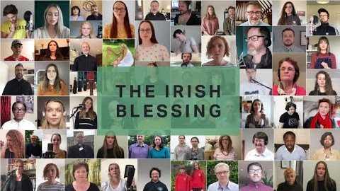
Musical example of a community of faith
The Irish Blessing – over 300 churches from our island sing a blessing over Ireland and beyond ...

