Slide 1
Catholic Schools Week 2021
Catholic Schools: Communities of Faith and Resilience
Wednesday
Love and Intergenerational Solidarity

Slide 2

And these three things remain
FAITH HOPE LOVE
And the greatest of these is
LOVE
1 Corinthians 13:13

Slide 3
Students will learn the importance of love and intergenerational solidarity to a Christian community of faith and resilience
Learning Intention

Slide 4

Success Criteria:
Students will be able to explain the phrases ‘intergenerational solidarity’ and ‘flourishing’ and identify different examples of them.
Students will be able to analyse statistics which show varying levels of religious practice among generations and to give reasons why that might be the case.
Students will be able to reflect on whether they are acting with love towards older generations.

Slide 5
KEY WORDS
Intergenerational Solidarity
Role Models
Trust
Support
Respect
Talents
Grandparents
Parents
Reciprocity
Love
Family
Learning
Faith
Friendship

Slide 6
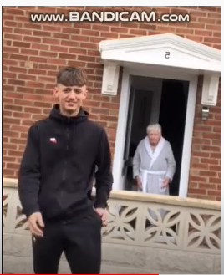
Eighteen-year-old Lewis Leigh from Wales went viral when he taught his seventy-six-year-old Nan a TikTok dance after delivering her groceries to her during the Covid-19 lockdown. Watch the thirty second video and then answer the questions on the next slide.
https://www.youtube.com/watch?v=aA7HNHjGNnA

Slide 7
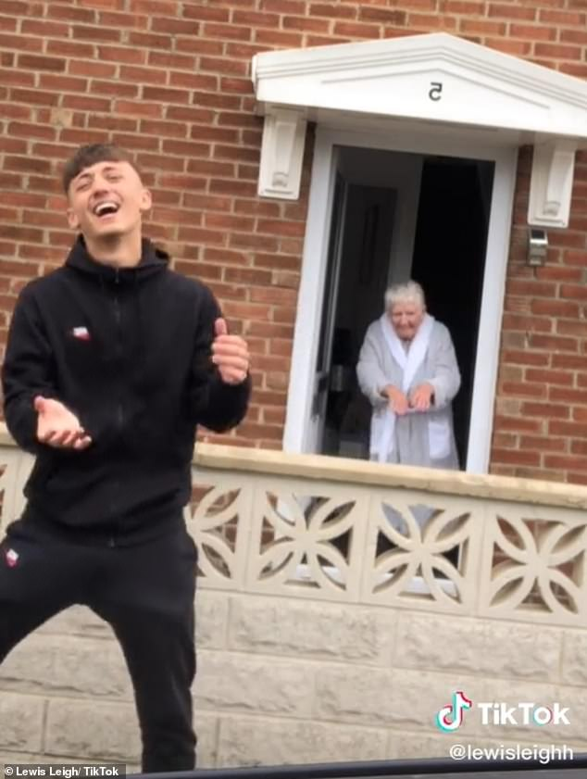
What shows us that there is a great bond between Leigh and his Nan?
This dance normally begins with a hand in the air. Why do you think Leigh adapted it?
Why makes this video different to most TikToks?
Discuss what intergenerational solidarity means. Does this video show this in action? How?
Read the Bible verse on the next page. What relevance might it have to this video?

Slide 8
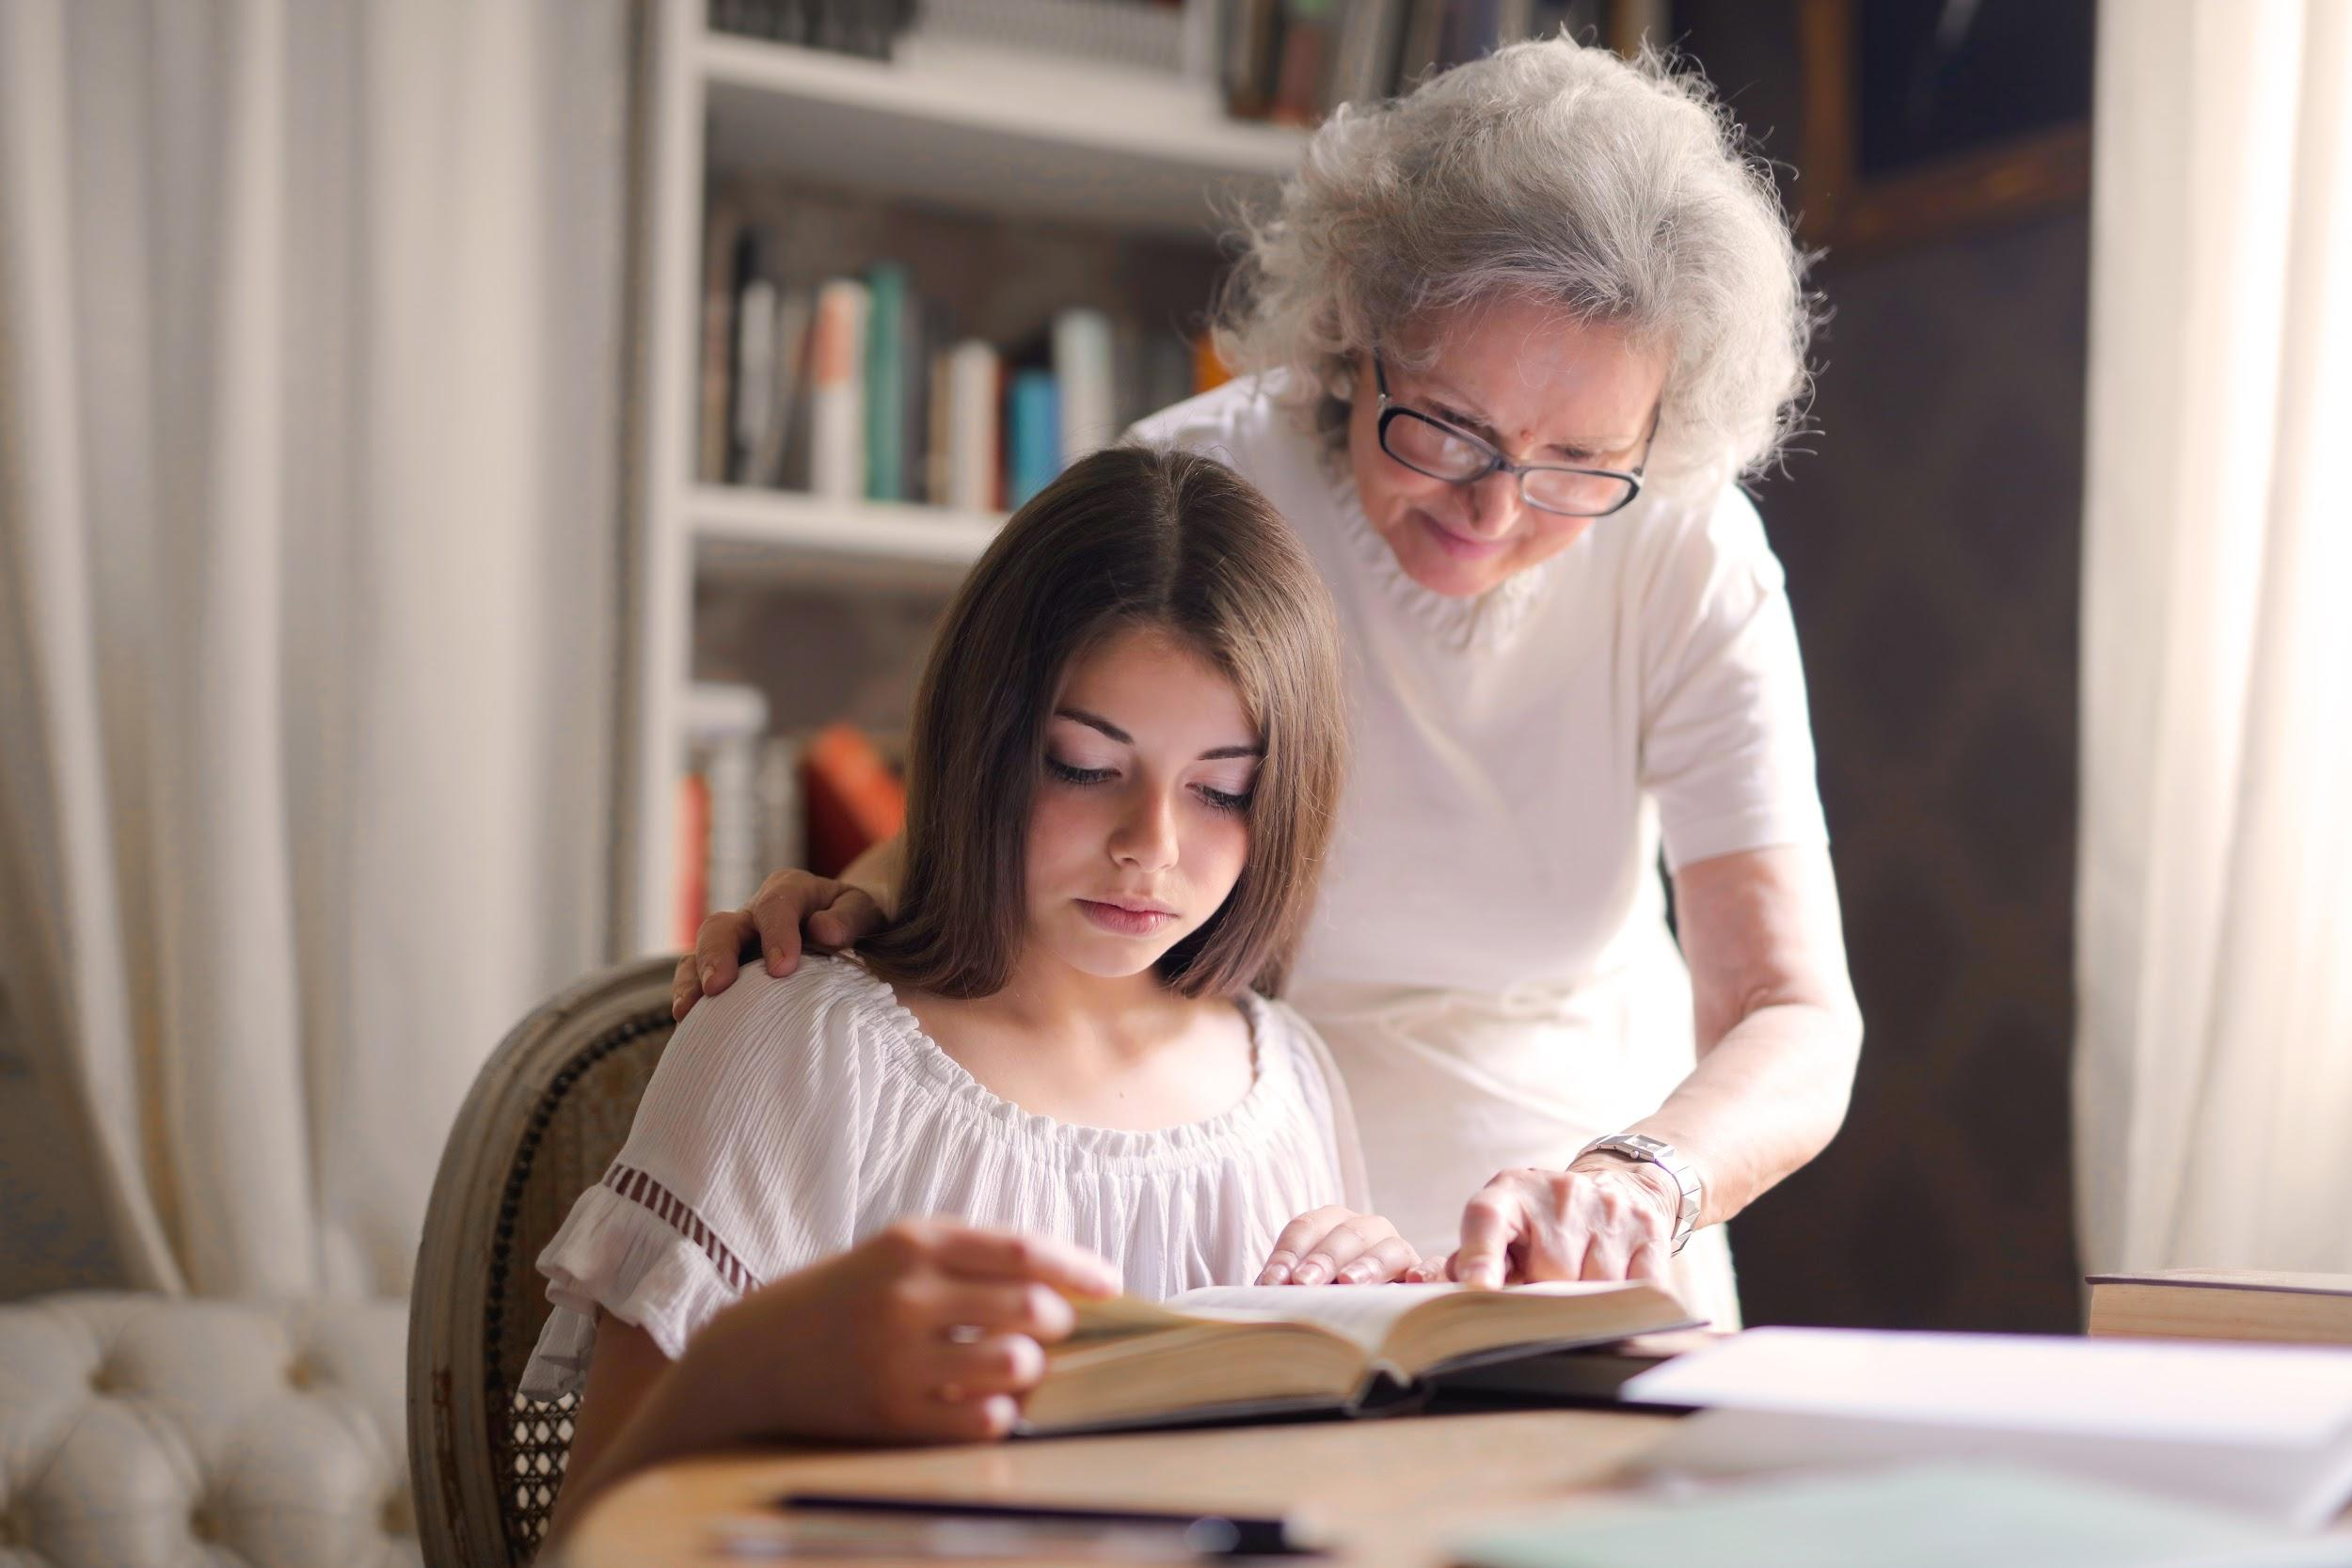
Proverbs 20:29: The glory of the young is their strength; the grey hair of experience is the splendour of the old.

Slide 9
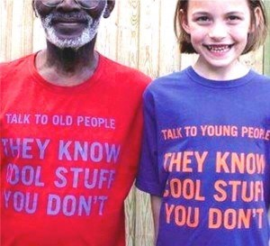
List the best things about being a teenager.
List the best things about being an older person.
What does the word flourish mean?
Pick some things from the lists above about the best things about being young and old which really help people to flourish.
What ‘cool stuff’ might each generation know that the other does not?
This activity may be done as a small group exercise if circumstances permit

Slide 10

Calasanctius College from Oranmore in Galway won the Bronze Award for their project ‘Our Living Scenes’ in the Intergenerational Solidarity Award 2019 by DCU. Every Thursday, TY pupils meet with older members of the community and take part in activities with them. Watch this short video (1:24 mins): https://youtu.be/CEEv2cInpk8

Slide 11

Think, Pair, Share:
Think: Take a moment to reflect on a particular moment that struck you from the video.
Pair: Share with someone else the moment that you chose and why. Let the other person do the same.
Share: Pick another pair and repeat the process. Finally, discuss as a class.

Slide 12
Alternatively, if Think, Pair, Share is not an option, students could answer these questions individually and discuss them as a class group.
List the skills that the older people shared with the younger people.
List the skills that the younger people shared with the older ones.
What impact do you think this TY activity would have on the older people? The younger people?
How does the video show intergenerational solidarity and flourishing?

Slide 13

Numeracy moment: Here are the statistics for religious practice from the 2016 census.
In 2016 the proportion of Roman Catholics increased steadily from 75.5 per cent for those aged less than one, to 83.5 percent for 11 year olds. It then falls with increasing age to reach a low of 60.5 percent for 27 year olds before steadily rising to reach a peak for 82 year olds at 91.9 per cent.
The reverse of this pattern can be largely seen for those indicating no religion, with an initial low of 4.5 per cent for 12 years olds, rising to a peak of 18.5 per cent for those aged 26 before declining as the population ages.

Slide 14
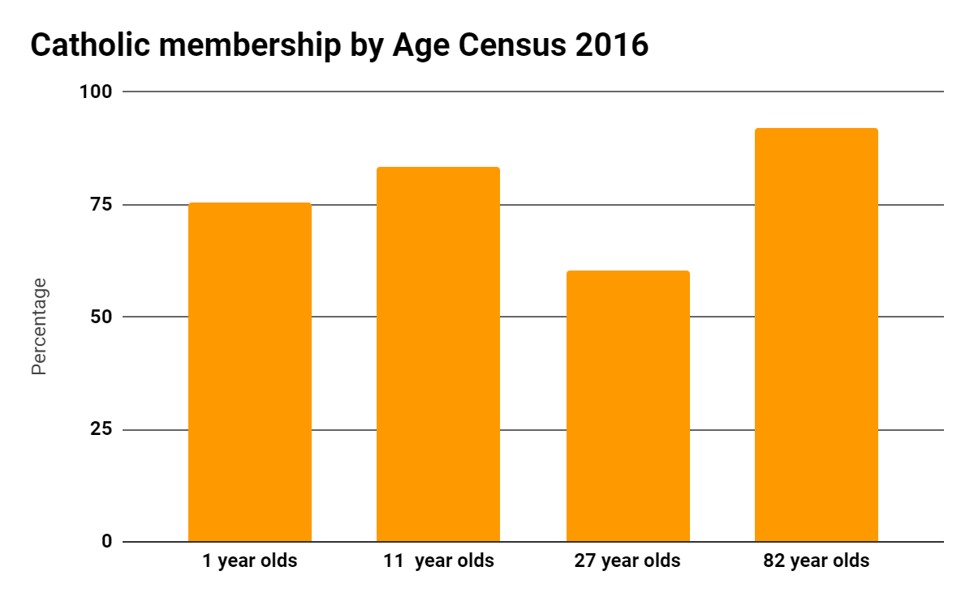

Slide 15
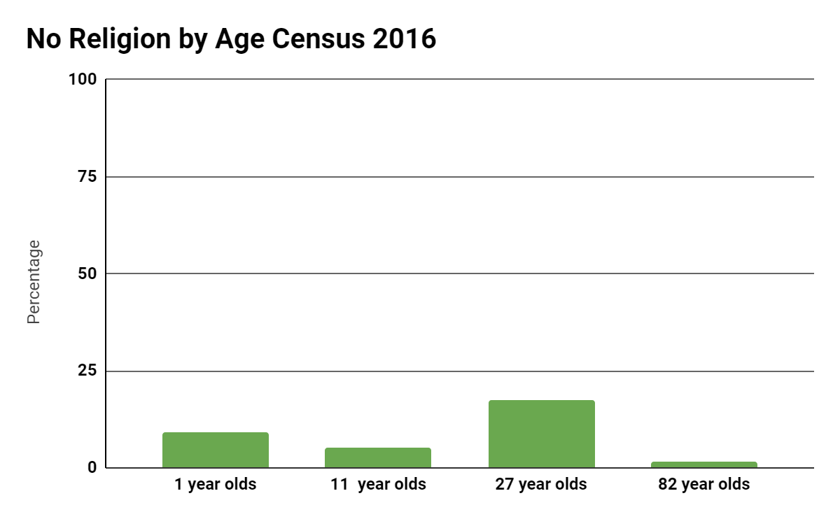

Slide 16
A census is a snapshot in time. The next census may not show, for example, 60.5 per cent of 27 year olds identifying as Roman Catholic. What reasons might there be for the fact that, in 2016, membership of the Catholic Church was lowest in this age group?
Why are so many young children Catholic?
Why are so many older people Catholic?
If the census were being taken today, how might the figures be different?
Compare the two slides with bar charts. What strikes you most about them?

Slide 17
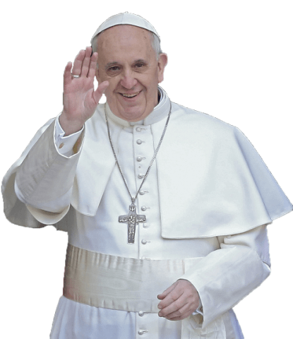
Hope and a future presuppose memory. The memory of our elderly people sustains us as we journey on. The future of society, and precisely of Italian society, is rooted in the elderly and in the young: the latter, because they have the strength and are of the age to carry history ahead; the former, because they are a living memory. A people that does not take care of its elderly, its children and its youth has no future, because it abuses both memory and promise.
Address to Italian Bishops 2013

Slide 18

According to Pope Francis, what is the role of elderly people with regard to memory?
What role do young people play?
Do you agree that a society that neglects the young and the old is in trouble?
Which group is more neglected by society, the young or the old?
What can you do personally and as a group to be more sensitive and caring towards older people?

Slide 19

Extension Activity: Research the work of Alone, which relies heavily on volunteers.

Slide 20

Prayer Challenge: If you are a person of faith, learn the prayer on the next slide and pray it for someone older whom you care about. Insert the person’s name instead of ‘us’.

Slide 21
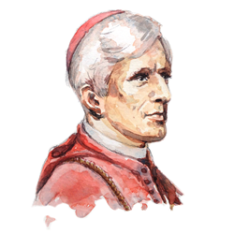
May he support us all the day long, ‘til the shades lengthen and the evening comes, and the busy world is hushed, and the fever of life is over, and our work is done. Then in his mercy may he give us a safe lodging, and a holy rest and peace at the last.
Saint John Henry Newman

Slide 22
Credits:
Orange Bullseye: https://www.nextpng.com/en/transparent-png-nimbf/download
Talk to old people/young people: https://scpeanutgallery.files.wordpress.com/2015/06/old-people-and-young-people-300x273.jpg
Oder woman/teenager by Andrea Piacquadio from Pexels: https://www.pexels.com/search/grandparents%20and%20grandchildren/
Think, Pair, Share icon: https://lookoutforlearning.wordpress.com/tag/think-pair-share/
Image of magnifying glass: https://pixabay.com/vectors/glass-magnifier-loupe-magnify-159521/
Image of Pope Francis: https://www.stickpng.com/img/download/584abb151da7ae6ee4705dcf
Alone Logo: alone.ie
Image of John Henry Newman: https://www.limerickdiocese.org/news/john-henry-newman-the-greatest-catholic-theologian-since-aquinas/
Photo of girl at railing by Emmanuel Phaeton on Unsplash

