Slide 1
Celebrating Saint Kevin
Lá Fhéile Caoimhín
4 Meitheamh/June 2021

Slide 2
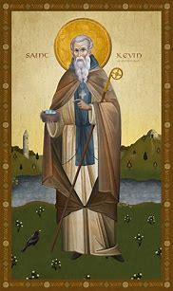
Saint
Saint Kevin of Glendalough
498-618

Slide 3
What We Know
Saint Kevin was from a royal family in Leinster with all that it entails.
Caoimhín means handsome, beautiful and kind. The feminine Caoimhe is anglicised as Keeva.
Quite early on Kevin turned away from wealth and power to give over control of his life to God.
He felt the call to be a hermit and sought the gentle wilderness of Glendalough – the glen of the two lakes – as his place of quiet.

Slide 4
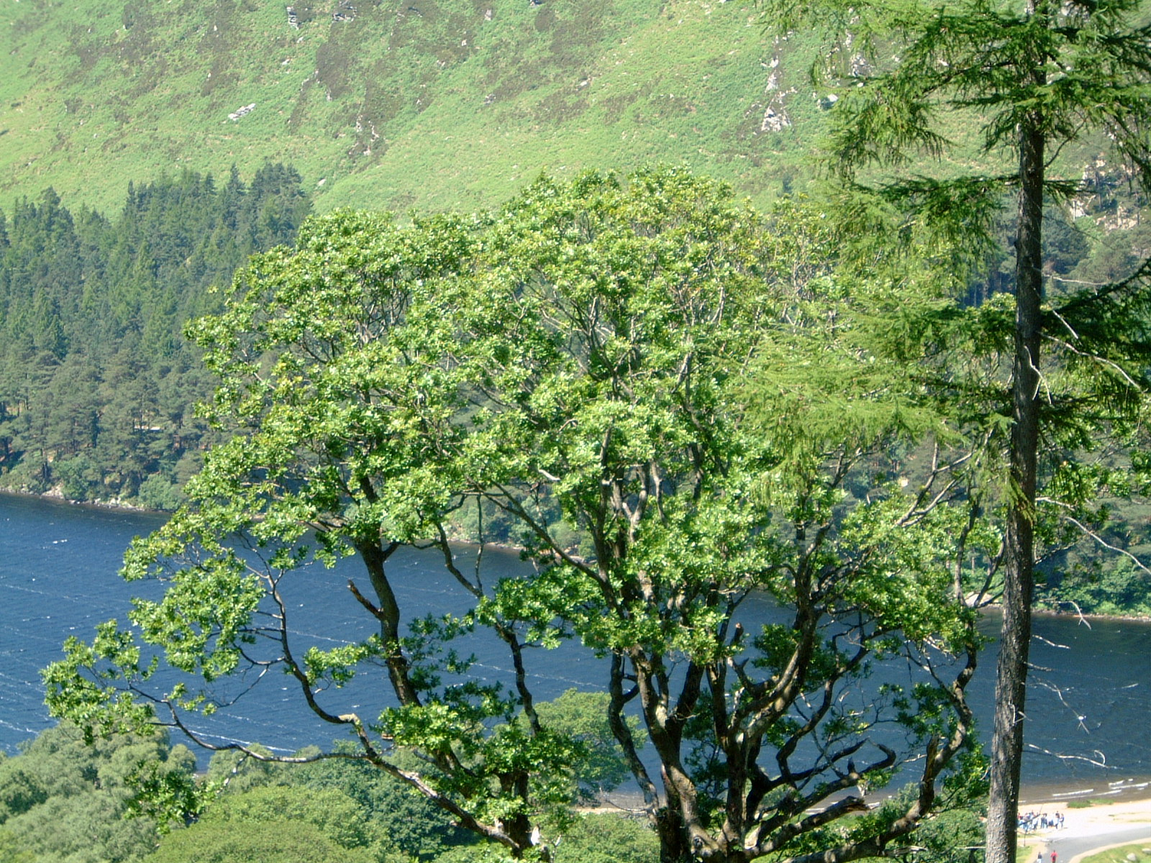

Slide 5
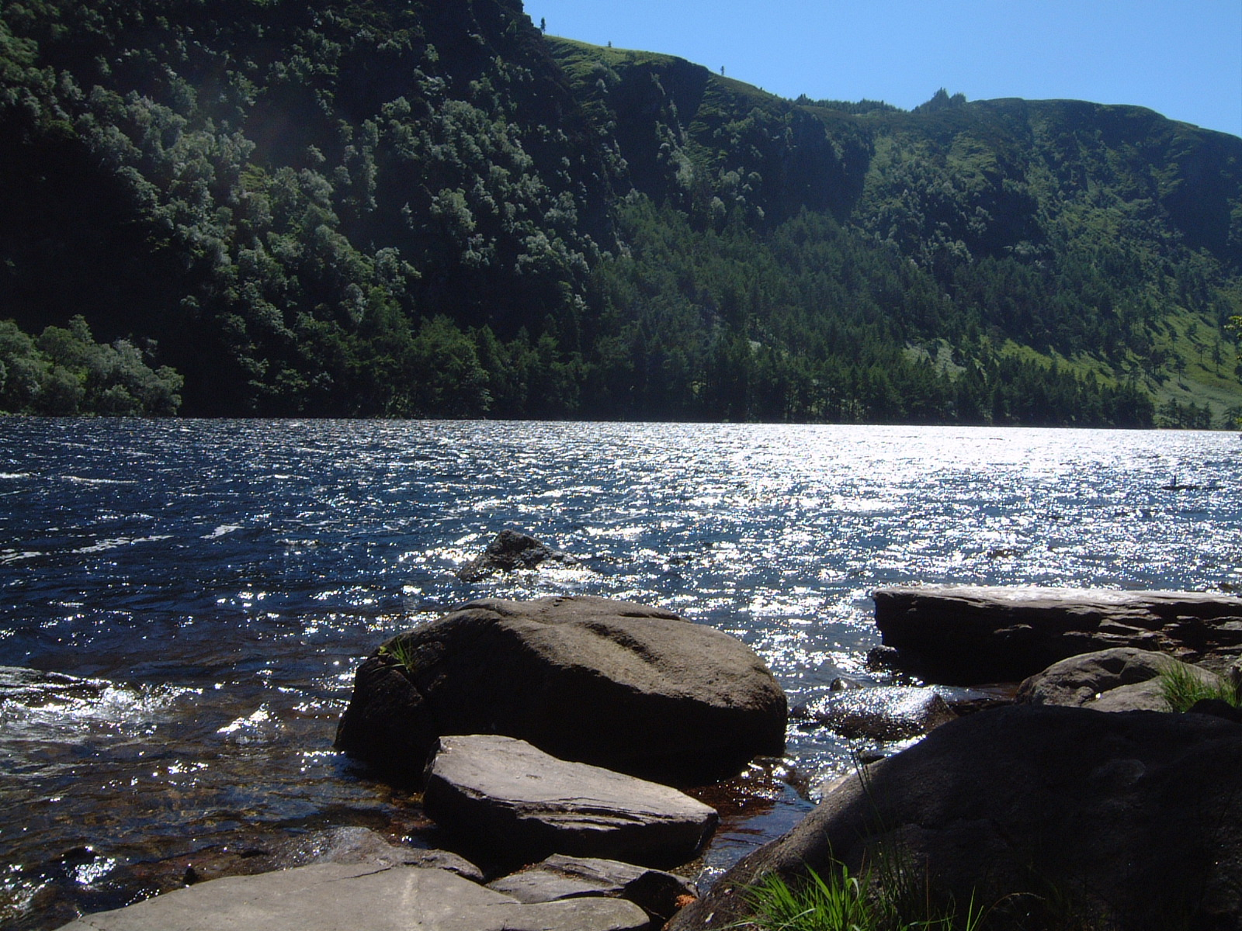
Happy are those who have placed their trust in the Lord (Jeremiah 17:7)
“But blessed is the man
who trusts me, God,
the woman who sticks
with God.
They’re like trees
replanted in Eden,
putting down roots
near the rivers—

Slide 6
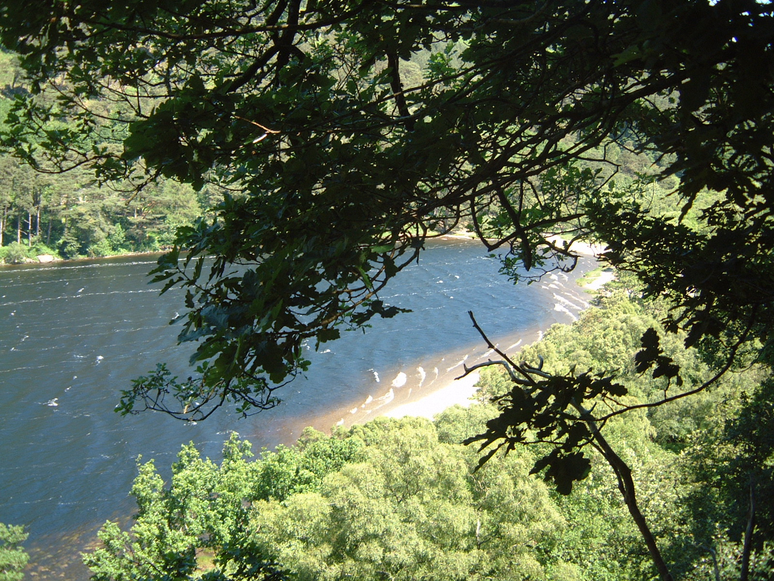

Slide 7
Glendalough Monastery
Kevin’s name and witness spread widely and in time he attracted so many followers that a monastery was founded in Glendalough.
The community imitated Kevin’s example of prayer, the ascetic life and the appreciation of all of God’s creatures.
He was a ‘Saint Francis’ before his time.

Slide 8
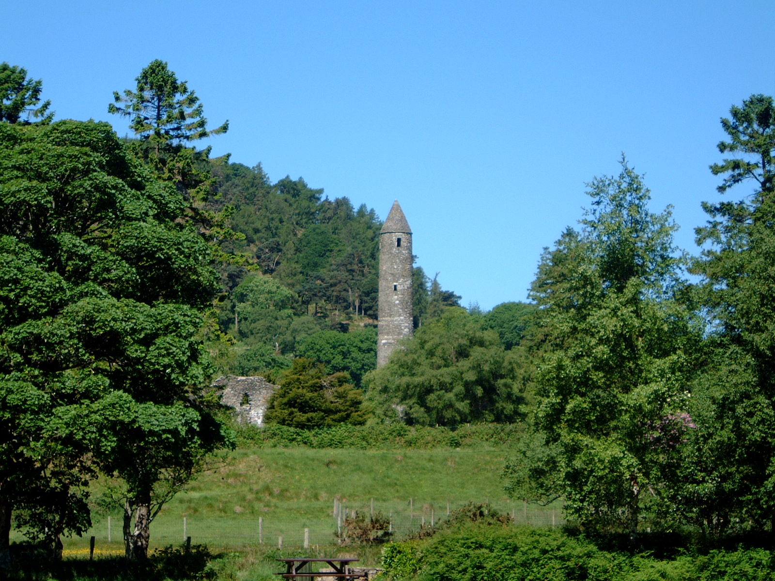
Glendalough Today

Slide 9
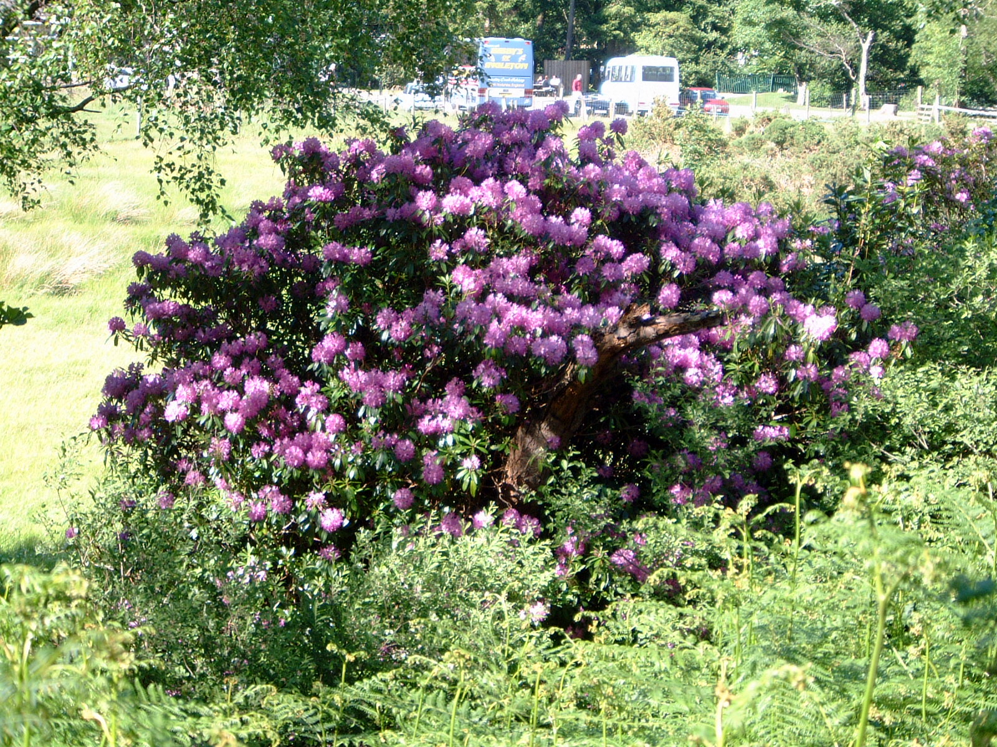
A Tourist Attraction

Slide 10
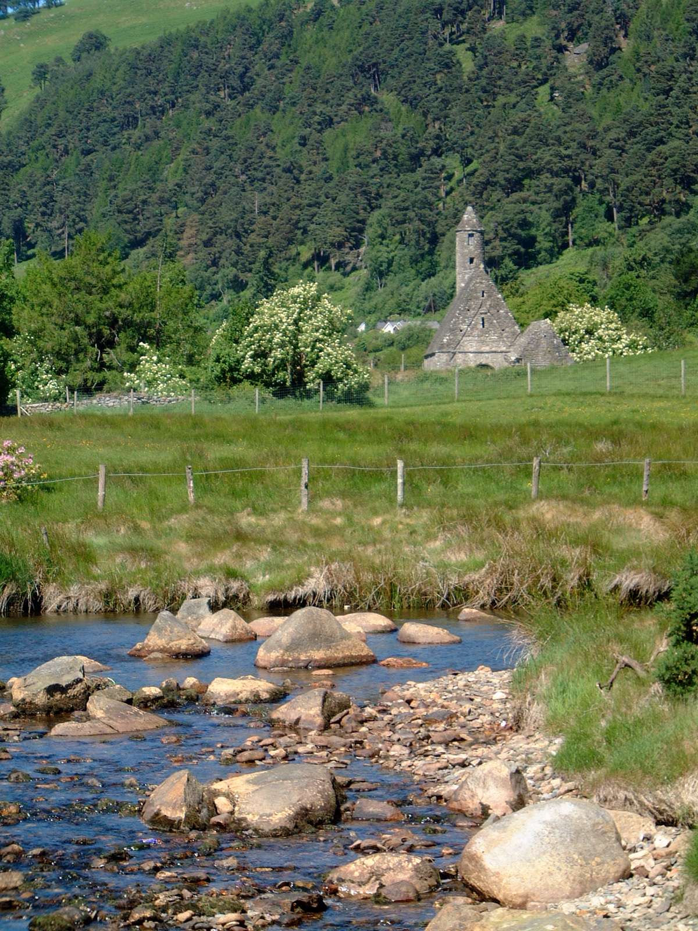
Peaceful Waters and Ancient Memories

Slide 11
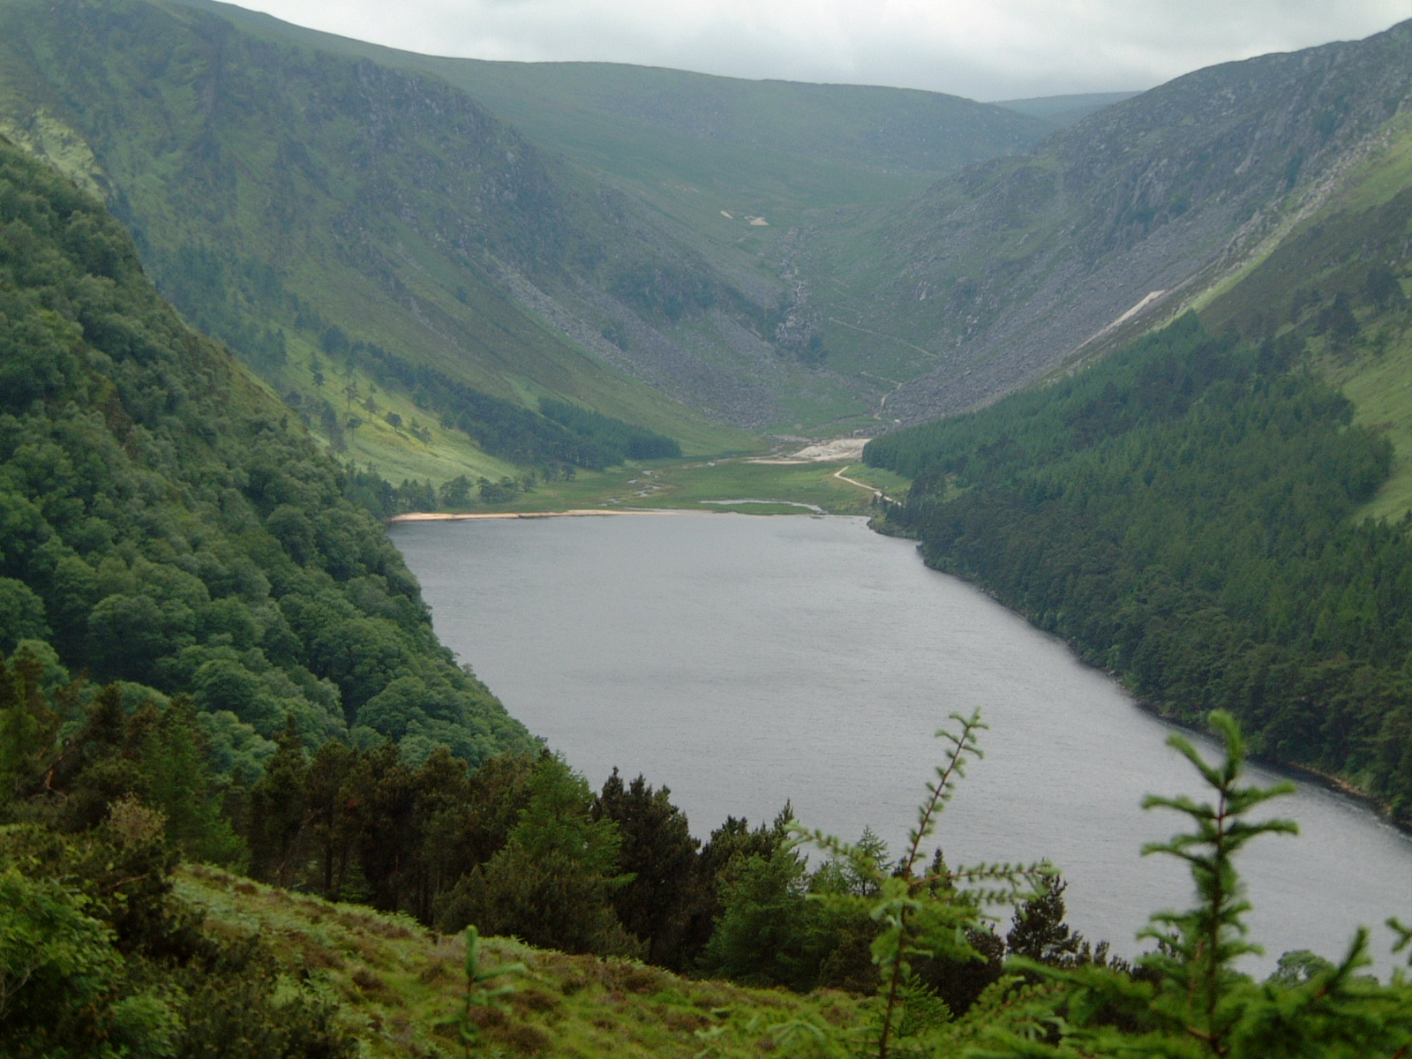

St. Kevin and the Blackbird (John Columba Mc Cann OSB)

Slide 12
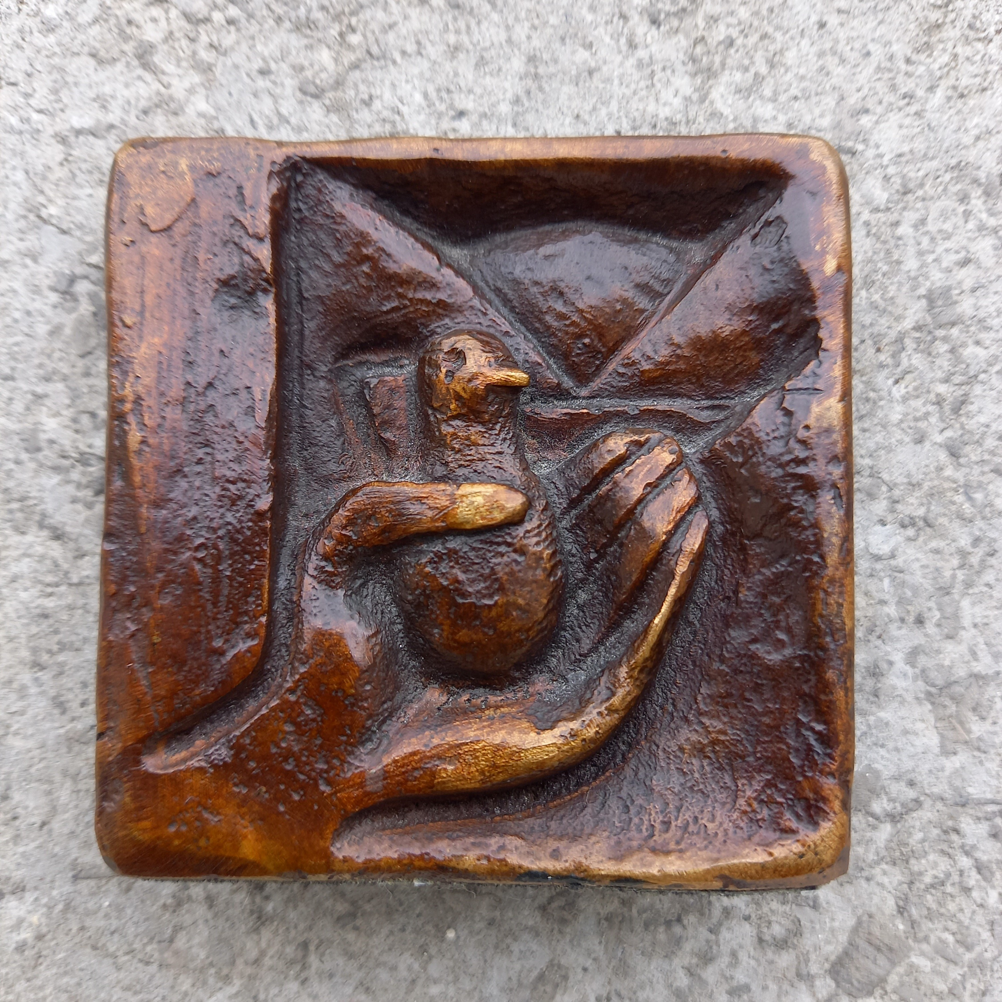
Imogen Stuart (Artist)

Slide 13
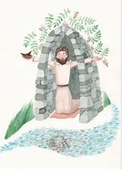
St Kevin and the Blackbird (Seamus Heaney)
From the neck on out down through his hurting forearms? Are his fingers sleeping? Does he still feel his knees? Or has the shut-eyed blank of underearth
Crept up through him? Is there distance in his head? Alone and mirrored clear in love’s deep river, ‘To labour and not to seek reward,’ he prays,
A prayer his body makes entirely For he has forgotten self, forgotten bird And on the riverbank forgotten the river’s name

Slide 14
WE PRAY
St Kevin, prayerful guide
Help us to imitate you by making stillness and silence a priority in our lives
St Kevin, generous servant
Help us to imitate you by never holding back on helping others
St Kevin, upholding creation
Help us to imitate you by showing reverence to even the smallest of creatures
St Kevin, open-minded
Help us to imitate you by listening to the promptings of the Spirit deep inside us
St Kevin, patron of Dublin
Help every person in our Archdiocese to hear a call to service and to stretch out their arms in kindness and compassion

Slide 15
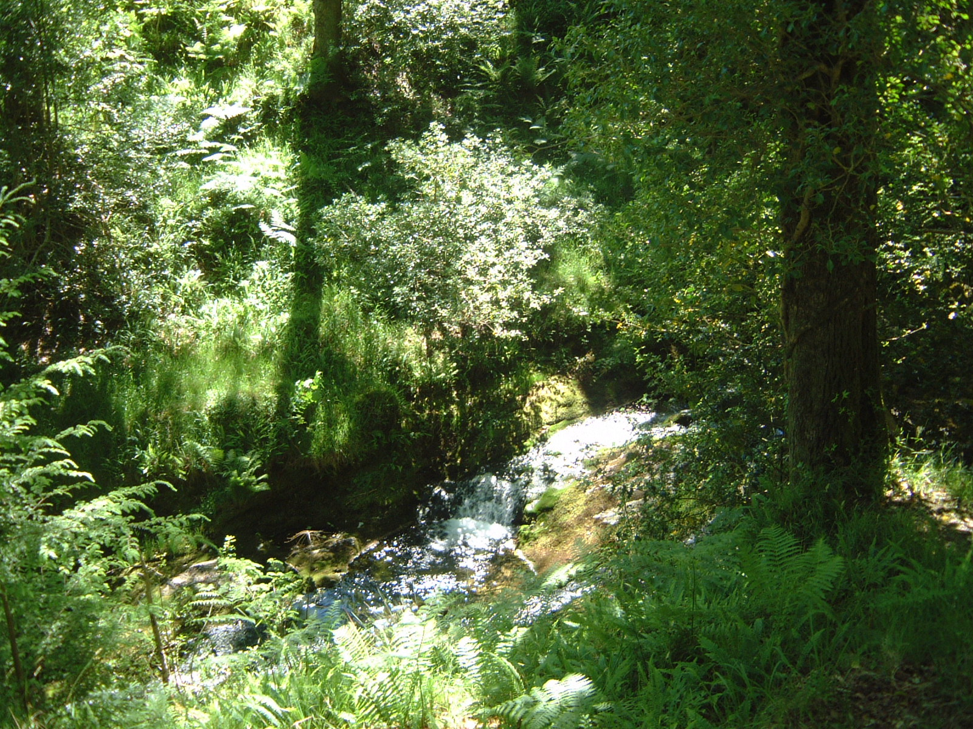
A Haven – Why Not Find Your Quiet Place?

Slide 16
