Slide 1
Christmas 2020

Slide 2
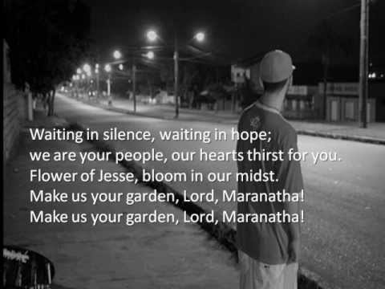
Waiting in silence – carey landry

Slide 3
Reflections of Archbishop martin
Advent
‘We have to use Advent to prepare for how we will celebrate Christmas, both liturgically and through our care services.’

Slide 4
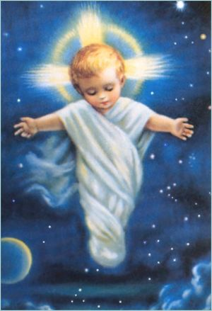
BAMBINELLI SUNDAY
The third Sunday of Advent

Slide 5
Blessing prayer of the baby jesus Figures
Loving God, you loved us so much
that you sent Jesus your son to be our brother and Saviour.
Bless these images of Jesus,
may they be a sign of your love and presence in our homes.
Lord, give your blessing to all who will be with us this Christmas,
especially our family and friends.
Bless those who cannot gather with us this Christmas too
and keep us all safe in your love.
Help us to share the joy of knowing you,
and to give generously to those who have nothing to share this Christmas.
We ask this through Christ our Lord.
Amen.

Slide 6
Christmas Masses
Can we find ways of spreading attendance at Mass over a longer period than just Christmas night and Christmas Day? How can we organise more Masses at Christmas, while managing necessary levels of hygiene and sanitising?

Slide 7

What mechanism does your parish have for hearing new ideas and making decisions about advent and christmas?
Are some of these suggestions practical for your community?
What creative possibilities come to you about the post-Christmas period events?

Slide 8
Joseph’s lullaby
Emmanuel 2019

Slide 9
Resources for family masses
Readings – several versions
Intercessions

Slide 10
children
How can we ensure that children can experience the mystery of Christmas as the birth of the Christ Child? Families could be encouraged to visit the crib together.

Slide 11
Crib blessing

Slide 12
Lonely People
How do we reach out to people who will be lonely at Christmas?
Many people living alone may not be able to travel to relatives

Slide 13
carols
Can we provide simple online services of religious Christmas music and stories?

Slide 14
Reconciliation
The Bishops also reminded that, when access to the Sacrament of Reconciliation is not readily available, people can make acts of perfect contrition in order to attain forgiveness and return fully to the state of grace.

Slide 15
intercessions

Slide 16
Advent service
Monastery of Saint Alphonsus
Saturday 28 November 2020 at 5.00 p.m.
www.Rednuns.com - webcam

Slide 17
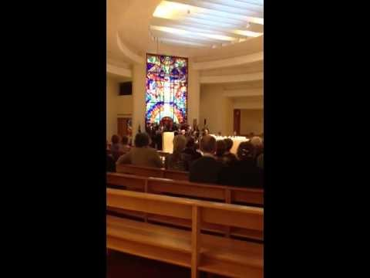
Cuireadh oileanach do mhuire ronan mc donagh - fuaimlaoi

