Slide 1
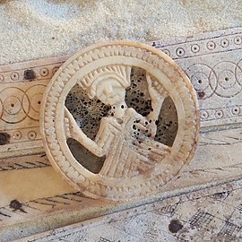
LEADING PRAYER
Funeral Leaders Training Session One

Slide 2

Opening Prayer
Litany Response
LORD HAVE MERCY

Slide 3
From the inside out
How am I in touch with myself?
Body awareness
  What is your body like? Are you feeling comfortable in your own skin? Any aches and pains? How is your breathing?
Mind awareness
  Where is your mind? What thoughts are going through your head?
Feeling awareness
  How are you feeling? What are you feeling at the moment?
God awareness
  What’s your sense of being tuned into God ?

Slide 4
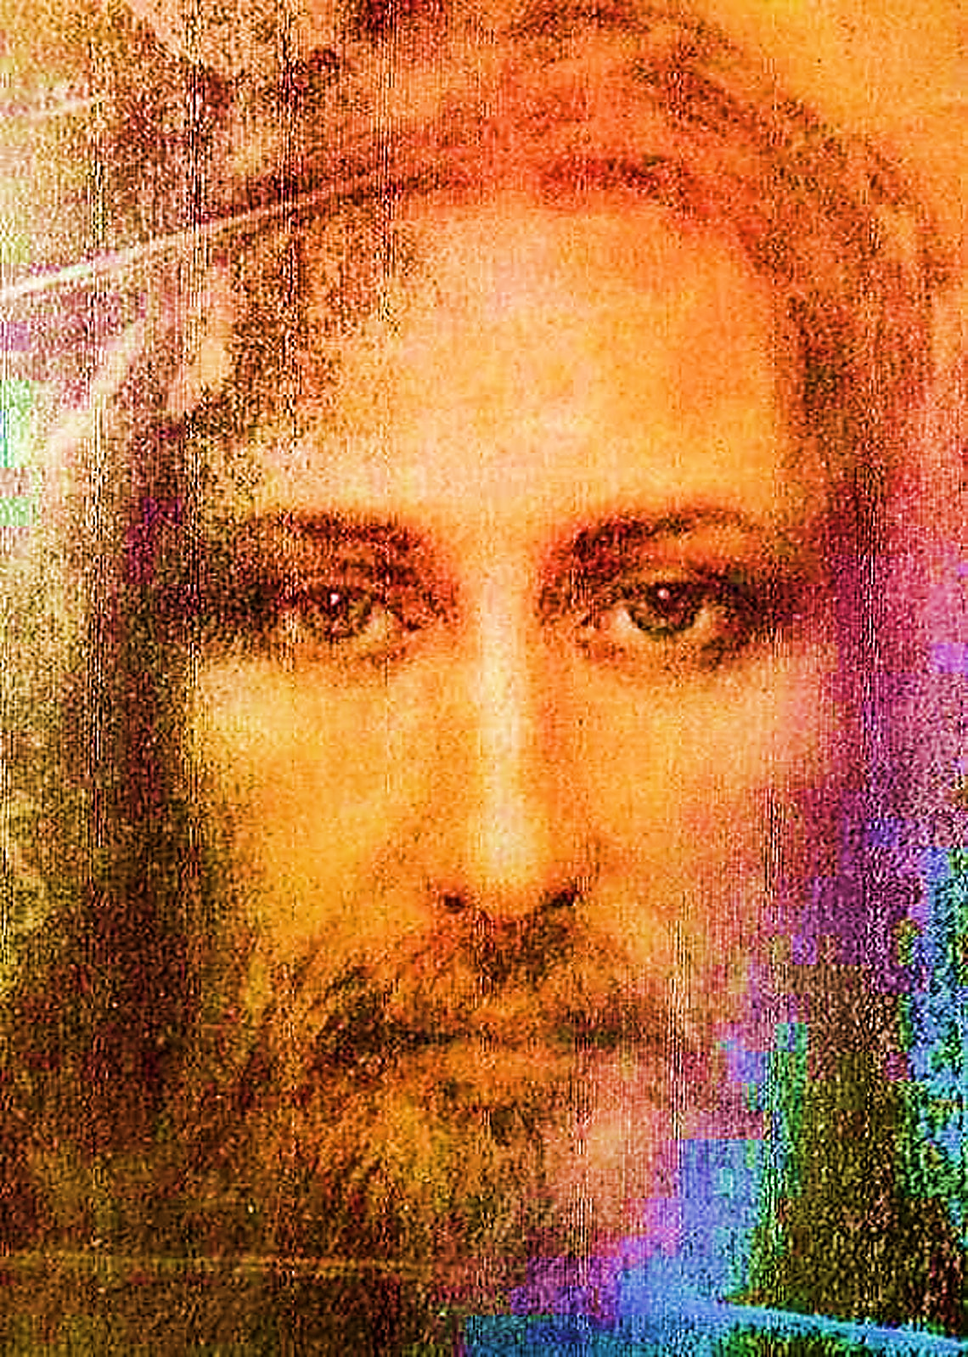
Gaze
Picture of Jesus
Exercise simply sitting
Share the experience

Slide 6
From the outside in
How am I aware of others?
  Awareness of emotions
  Awareness of body language
  Noticing eye contact
  Noticing reaction
  Awareness of the presence of God in the other
What have you noticed about us?

Slide 7
Greeting
Sit facing your partner
Greet them with the phrase ‘The Lord be with you.’
One at a time
Notice how they say this?
Notice expressions?
Notice how you feel?

Slide 8

Personal prayer
What is personal prayer for you?
What’s your favourite?
Silence and quiet
Morning/Night prayer
Music and song
Psalms
Meditation
Rosary
Memorare

Slide 9
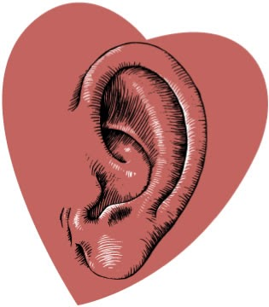
SHARE
WHAT DID YOU HEAR?

Slide 10

Communal Prayer
What’s the difference between personal prayer and communal prayer?
  Its about community
  Its about gathering
  Its about shared response
  Its about known patterns
  Its part of the rite
  Its an example of ritual

Slide 11
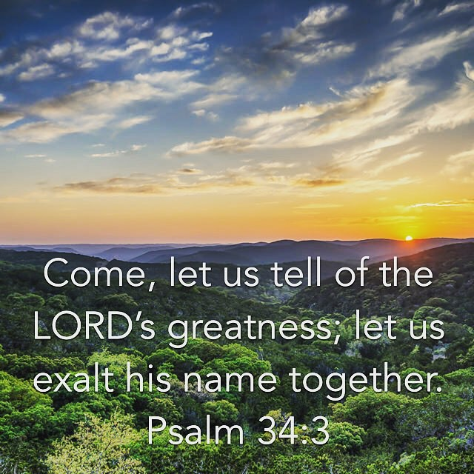
Let us
Let us pray
Let us kneel
Let us stand
Let us sing

Slide 12

Joining in moments

Slide 13
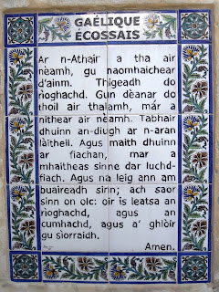
THE LORD’S PRAYER
Let us pray

Slide 14
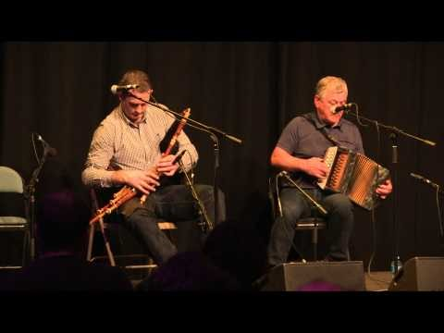
SHORT BREAK

Slide 15

COMMUNICATION SKILLS
Preparation
Microphone
Eye contact
Book contact
Entry and Exit
Posture
Tone of voice
Pacing
Hard words
Page turning

Slide 16

COMMUNICATION SKILLS
Preparation
  Know Texts
  Know Space
  Know People
  Know Technology
  Know Undertaker
Microphone
  What can it do for you
  How will you use it
  Check Main Switch
  Testing Testing
  Explosive Consonants

Slide 17

COMMUNICATION SKILLS
Eye Contact
  Essential
  Soft
  Invitations
  Attention
Book Contact
  Prepare book
  Maintain balance
  Use thumb
  Use stand

Slide 18

COMMUNICATION SKILLS
Entry and Exit
  Confident pace
  Watch steps
  Acknowledge presence
  Place yourself
  Hold moment
  Leave discreetly
Posture
  Stand confidently
  Feet apart
  Sit relaxed
  Grounded always
  Stay still
  Head up

Slide 19
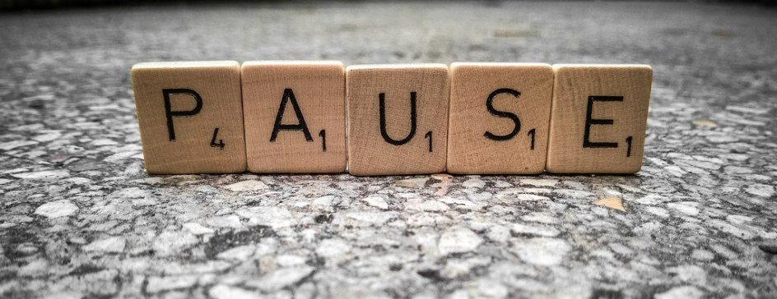
COMMUNICATION SKILLS
Tone of voice
  Warm
  Assured
  Project
  Clear
Pace
  Take time
  Observe punctuation
  Use pause
  Helpful silences

Slide 20


COMMUNICATION SKILLS
Hard words
  Rehearse
  Anticipate
  Relax
Page turning
  Ribbons
  Stickers
  Noises

Slide 21
Homework
Spend some time in prayer with the Jesus image
Read your notes and look over slides
Chat with others about aspects of the course
Attend a Graveside/Crematorium Service
Watch an online service
Find out where your sound system is in the parish and how it works
Find out where the Liturgical books for Funerals are kept in the parish
Notice…Notice…Notice

Slide 22
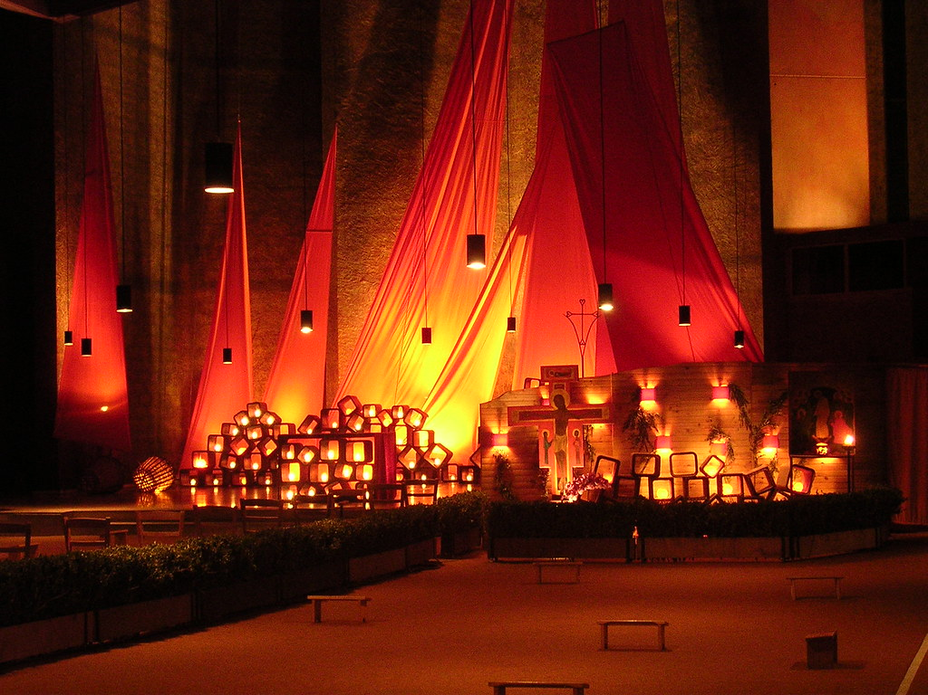
Reflection Brother Roger of Taizé
‘Trust in the resurrection enables us to realise
that a communion between believers
is not interrupted by death.
In simplicity of heart,
we can ask those we love
and have gone before us into eternity’s life:
“Pray for me; pray with me.”
During their life on earth,
their prayer supported us.
After their death,
how could we stop relying on them?’

Slide 23
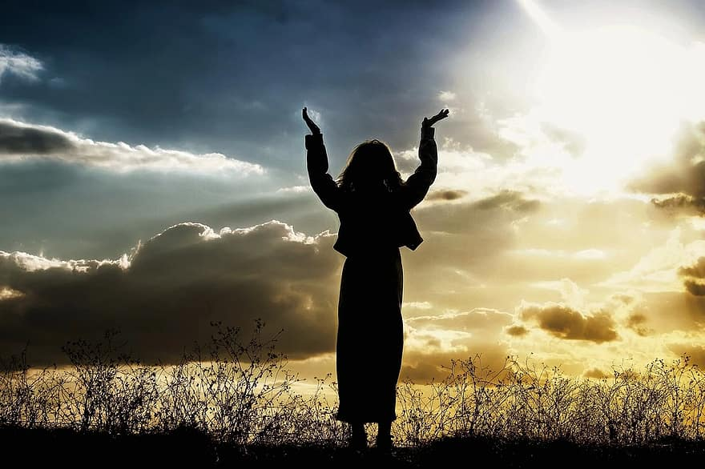
Concluding Prayer
All praise to you, God of creation.
Praise to you, holy and living God.
We praise and bless you for your mercy
We praise and bless you for your kindness.
Blessed is the Lord, our God.
Response: Blessed is the Lord, our God.
We praise you, our refuge and strength,
We bless you, our God and Redeemer.
Your praise is always in our hearts.
We remember the mighty deeds of the covenant.
Blessed is the Lord, our God.
Response: Blessed is the Lord, our God.

Slide 24
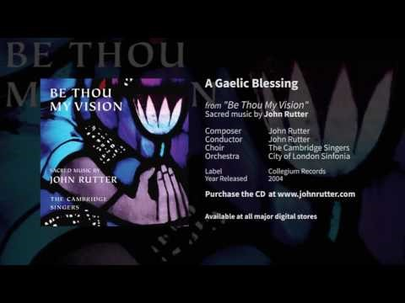
Gaelic Blessing

