Slide 2
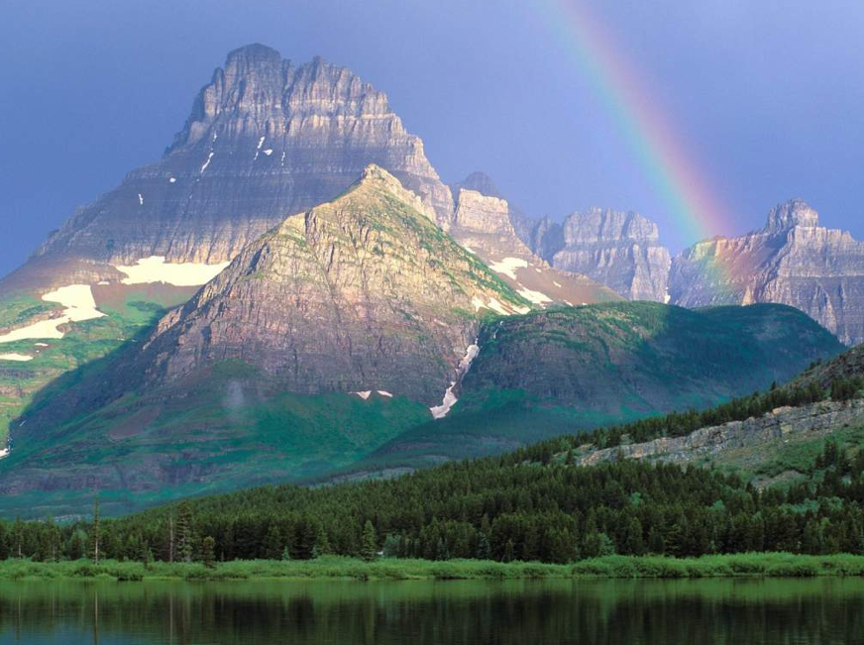
Finding God in the singing heart of the world
Towards a new spirituality of creation

Slide 3
    1. Our growing scientific understanding of the world
    and the universe has transformed our appreciation of
    what God is about in creation.
    All of this has an enormous contribution to make to
    our own spirituality and the spirituality
    of those to whom we minister.
    But it is conceptually and spiritually very challenging.
    2. The intellectual challenge it poses to spirituality.
    ‘Science’ comes packaged as it were in a materialist
    wrapping that carries a message telling us that the
    old faith too is outmoded, out of date.
    3. It is progress of the scientific enterprise that
    has facilitated the emergence of the great challenges
    we face in our time, challenges that will frame the nature
    of Christian mission in the decades, indeed centuries,
    ahead.

Slide 4
    1. Our growing scientific understanding of the world
    and the universe has transformed our appreciation of
    what God is about in creation.
    All of this has an enormous contribution to make to
    our own spirituality and the spirituality
    of those to whom we minister.
    But it is conceptually and spiritually very challenging.
    2. The intellectual challenge it poses to spirituality.
    ‘Science’ comes packaged as it were in a materialist
    wrapping that carries a message telling us that the
    old faith too is outmoded, out of date.
    3. It is progress of the scientific enterprise that
    has facilitated the emergence of the great challenges
    we face in our time, challenges that will frame the nature
    of Christian mission in the decades, indeed centuries,
    ahead.

Slide 5
It must be said that some committed and prayerful Christians, with the excuse
of realism and pragmatism, tend to ridicule expressions of concern for the environment.
Others are passive; they choose not to change their habits and thus become
inconsistent. So what they all need is an “ecological conversion”, whereby the
effects of their encounter with Jesus Christ become evident in their relationship
with the world around them. Living our vocation to be protectors of God’s handiwork
is essential to a life of virtue; it is not an optional or a secondary aspect of our
Christian experience.’
Laudato si, 217

Slide 6
[Mother Earth] … Our common home is being pillaged,
land laid waste and harmed with impunity …
Cowardice in defending it is a grave sin …
We cannot allow certain interests – interests which are
global but not universal – to take over, to dominate states
and international organisations and to continue destroying
creation.
    Address of Pope Francis to the Second
    World Meeting of Popular Movements, July 2015

Slide 7
[Mother Earth] … Our common home is being pillaged,
land laid waste and harmed with impunity …
Cowardice in defending it is a grave sin …
We cannot allow certain interests – interests which are
global but not universal – to take over, to dominate states
and international organisations and to continue destroying
creation.
    Address of Pope Francis to the Second
    World Meeting of Popular Movements, July 2015

Slide 8
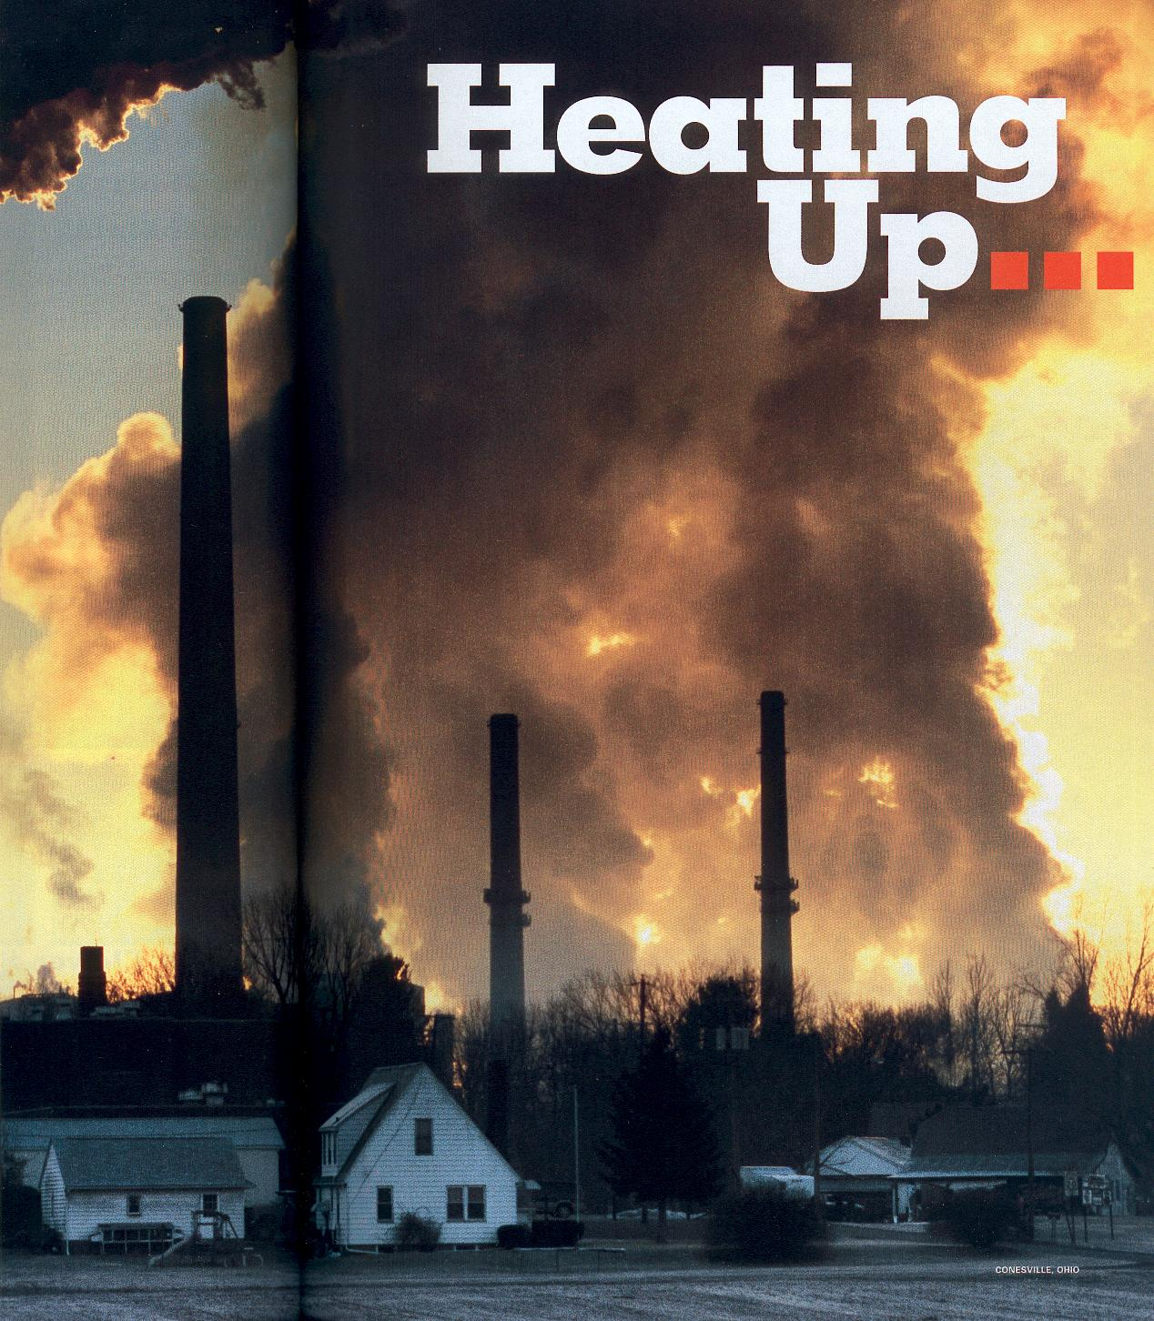
FCJ Retreat August 2015
Climate
change

Slide 9
Climate change represents one of the principal
challenges facing humanity in our day.
Laudato si, 25

Slide 10
Carbon dioxide
450 parts per million is considered the upper safe limit (500 billion tonnes more)

Slide 11
What effects has global warming had so far?
Global sea level has been rising by about 2mm a year.
Sea ice in the Arctic has almost disappeared.
In 2002 the Larsen B ice shelf collapsed into the sea.
Almost all the world’s glaciers are in retreat.
Permafrost has started to melt.
Parts of the Amazon rainforest are turning to savannah
Coral reefs are dying off.
150,000 people a year are dying as a result of climate change (as diseases spread faster at higher temperatures).
Extreme weather events have increased (they have quintupled since the 1950s).

Slide 12
Global sea level has been rising by about 2mm a year
10 – 20cm in the 20th century (more than half the rise in the preceding 1000 years)
It might rise by a further metre this century
Every 1mm rise means coastal retreat of 1.5m

Slide 13
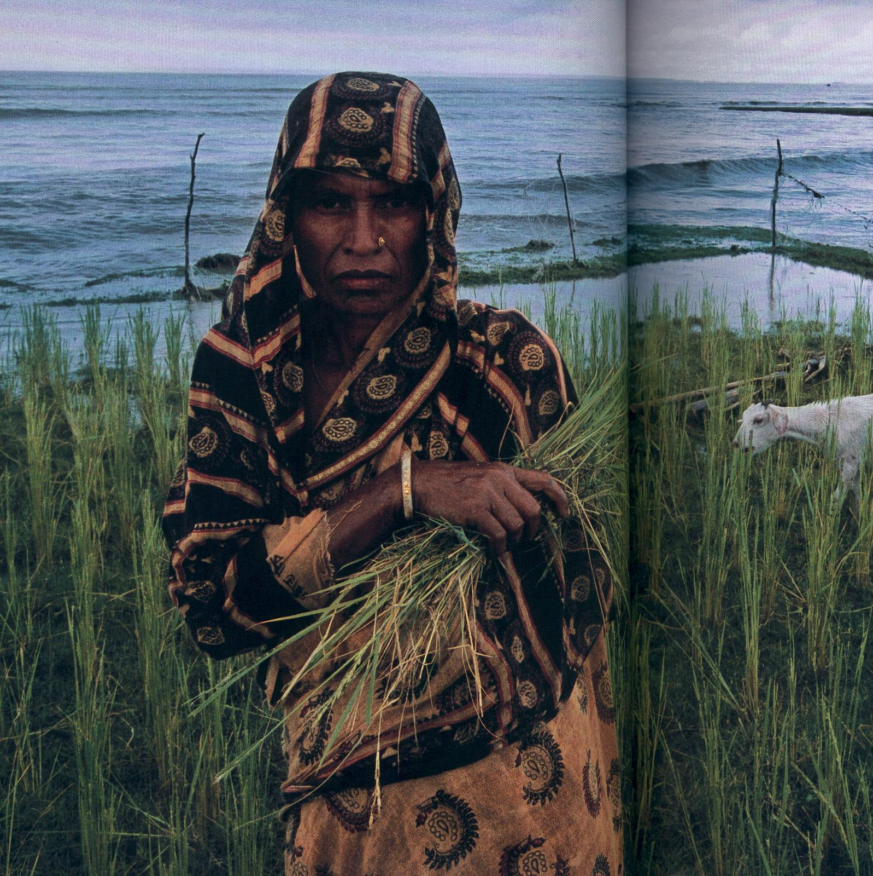
Rising sea levels will result in tens to hundreds of millions more people being flooded each year

Slide 14
The causes
Melting glaciers and thermal expansion of seawater responsible for sea level rise

Slide 15
Impacts of rising sea level
Coastal erosion
Inundation
Saltwater intrusion into soil and groundwater

Slide 16
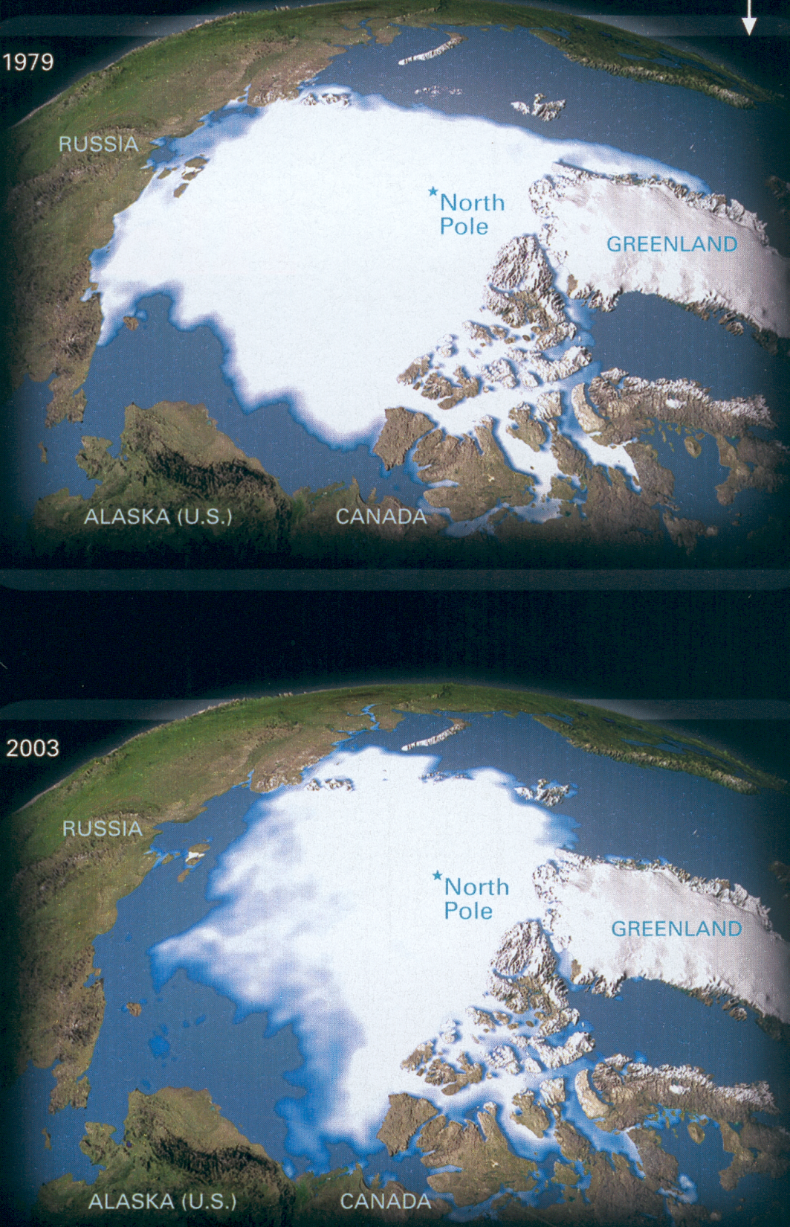
1979
Melting
glaciers
2003

Slide 17
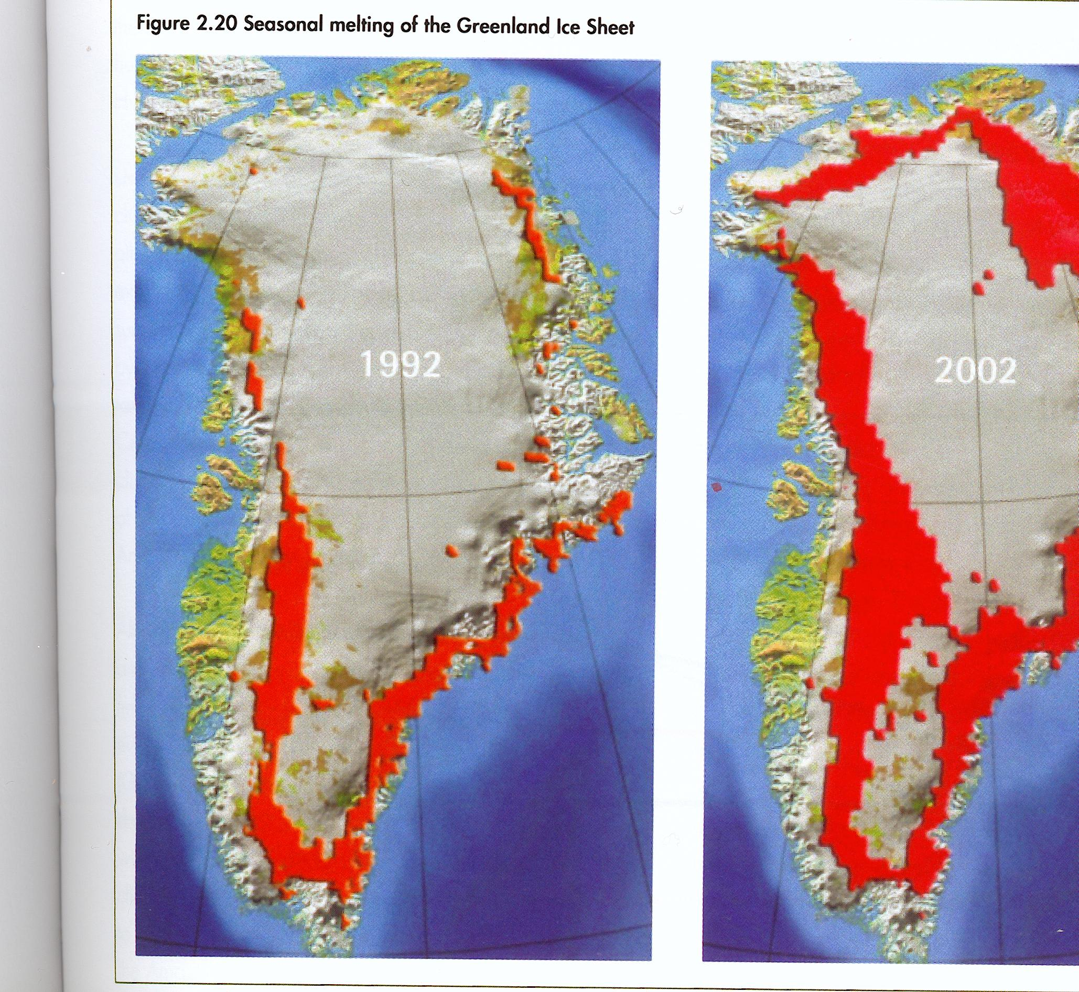

Slide 18
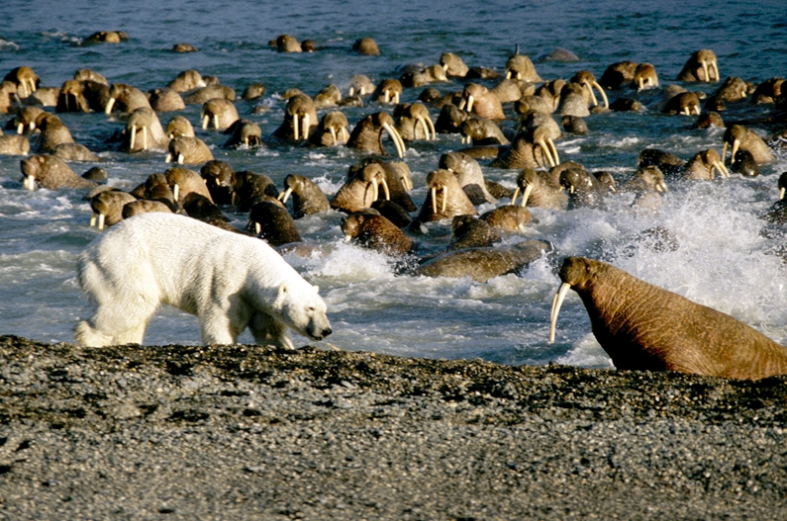
With 2° of warming, all the ice at the Arctic will melt in summer: no more polar bears, walruses or the ecosystem that supports them.

Slide 19
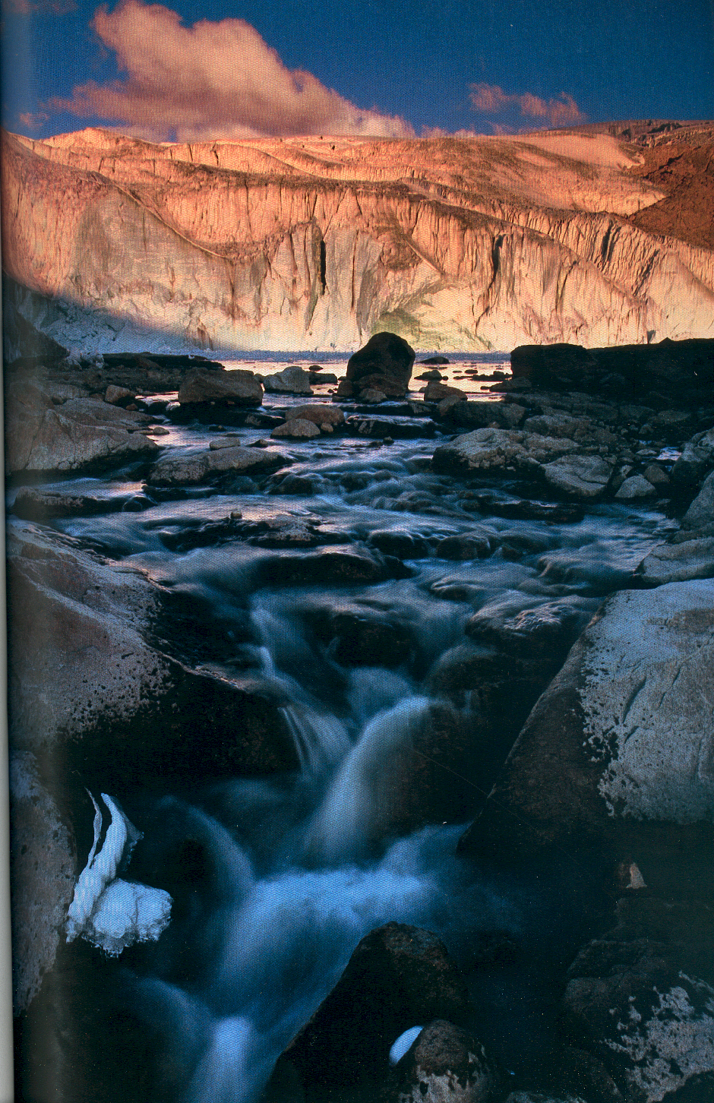
Peru’s Quelccaya
ice cap
in the Andes …
Retreating by up to 200m
a year …
All gone by 2100 …

Slide 21
… and all this with just 0.6º
The conservative consensus is that global temperatures are likely to rise by between 1.8 and 4.0° this century, with a possible maximum of 6.4°. some scientists think this way too low: that it could be up to 11.5°: very unlikely – but possible.

Slide 22
At rates higher than the minimum rise global food production will be seriously affected: entire regions will become too hot and dry to grow crops
Rice yields fall by 15 per cent for every degree of warming

Slide 23
What lies ahead?

