Slide 1
Harvesting the Fruits of the Synodal Pathway
APRIL 2022

Slide 2

INTRODUCTIONS
Your team for tonight
From the Synodal Committee
Co-leaders Fr Kieran McDermott and Patricia Carroll
Peter Siney
Mary Kirk
Kirsten Mahon
With Archbishop Dermot Farrell
Notes:
Mary/Peter
No More than five to ten minutes

Slide 3
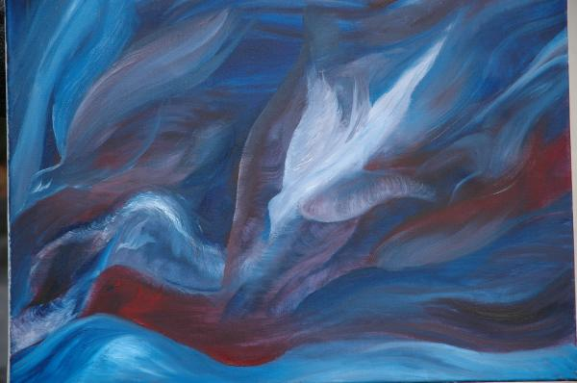
Prayer
FROM THE LETTER TO THE GALATIANS
The fruit of the Spirit is
love, joy, peace, patience,
kindness, goodness, faithfulness,
gentleness, self-control;
against such things there is no law.
If we live by the Spirit, let us also keep in step with the Spirit.
Notes:
Mary/Peter

Slide 4
Let us pray
We stand before you, Holy Spirit, as we gather together in Your name.
With You alone to guide us make Yourself at home in our hearts;
Teach us the way we must go and how we are to pursue it.
We are weak and sinful; do not let us promote disorder.
Do not let ignorance lead us down the wrong path nor partiality influence our actions.
Let us find in You our unity so that we may journey together to eternal life
and not stray from the way of truth and what is right.
All this we ask of You, who are at work in every place and time,
In the communion of the Father and the Son, forever and ever.
Amen
Notes:
Mary/Peter

Slide 5
Welcome
The process to date
Outline of the evening
  Small group sharing on your experience of your parish gatherings
  Initial soundings
  Going deeper focusing on what is emerging from parish gatherings
  Comfort break – noticing what is being said in group contributions
  In reflective mode – What is the Holy Spirit saying
  Feedback from small group
Keeping in mind that this is a moment of Spiritual Conversation together
Notes:
Led by Kieran McDermot FIVE MINUTES

Slide 6
In small groups
What was the experience of the parish gatherings like for you?
Please allow everyone to speak once before you speak twice!!
15 Minutes
Notes:
Kirsten to lead 15 MINUTES

Slide 7
Initial Soundings
For five minutes we will take some comments from groups…..
Notes:
Kirsten 5 minutes

Slide 8
Going Deeper
Nominate someone to scribe and capture the points
Focus question for this 15 minutes:
What is emerging from your gatherings?
Notes:
Kirsten 15 Minutes

Slide 9
COMFORT BREAK
Take time to reflect on the feedback from all the groups
by walking around the room and reading responses.
Quiet music will play
to hold the reflective quiet environment.
Notes:
Patricia to lead this 15 minutes

Slide 10
What’s the Spirit indicating
A moment of silence
Get in touch with what you are noticing
Share what you feel the Holy Spirit is saying in this?
Notes:
Patricia to lead 15 minutes

Slide 11
FEEDBACK FROM GROUPS
The note taker from each group is invited to share the insights emerging
We listen to understand
Notes:
Kieran and Kirsten take feedback, Patricia types up on screen 30 Minutes

Slide 12
THANK YOU and NEXT STEPS
Thank you for
Sharing so well
Trusting the process
Being open to the Holy Spirit
Animating your parish group and giving of your time and talent
We are now in the Collation stage
16 Synod readers will read these taking a deanery overview
Diocesan Report will be in final form by 29th May
Sent to Irish Bishops Conference
All moving towards 18th June synodal gathering of delegates to synthesise the National Report
Goes to Rome for the 2023 Synod on Synodality
Notes:
Kirsten and Kieran

Slide 13
FINAL PRAYER MOMENT
Archbishop Dermot Farrell

