Slide 1
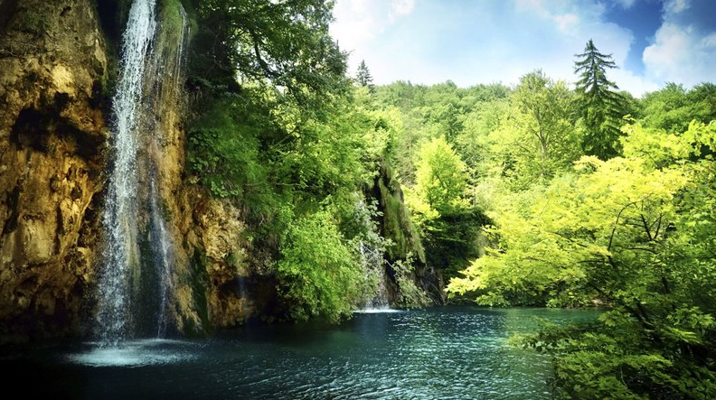
TEACHING THE ENCYCLICAL
LAUDATO SI IN THE CLASSROOM
John Feehan
The universe unfolds in God,
who fills it completely.
There is a mystical meaning in every creature,
every aspect of reality.
Laudato si, 233

Slide 2
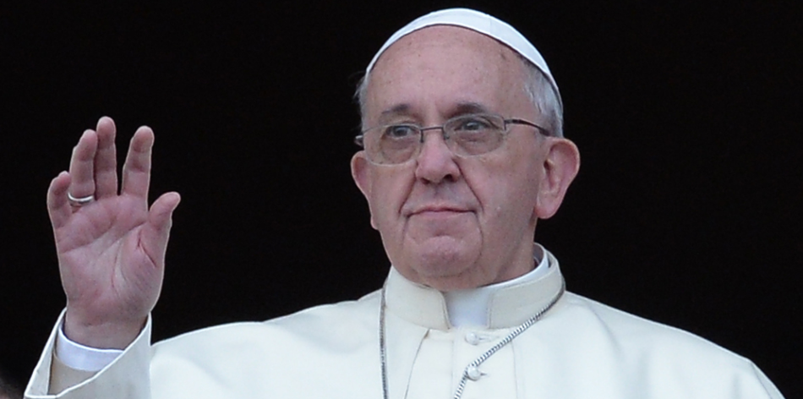
‘The ecological crisis is a summons to profound interior conversion.’
‘Living our vocation to be protectors of God’s handiwork is essential to a life of virtue; it is not an optional or a secondary aspect of our Christian experience.’
‘It must be said that some committed and prayerful Christians,
with the excuse of realism and pragmatism, tend to ridicule
expressions of concern for the environment. Others are passive;
they choose not to change their habits and thus become inconsistent.
So what they all need is an
“ecological conversion”, whereby
the effects of their encounter with
Jesus Christ become evident in
their relationship with the world
around them.’
Laudato si, 217

Slide 3
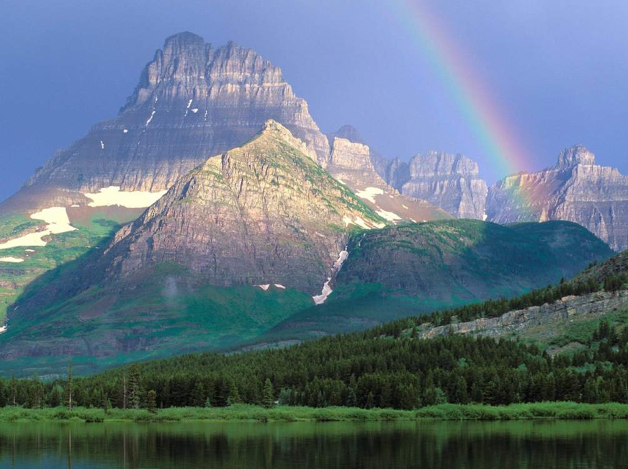
[Mother Earth] … Our common home is being pillaged,
land laid waste and harmed with impunity …
Cowardice in defending it is a grave sin …
We cannot allow certain interests – interests which are
global but not universal – to take over, to dominate states
and international organisations and to continue destroying
creation.
    Address of Pope Francis to the Second
    World Meeting of Popular Movements, July 2015

Slide 4
[Mother Earth] … Our common home is being pillaged,
land laid waste and harmed with impunity …
Cowardice in defending it is a grave sin …
We cannot allow certain interests – interests which are
global but not universal – to take over, to dominate states
and international organisations and to continue destroying
creation.
    Address of Pope Francis to the Second
    World Meeting of Popular Movements, July 2015

Slide 5
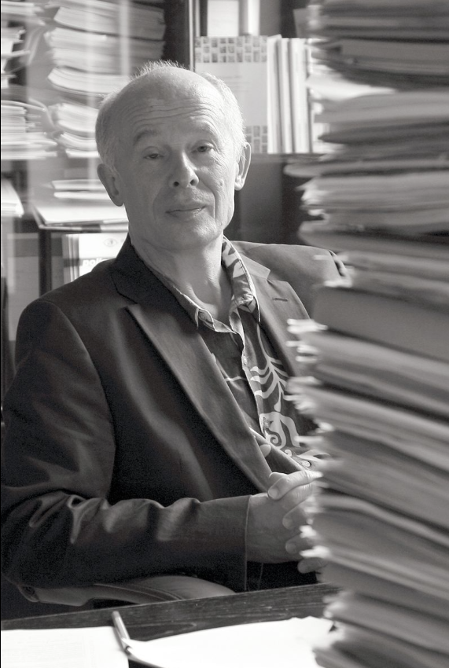
John Schellnhuber

Slide 6
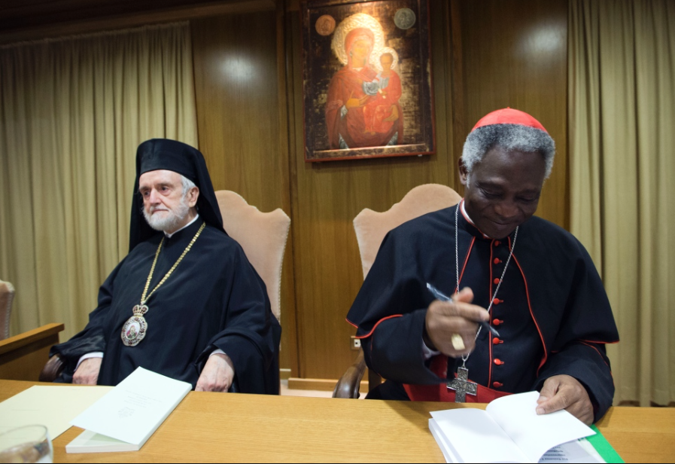

Slide 13
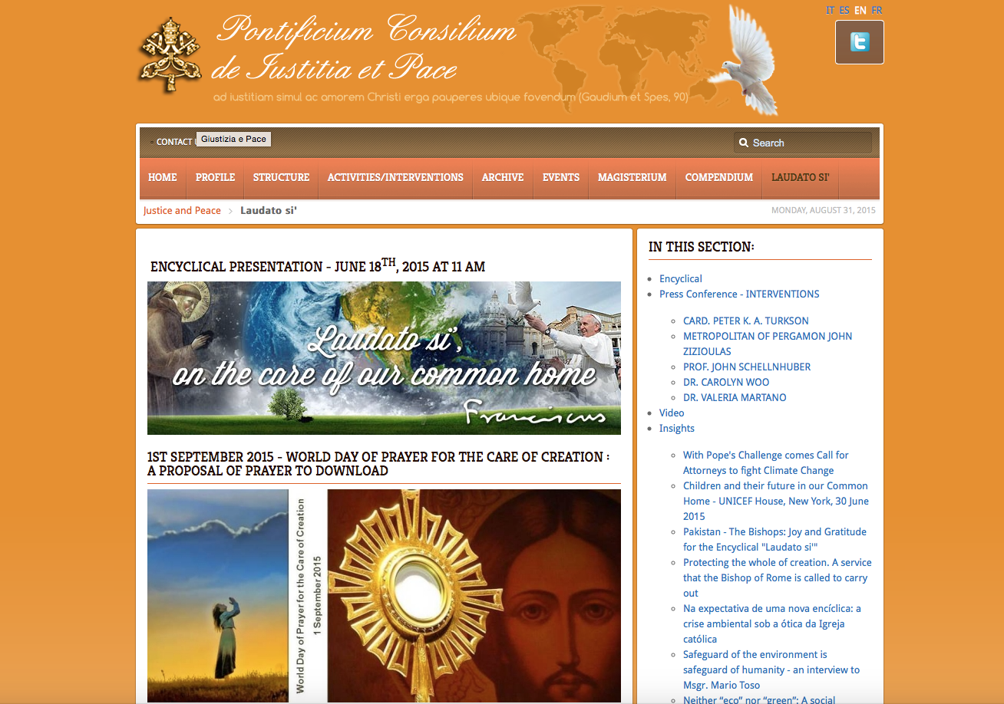

Slide 14
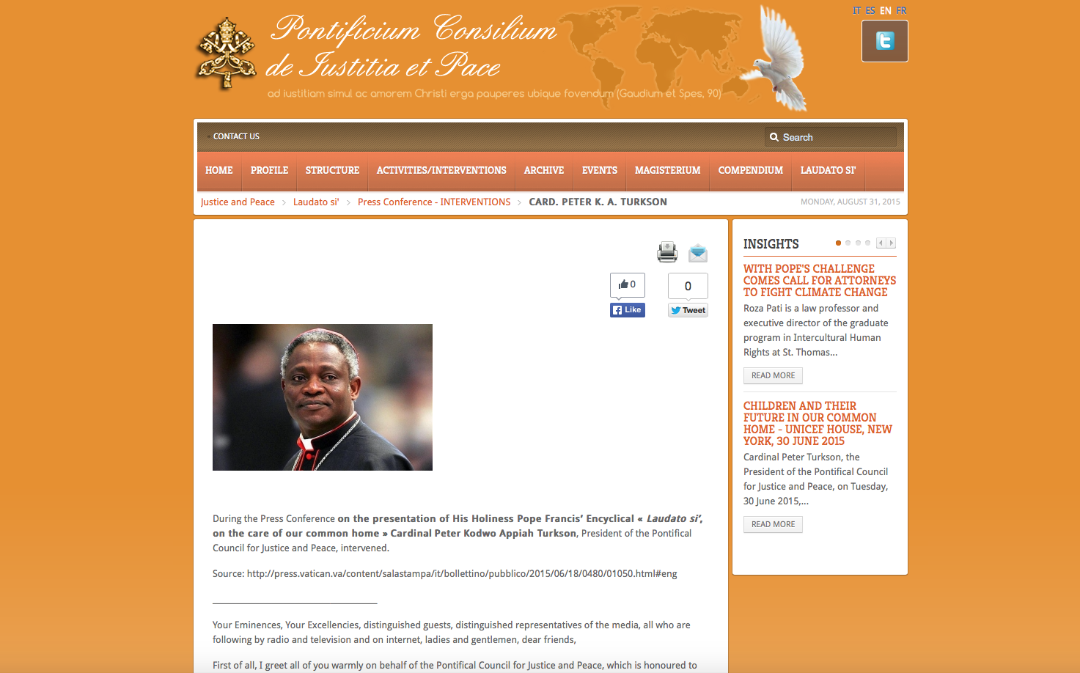

Slide 15
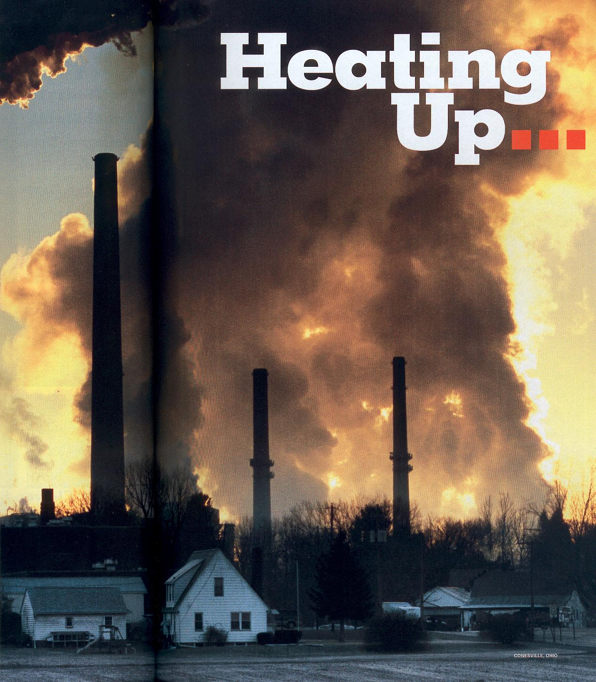
Climate change represents one of the principal
challenges facing humanity in our day.
Laudato si, 25

Slide 16
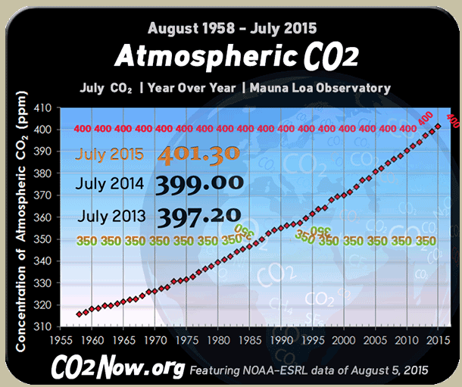

Slide 17
What effects has global warming had so far?
Global sea level has been rising by about 2mm a year.
Sea ice in the Arctic has almost disappeared.
In 2002 the Larsen B ice shelf collapsed into the sea.
Almost all the world’s glaciers are in retreat.
Permafrost has started to melt.
Parts of the Amazon rainforest are turning to savannah
Coral reefs are dying off.
150,000 people a year are dying as a result of climate change (as diseases spread faster at higher temperatures).
Extreme weather events have increased (they have quintupled since the 1950s).

Slide 18
Global sea level has been rising by about 2mm a year
10 – 20cm in the 20th century (more than half the rise in the preceding 1000 years)
It might rise by a further metre this century
Every 1mm rise means coastal retreat of 1.5m

Slide 19
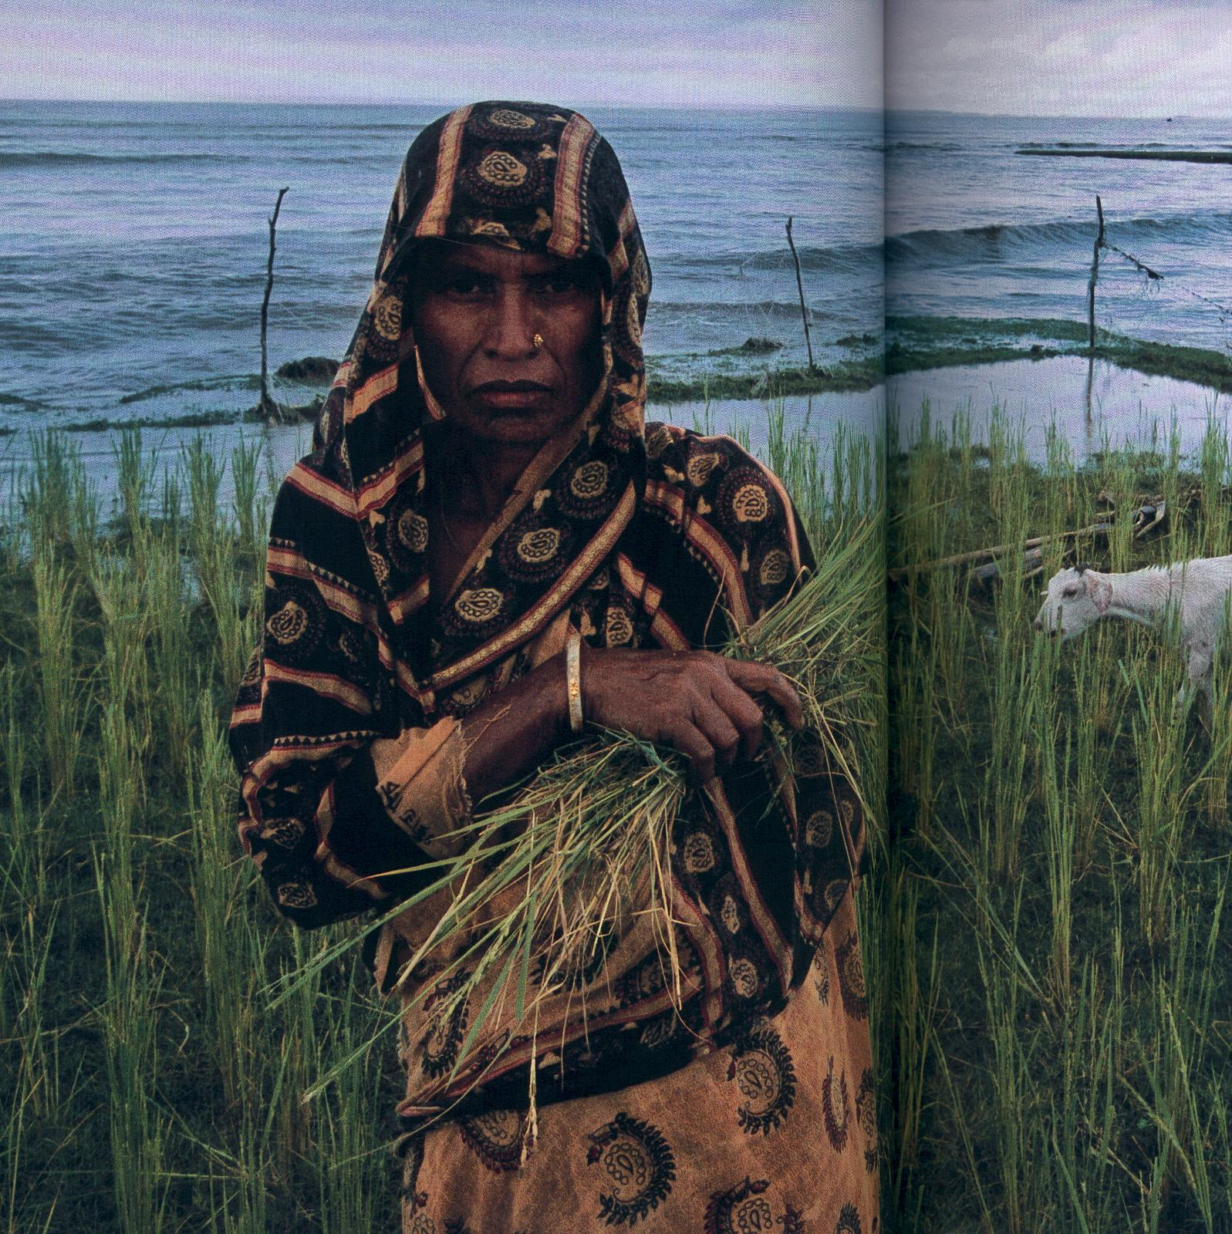
Rising sea levels will result in tens to hundreds of millions more people being flooded each year

