Slide 1
The causes
Melting glaciers and thermal expansion of seawater responsible for sea level rise

Slide 2
Impacts of rising sea level
Coastal erosion
Inundation
Saltwater intrusion into soil and groundwater

Slide 3
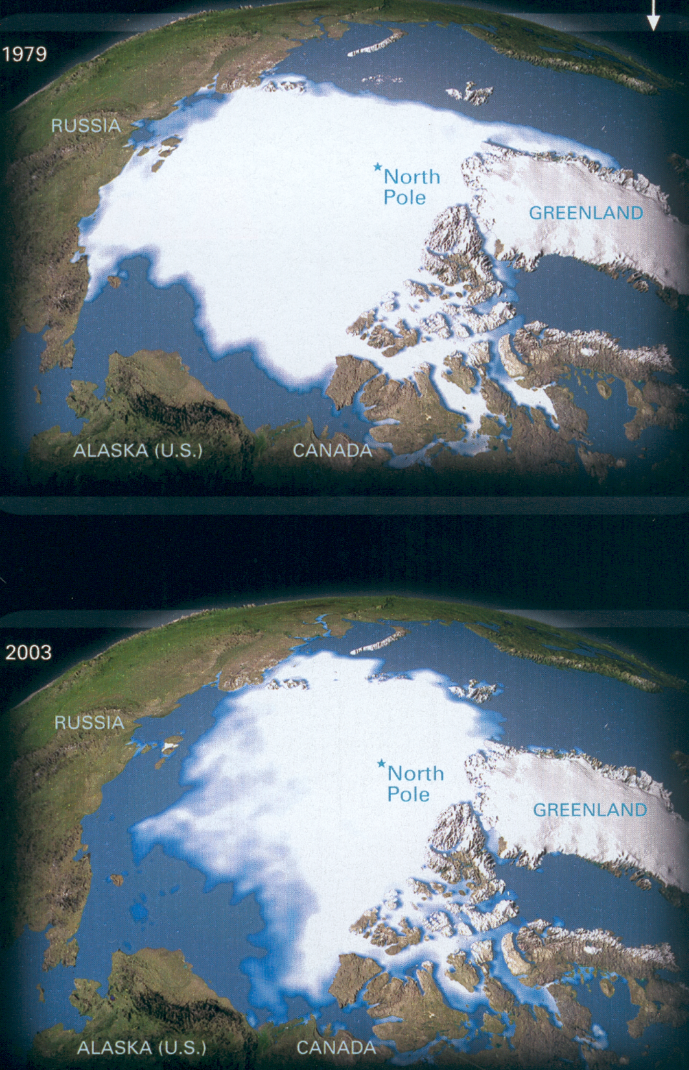
1979
Melting
glaciers
2003

Slide 4
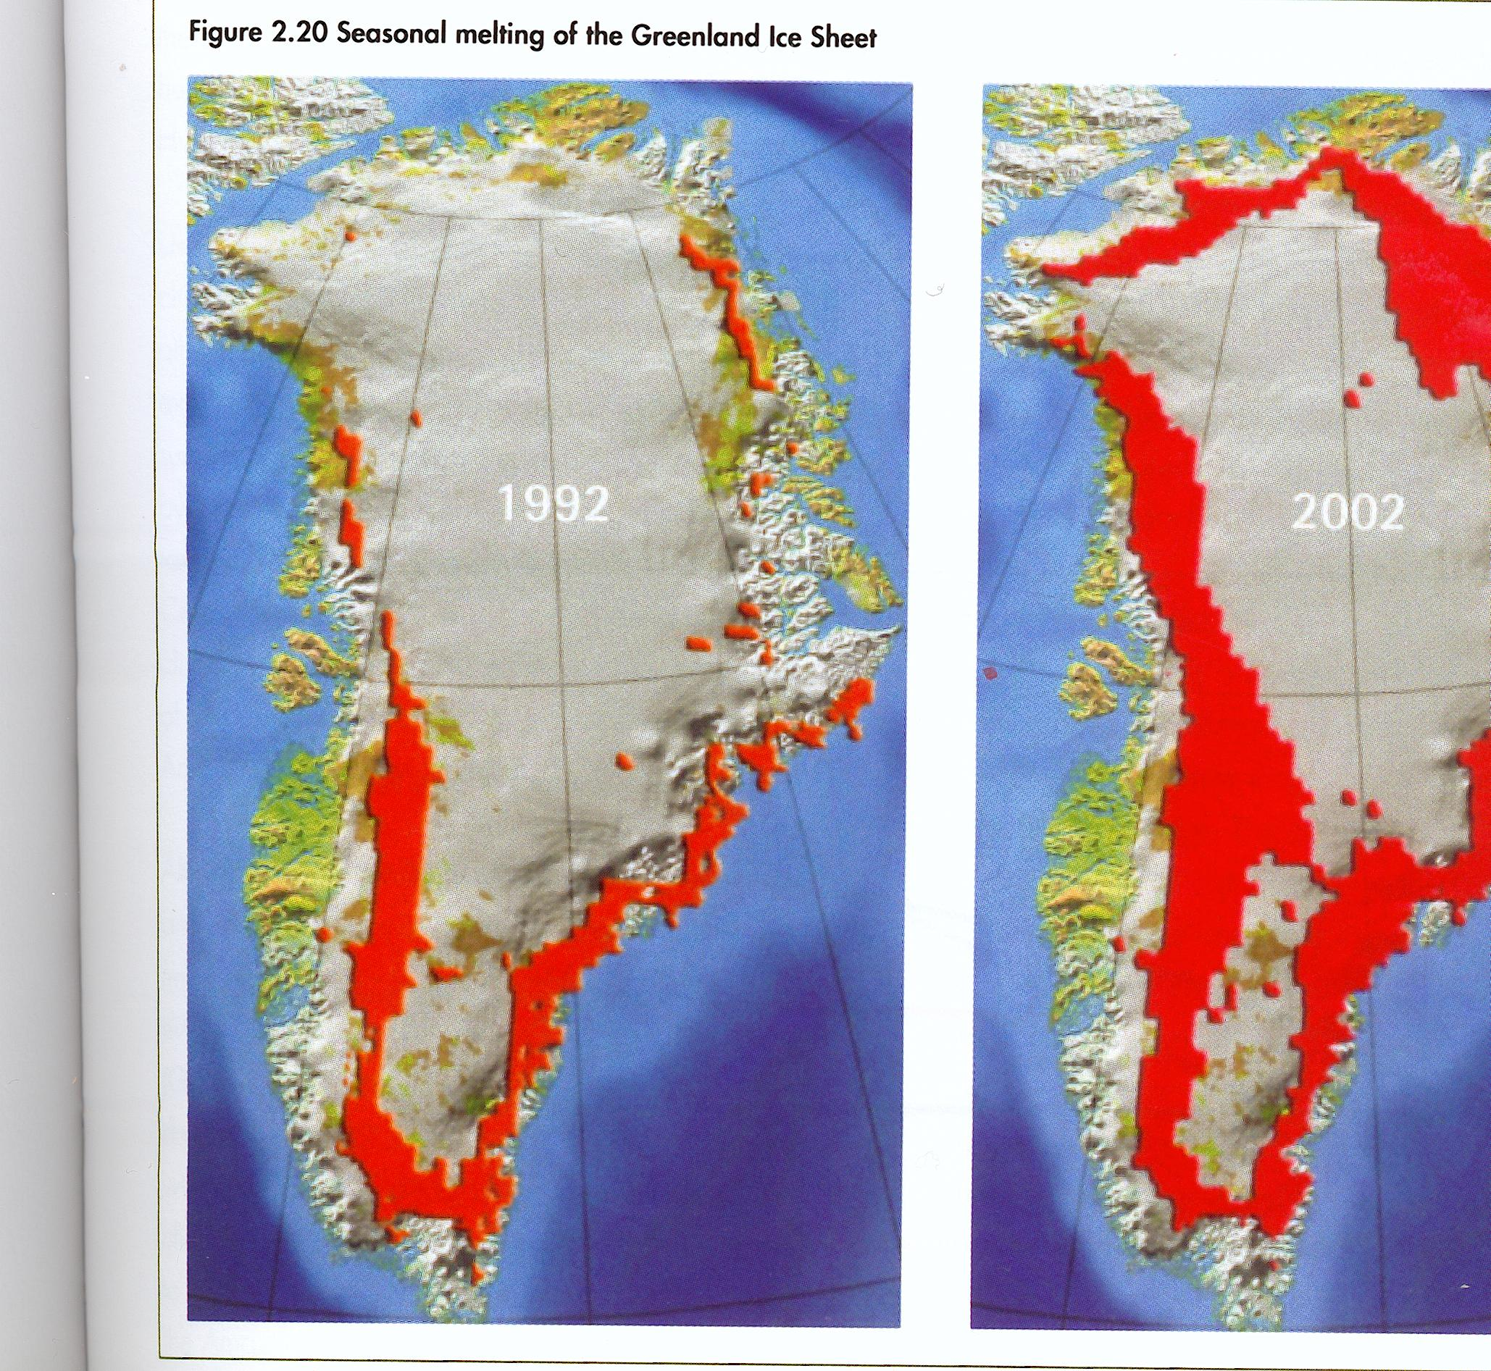

Slide 5
With 2° of warming, all the ice at the Arctic will melt in summer: no more polar bears, walruses or the ecosystem that supports them.

Slide 6
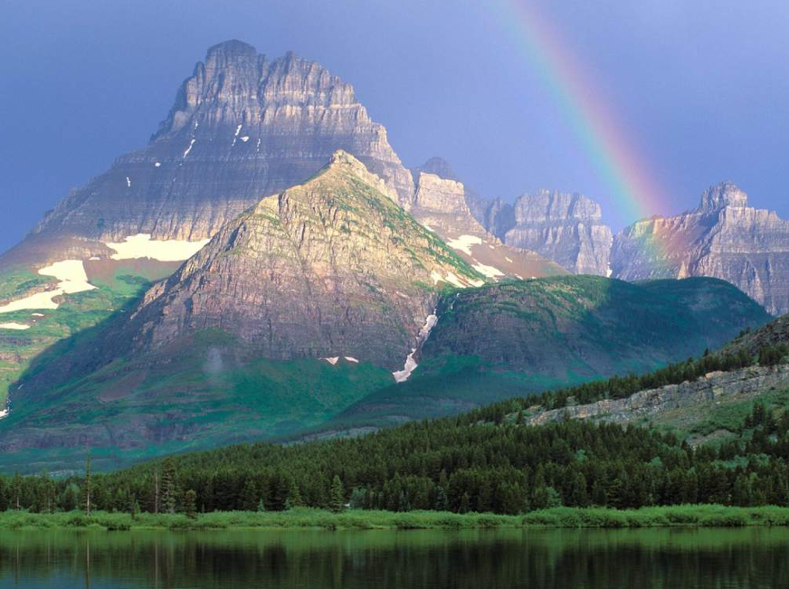
Peru’s Quelccaya
ice cap
in the Andes …
Retreating by up to 200m
a year …
All gone by 2100 …

Slide 7
… and all this with just 0.6º
The conservative consensus is that global temperatures are likely to rise by between 1.8 and 4.0° this century, with a possible maximum of 6.4°. some scientists think this way too low: that it could be up to 11.5°: very unlikely – but possible.

Slide 8
At rates higher than the minimum rise global food production will be seriously affected: entire regions will become too hot and dry to grow crops
Rice yields fall by 15 per cent for every degree of warming

Slide 9
A taste of what is to come? The Chicago heat wave of 1995
Temperatures of 38-41°C on five consecutive days
Chicago is in the centre of the US corn belt
The intense heat shrank the US corn harvest that year by 15%
= 3 billion dollars

Slide 10
What lies ahead?
A 2.1° rise will expose between 2.3 and 3 billion people to the risk of water shortages.
Soils will become a net source of carbon rather than a net sink.
The proportion of land experiencing extreme drought is predicted to rise from 3 per cent today to 30 per cent: with consequent crop reductions
The thermohaline circulation (THC) could weaken or shut down.

Slide 11
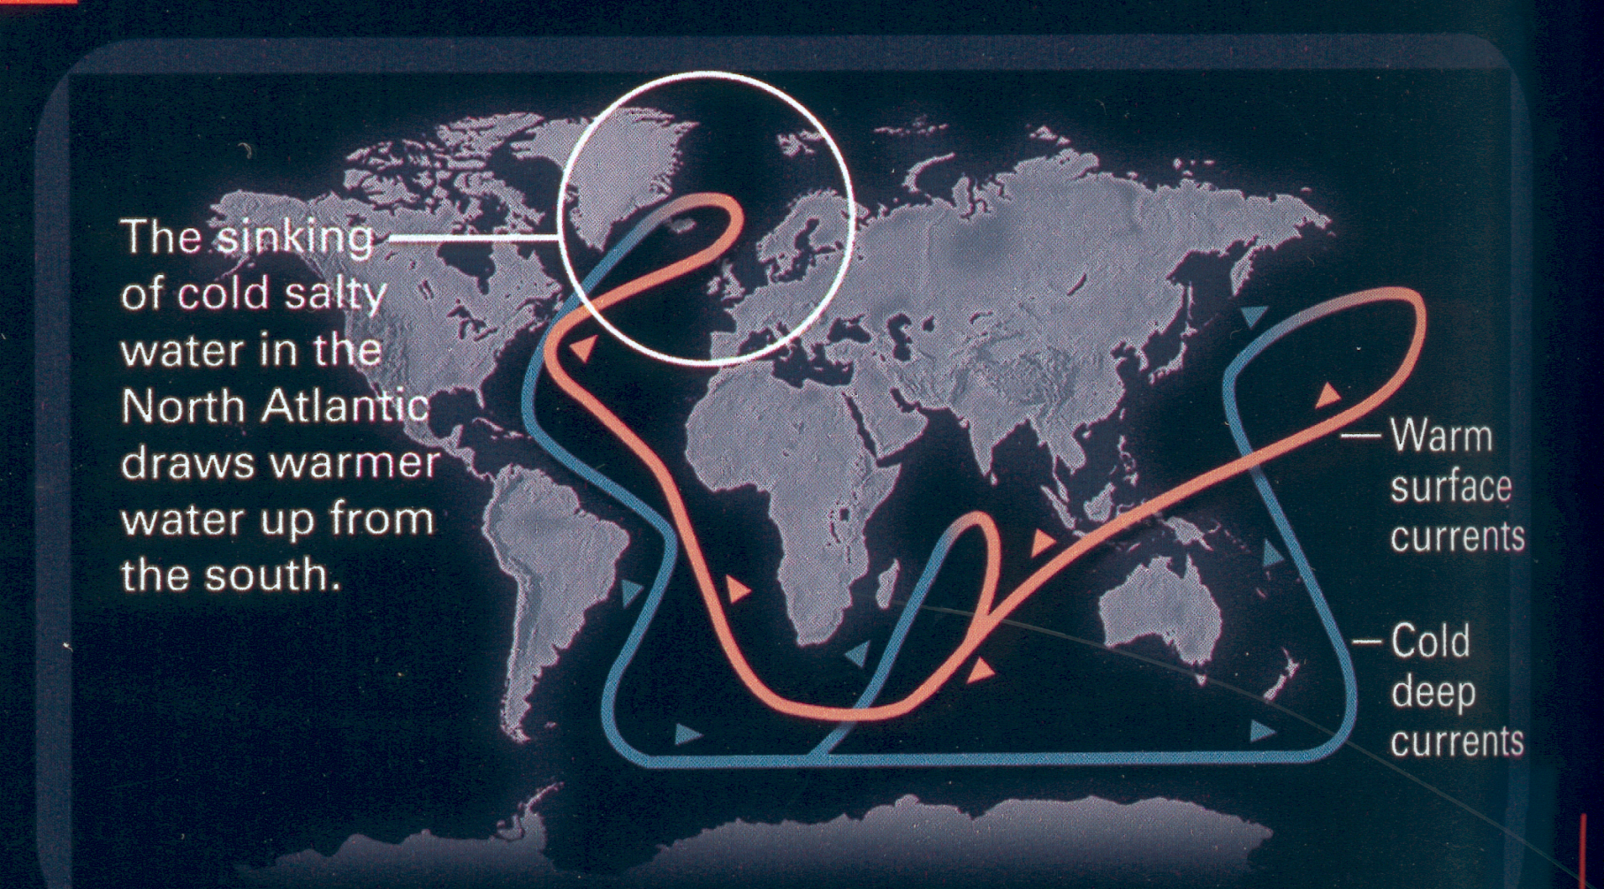
The Global Ocean Circulation System
The day after tomorrow … ?

Slide 12
What lies ahead?
- A rise in the middle of the expected range commits 15 to 37 per cent of the world’s species to extinction by 2050.
- At 1.4° coral reefs in the Indian Ocean will become extinct.
- With 2° 97 per cent of the world’s coral reefs will bleach.
- The oceans will acidify (from 8.2 to 7.7 by century’s end): too acid for sea creatures – including plankton – to make shells.

Slide 13
What lies ahead?
Even a small degree of warming could cause the loss of much of the Amazon rain forest, leading to the disappearance of rainfall.
The Amazon has the potential to release 730 tonnes of carbon – about 10 per cent of man-made emissions – every year for 75 years (this is an example of positive feedback: climate change accelerating itself).

Slide 14
What lies ahead?
- Rising sea levels will allow salt water to pollute the drinking water of some of the world’s largest coastal cities: Shanghai, Manila, Jakarta, Bangkok, Kolkata, Mumbai, Karachi, Lagos, Buenos Aires and Lima.

Slide 15
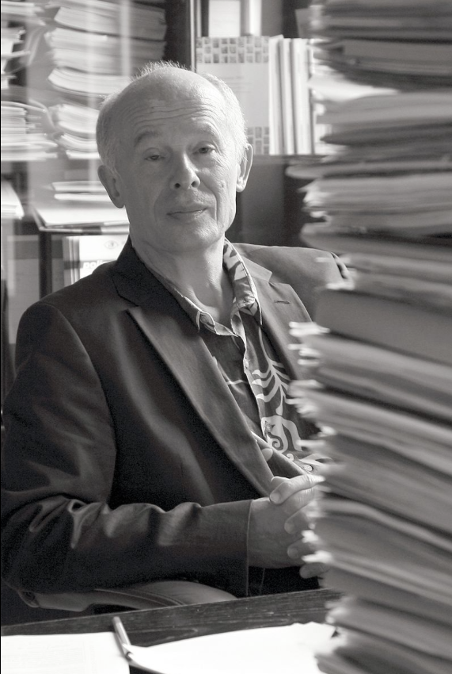
‘To avoid disaster we need to cut emissions by 5% by 2050, and by 80-90% and phased out completely in developed economies
by the end of the century.’

Slide 16
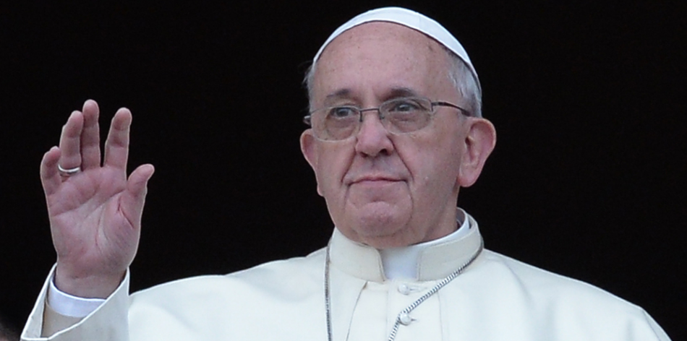
‘Humanity is called on to recognize
the need for changes in lifestyle,
production and consumption, in order
to combat this warming or at least
the human causes which produce or
aggravate it.’
Laudato si, 165

Slide 17
‘The pace of consumption, waste and environmental change
has so stretched the planet’s capacity that our contemporary lifestyle,
unsustainable as it is, can only precipitate catastrophes, such as those
which even now periodically occur in different parts of the world.’
Laudato si, 161

Slide 19
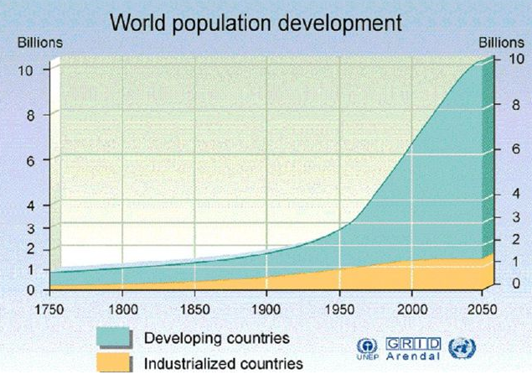

Slide 20
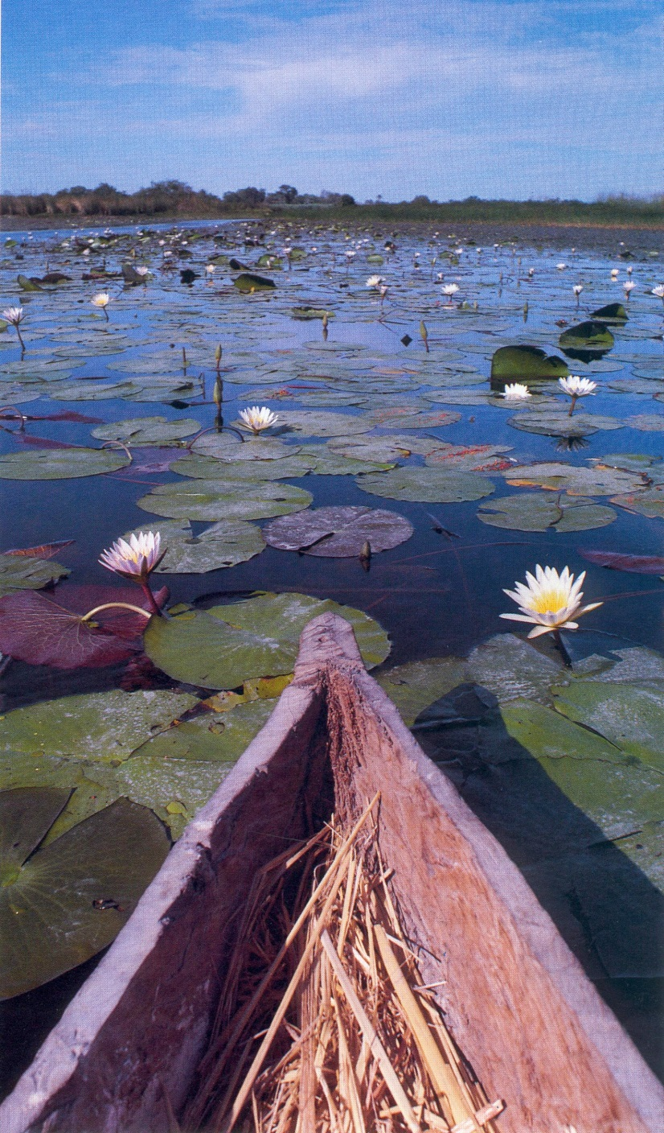
Water is the new gold:
Global consumption is doubling every 25 years

Slide 21
Access to safe, drinkable water is a basic and universal human
right, since it is essential to human survival and, as such, is a
condition for the exercise of other human rights.’
Laudato si, 30.
Unusual in being italicised. Pope Francis also alerts us to the
danger of multinational business taking control of water.

Slide 22
Every year 80 million extra people need water – as supply shrinks
By 2050:
– India will have 563 million more people
– China will have 187 million more people
– Pakistan will have 200 million more people (one of the world’s most arid countries, with 141 million today)
– Egypt, Iran, Mexico: 50% population increase in each

Slide 23
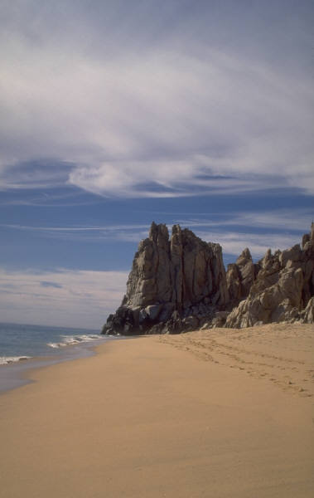
A water-challenged world
400 of China’s 600 cities are in severe drought.
The same is true of 22 countries in Africa.
In Mexico City and Arizona there is no water left.
If things go on as they are, by 2025 two-thirds of the world will have little water.

Slide 24
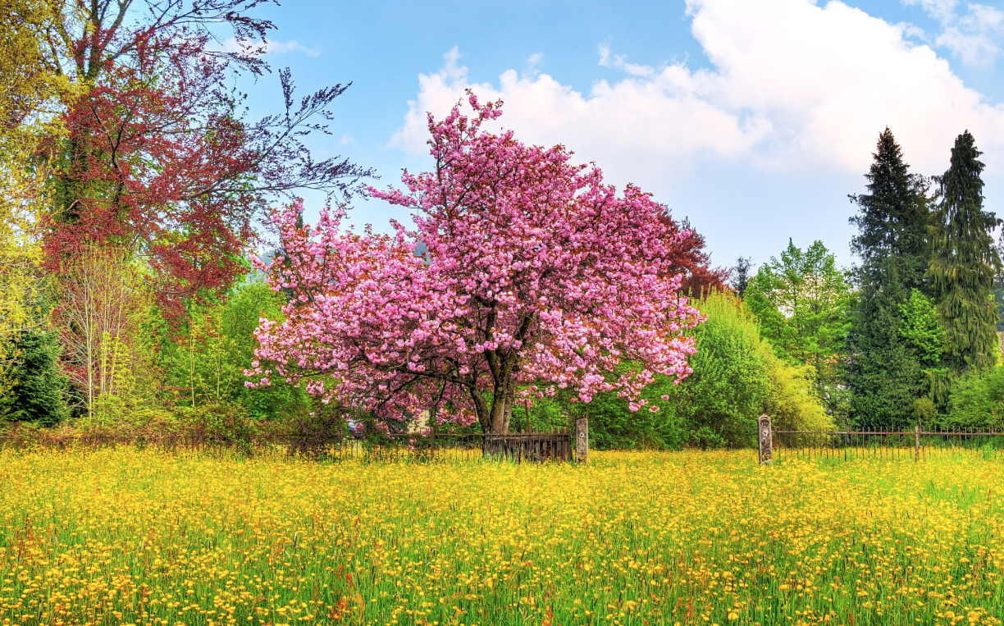
The fading rainbow of life on earth …

