Slide 1
LITURGY TUESDAYS 1
Ashes to Ashes – Pat O’Donoghue
Chat
Trócaire Resources – Mary Coogan
Chat
Lenten Retreat – Damian McNeice
Chat

Slide 2
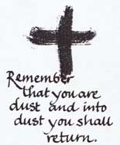
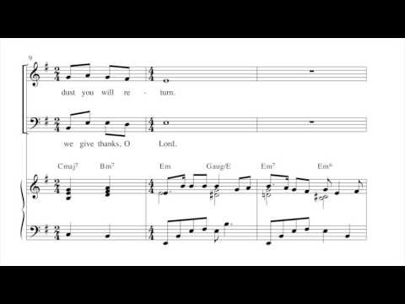
Ashes Refrain – Paul Tate

Slide 3
Bishop Mario Grech
Secretary General of the Synod of Bishops

Slide 4
Ministry during Covid – A Reflection
We need to reflect, to question ourselves about
the richness of lay ministries in the Church,
to understand if and
how they have expressed themselves.

Slide 5
Reconciliation/Word of God
I find it curious that many people have complained
about not being able to receive communion
and celebrate funerals in church,
but not as many have worried about
how to reconcile with God and neighbour,
how to listen to and celebrate the Word of God
and how to live out a life of service.

Slide 6
The Real Presence
Paul VI wrote that in the Eucharist
“the presence of Christ is ‘real’
not by exclusion,
as if the others were not ‘real.’

Slide 7
Look at Service
Concerning service, here’s a thought:
Didn’t those doctors and nurses
who risked their lives to stay close to the sick
transform the hospital wards into other “cathedrals”?

Slide 8
Sacristy Church
Service to others in their daily work,
plagued by the demands of the health emergency
was for Christians an effective way of expressing their faith,
of reflecting a Church present in today’s world,
and no longer a “sacristy Church,”
withdrawn from the streets,
or content to project the sacristy into the street.

Slide 9
Family Church
In the Acts of the Apostles we have a detailed description
of the family Church, the domus ecclesiae:
“Day by day, as they spent much time together in the temple,
they broke bread at home and ate their food with glad and generous
hearts” (Acts 2:46).

Slide 10
Created in Love
There have been some families who,
in this time of restrictions, proved to be,
on their own initiative, “creative in love”.
This has included the way parents
accompanied their youngsters
in forms of home-schooling,
the help offered to the elderly, combating loneliness,
to the creation of spaces for prayer,
and being available to the poorest.

Slide 11
4th Century Blues
Theology and the value of pastoral care
in the family seen as domestic Church
took a negative turn in the fourth century,
when the sacralisation of priests and bishops took place,
to the detriment of the common priesthood of baptism,
which was beginning to lose its value.

Slide 12
Domestic
The more the institutionalisation of the Church advanced,
the more the nature and charism of the family
as a domestic Church diminished.

Slide 13
Reflection
How might this reflection influence the decisions you will make about Ash Wednesday?

Slide 14
Ash Wednesday 2021
What will we do?
Blessed ashes in plastic with prayer card included
In Church or Delivered to Door
Blessing online of ashes/earth for people at home
Blessing of ashes/earth with Holy Water
Administered by someone in the ‘Bubble’

Slide 15
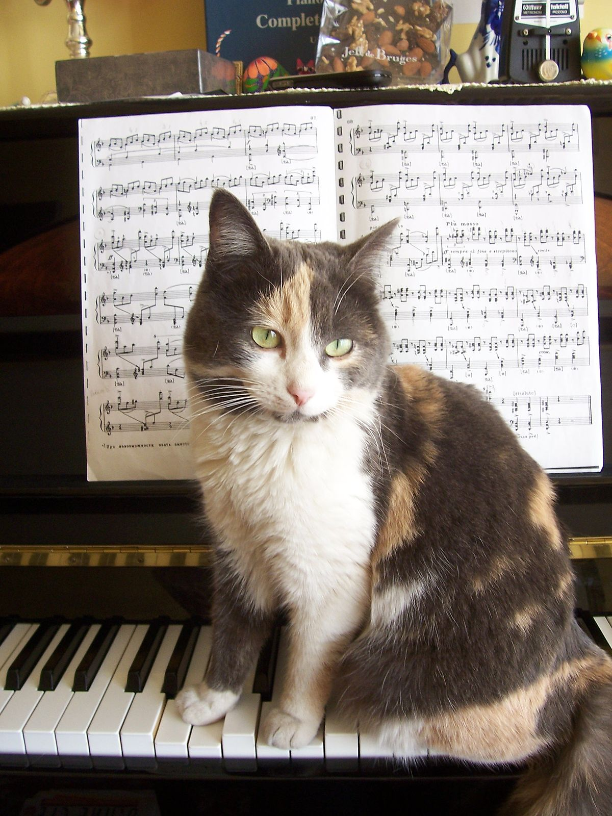
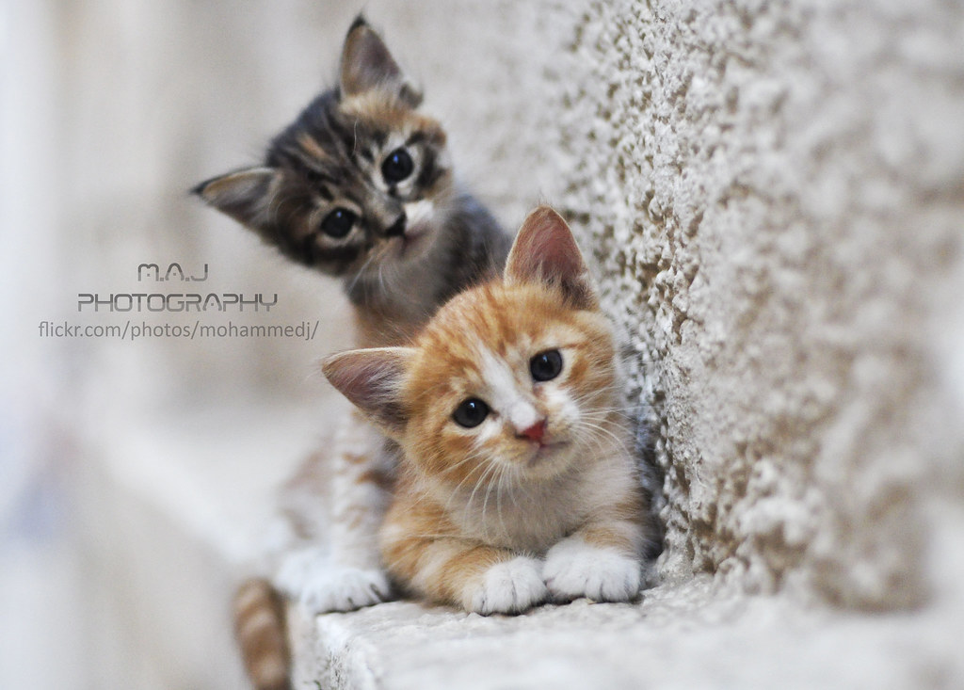
LET’S CHAT

Slide 16
Closing Prayer
Prayer for Peace
As we move through the Lenten time, the time when we contemplate Jesus in the desert, pray for the people of South Sudan and pray for peace here. Accompany us, hold our hands, hold the hands of the Church in South Sudan. Hold the hands of our brothers and sisters in South Sudan, walk with us during this Lenten time.
Through Christ our Lord, Amen.
Father James Oyet Latansio- South Sudan

