Slide 1
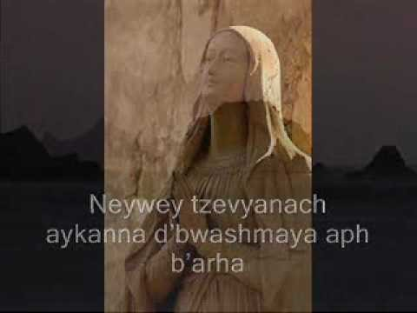
The Lord’s Prayer – Syrian Aramaic

Slide 2
Music and Art
Reconciliation Service

Slide 3
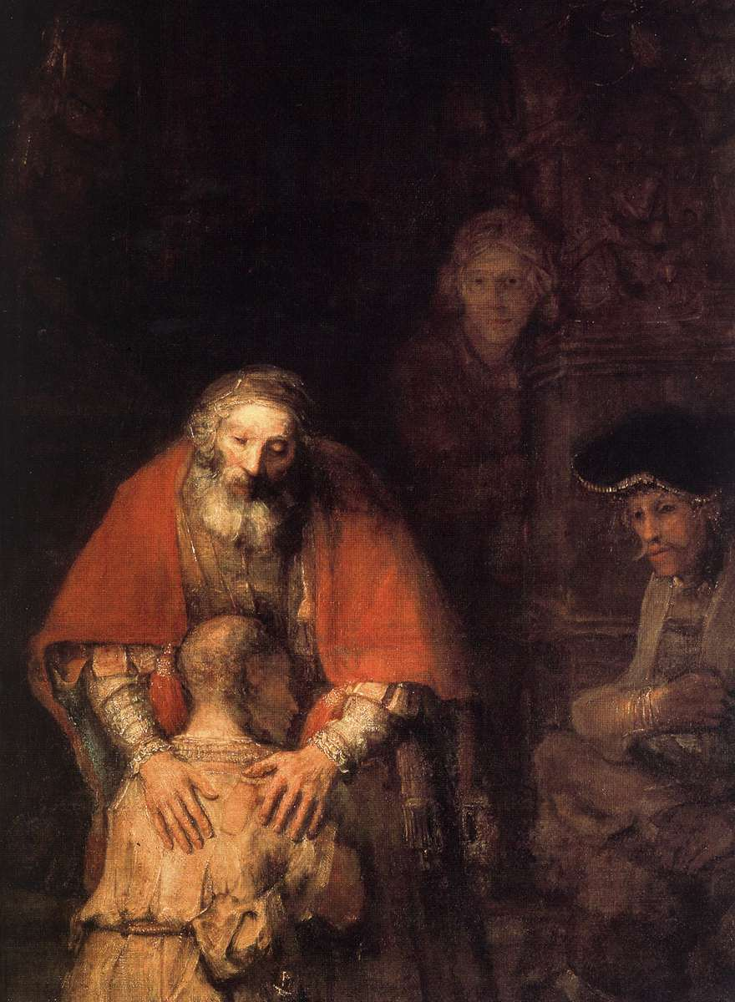
The Prodigal Hands - Rembrandt

Slide 4
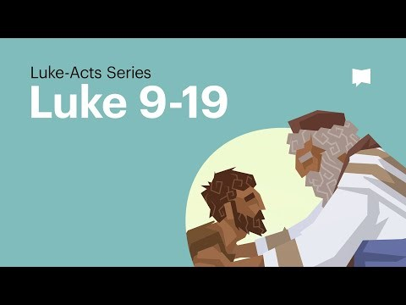
The Prodigal Story

Slide 5
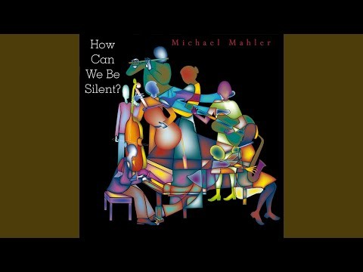
Give Us Your Peace- Michael Mahler

Slide 6
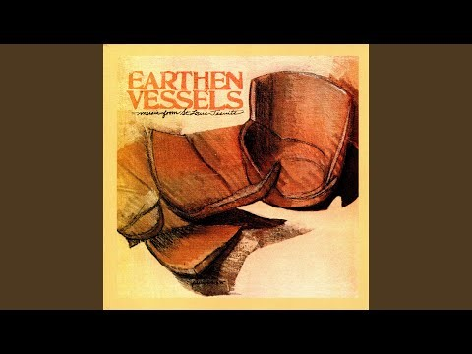
My Son Has Gone Away

Slide 7
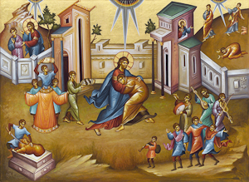
The Prodigal Icon

Slide 8
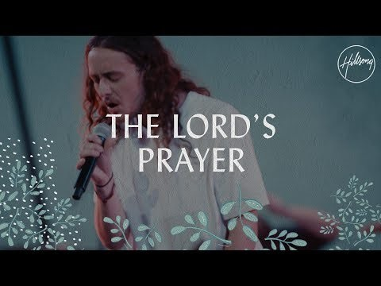
The Lord’s Prayer – Hillsong Music

Slide 9
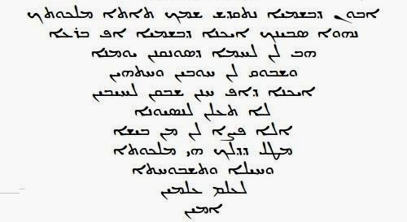
The Lord’s Prayer (Syriac/Aramaic)

Slide 10


Slide 11
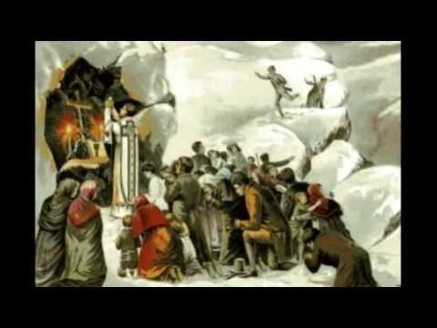
Ár nAthair – Seán Ó Riada

