Slide 1
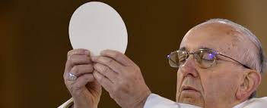
PARISH PARENT HELPS 4
Preparing as a Family for First Communion

Slide 2
Remember that HE IS WITH YOU
When we gather in your name YOU ARE WITH US
When we listen to your word YOU ARE WITH US
When we give you thanks and praise YOU ARE WITH US
When we help someone in need YOU ARE WITH US
When we ask for your forgiveness YOU ARE WITH US
When we place our trust in you YOU ARE WITH US

Slide 3
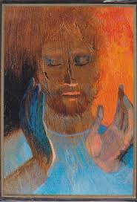
REFLECT FOR YOURSELF
What words strike you in this prayer?
How do you feel God is with you in your family life?

Slide 4
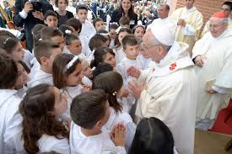
HOLY COMMUNION: IT’S ALWAYS SPECIAL
What makes First Holy Communion so special for your family?
After this celebration is over, what kind of support would you need to help you and your family continue your journey of faith together?

Slide 5

CONTINUING THE JOURNEY OF FAITH
Here are simple ways your family can continue the journey
1. Try to find time at home to remember God in prayer. This could be done at mealtimes and bedtime.
2. Encourage your child to light a candle at home and when they come to Church.
3. When you are at Mass encourage your child to join in.
4. Help your child to find their place in the parish by taking part in ministries like altar serving or choir.
5. Remember special family anniversaries and invite the children to pray often for those are no longer with us.
6. Help your child to say prayers of thanks to God when something good happens in their lives.
7. Display the First Communion pictures in a special place and have chats about how Jesus is with us on our journey.
8. Take time once a week to take part in the Home Activities from GROW IN LOVE with your child.

Slide 6
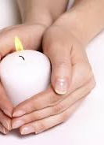
LISTEN TO THESE WORDS OF SCRIPTURE
‘Let the children come to me,
and don’t hold them back
because the Kingdom of God is theirs.’ Luke 18:16
Light a candle for your child,
giving thanks for the gift of their life.
As you light your candle ask for the grace to walk
with your child on their unique journey of faith.

Slide 7
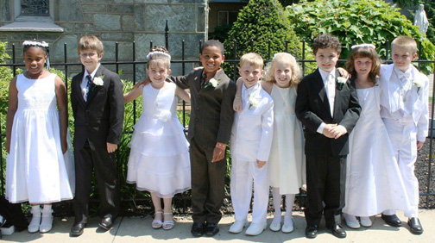
YOU CAN CONTINUE TO HELP YOUR CHILD
By praying at home with your child
Remembering the special day of First Holy Communion every time you are at Mass
By having conversations about faith at home
Displaying symbols of faith
Renewing your own faith in God by living a life of love and service

