Slide 1
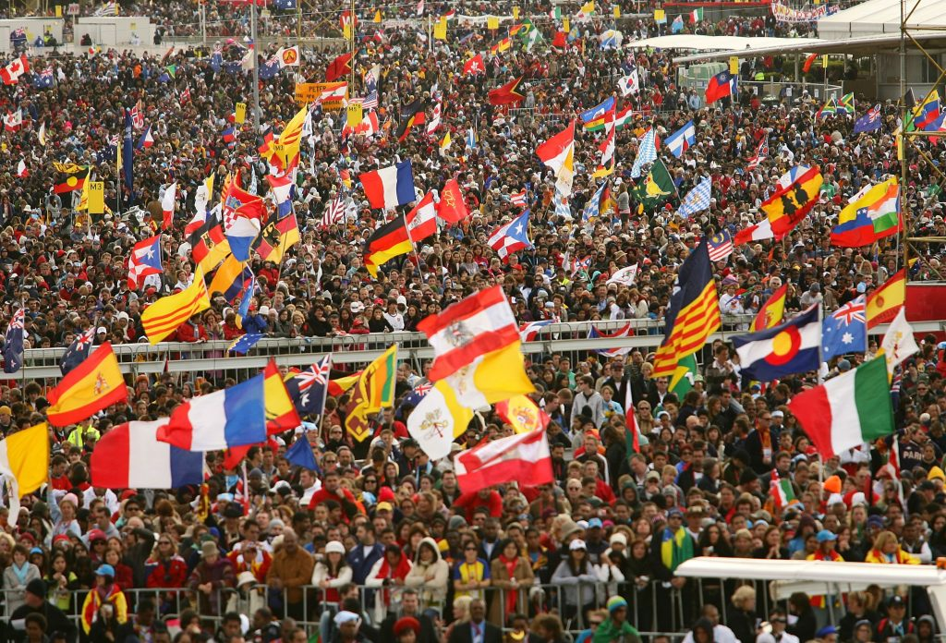
Dear Young People,
You have come to
Krakow to meet Jesus

Slide 2

Today’s
speaks of just such a meeting between
Jesus and a man named Zacchaeus
Luke 19:1-10

Slide 3
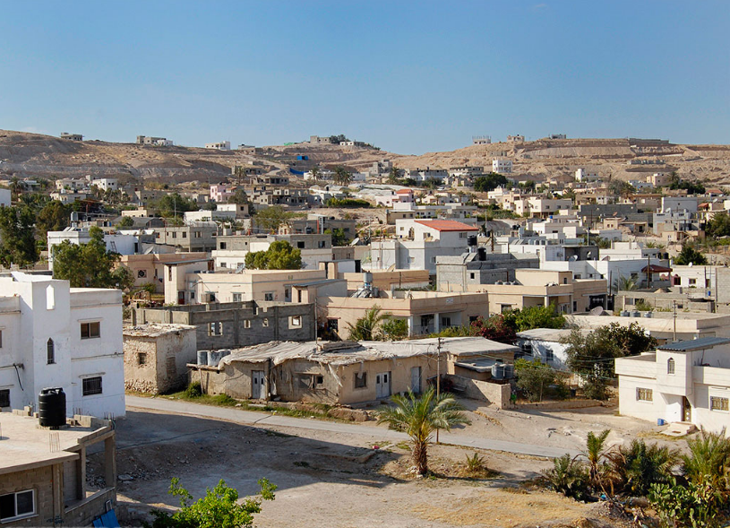
… in Jericho, where Jesus does not simply preach or greet people; as Luke tells us, he passed through the city

Slide 4
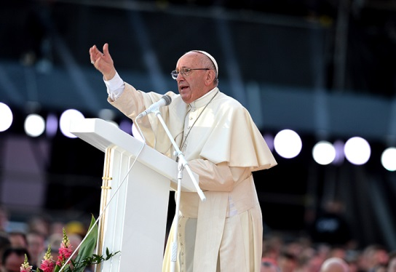
In other words,
Jesus wants to draw near to us personally

Slide 5

… to accompany our journey to its end …

Slide 6
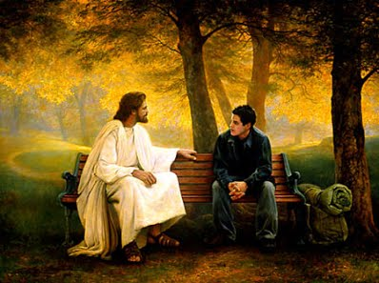
So that His life
and our life can truly meet

Slide 7

So that His life
and our life can truly meet

Slide 8
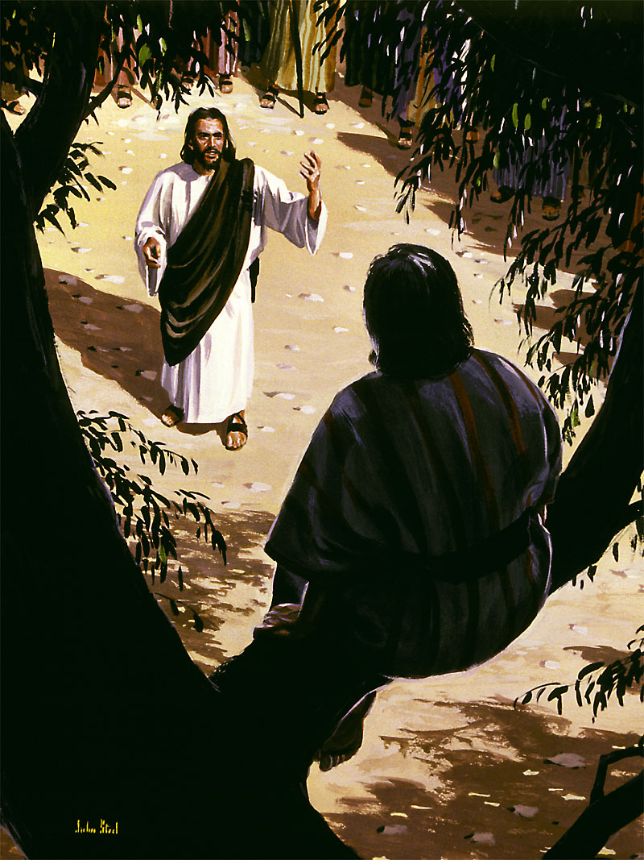
An amazing
encounter then
takes place…

Slide 9


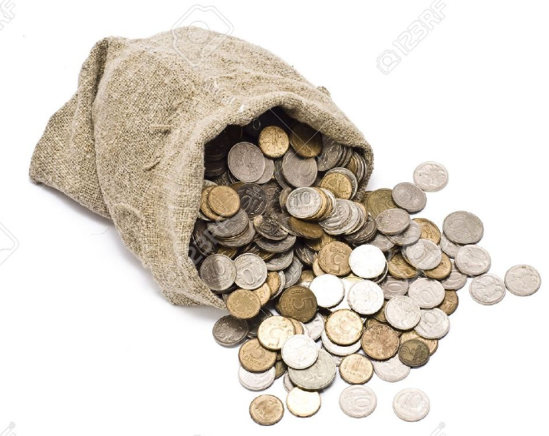
Zacchaeus:
a tax collector,
a wealthy collaborator of the hated Roman occupiers,
someone who exploited his own people…

Slide 10
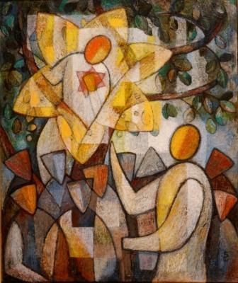
His
encounter
with Jesus
changed
his life

Slide 11

Just as it has changed, and can still change,
each of our lives.

Slide 12
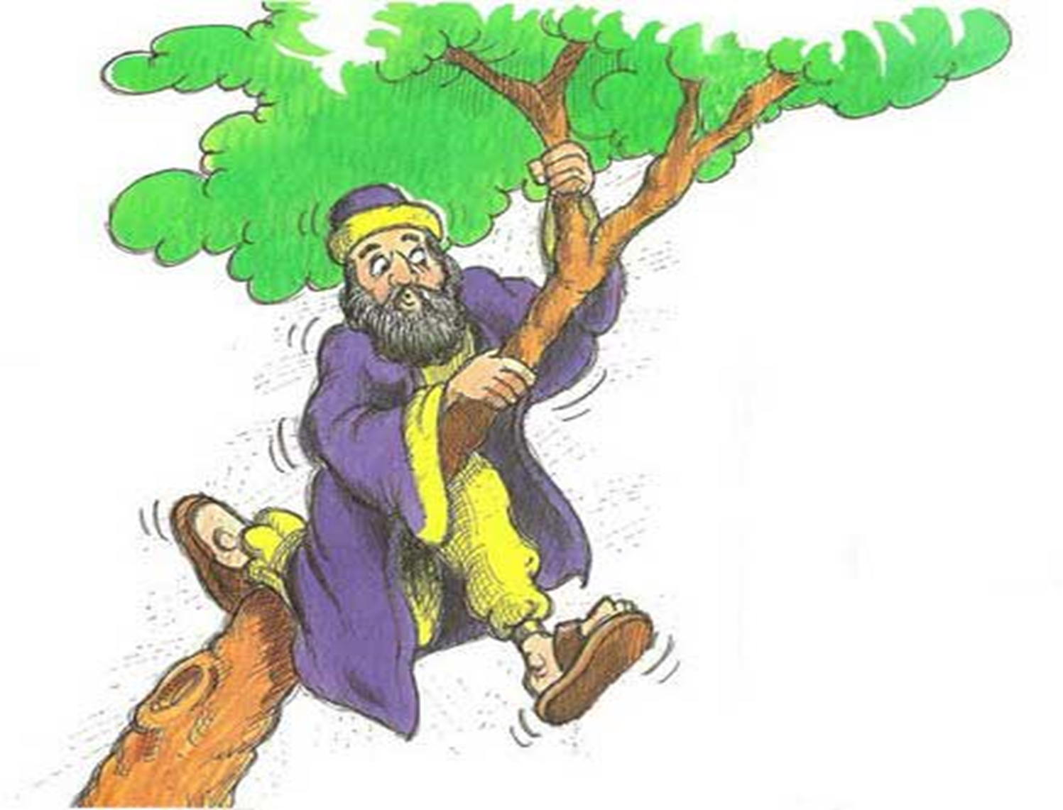
But Zacchaeus
had to face a
number of obstacles
in order to meet
Jesus…

Slide 13

These obstacles also have something to say to us…

Slide 14

Obstacle #1 Smallness of stature
Zacchaeus couldn’t see the Master
because he was little…

Slide 15
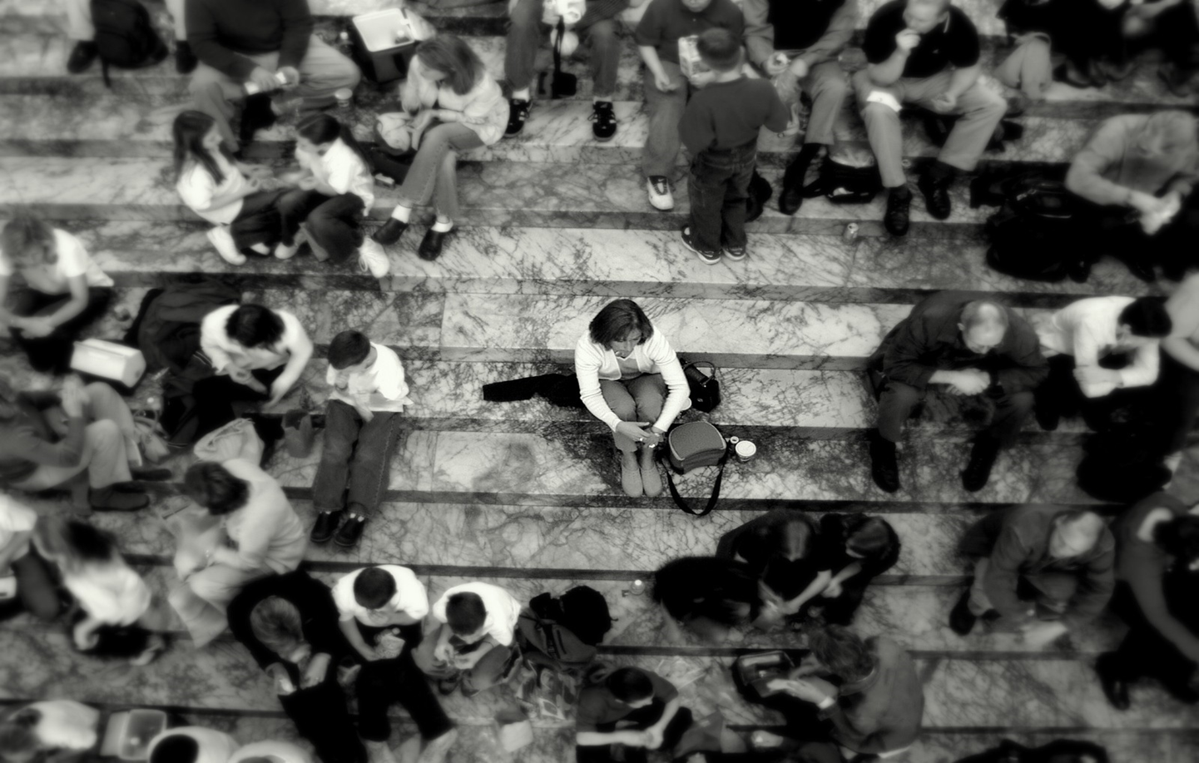
Even today we can risk not getting close to Jesus because we don’t feel ‘big’ enough
because we don’t think ourselves worthy

Slide 16

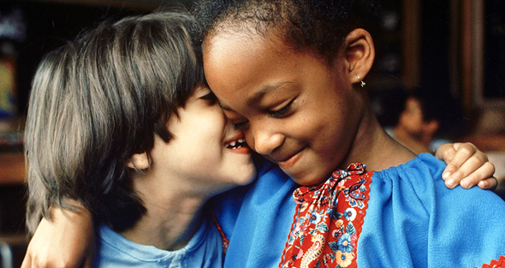
But faith tells us that
we are children of God

Slide 17
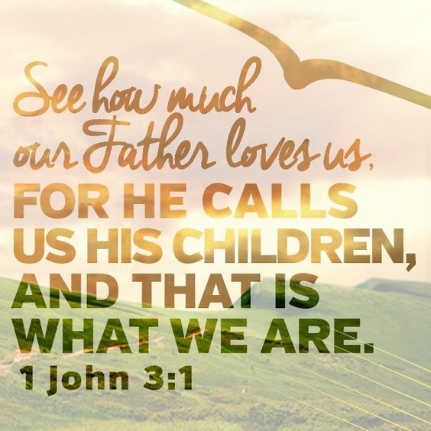

Slide 18


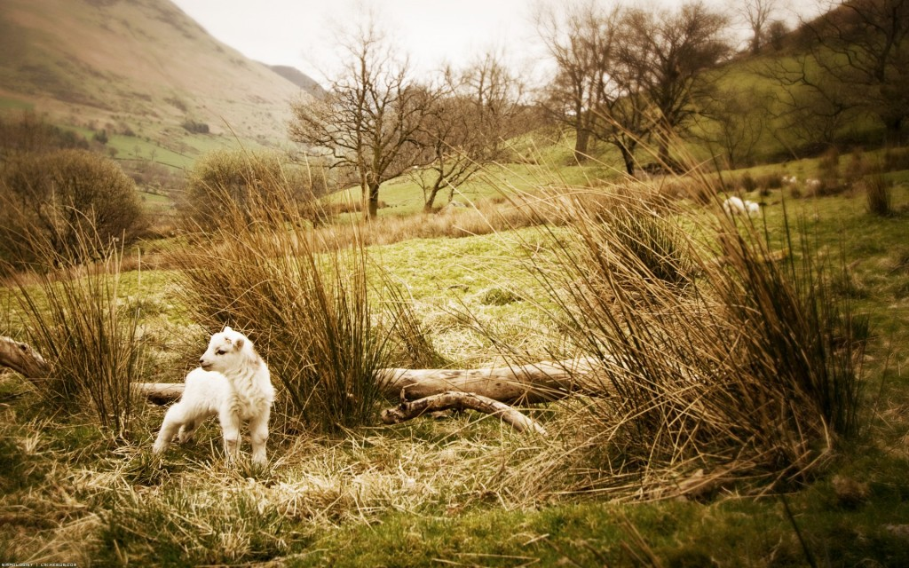
We have been created in God’s image
And the Holy Spirit wants to
dwell in us
Jesus has taken
upon himself
our humanity
His heart will never be separated from us

Slide 19

We are called to be happy forever with God!

