Slide 1
Reconciliation Service Lent 2022
The Synodal Pathway

Slide 2
Synod Elements
Communion: Sharing
Participation: Taking Part
Mission: Reaching Out

Slide 3
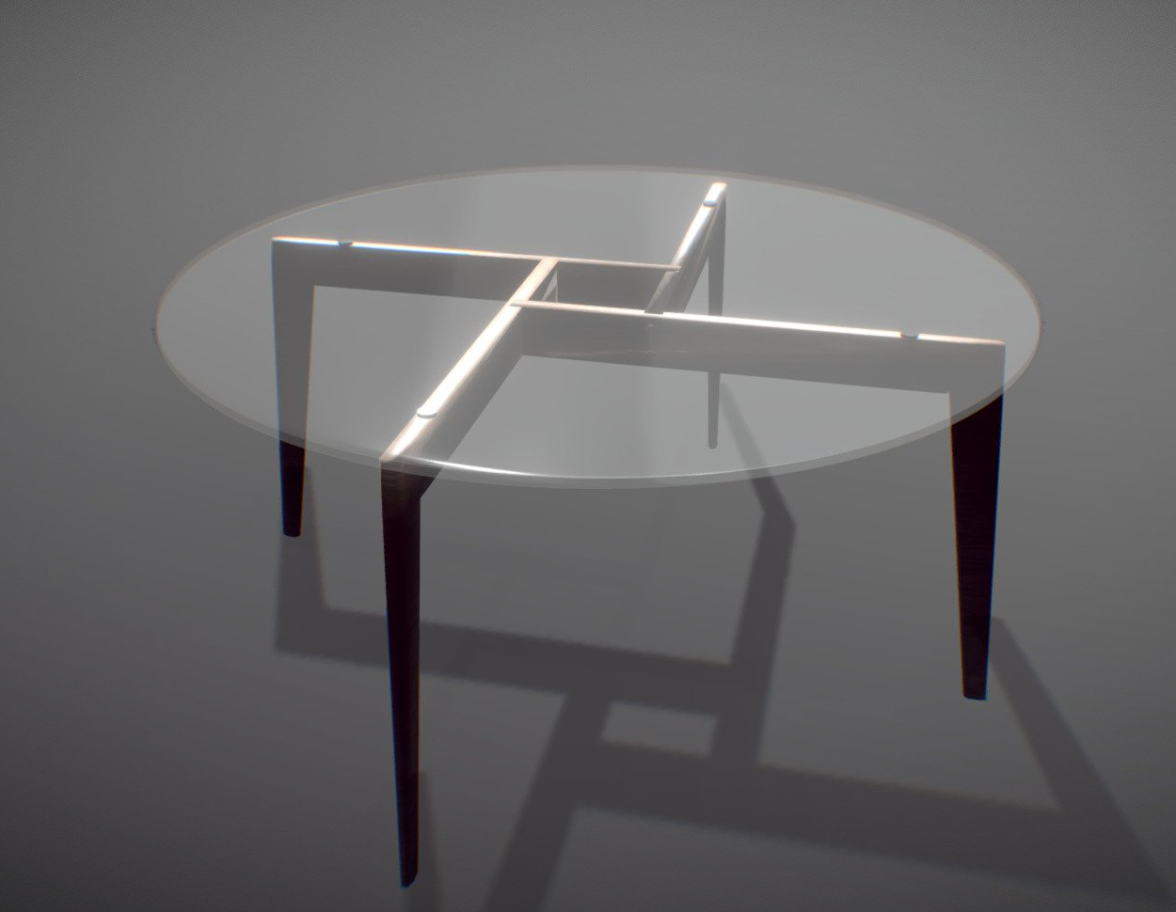

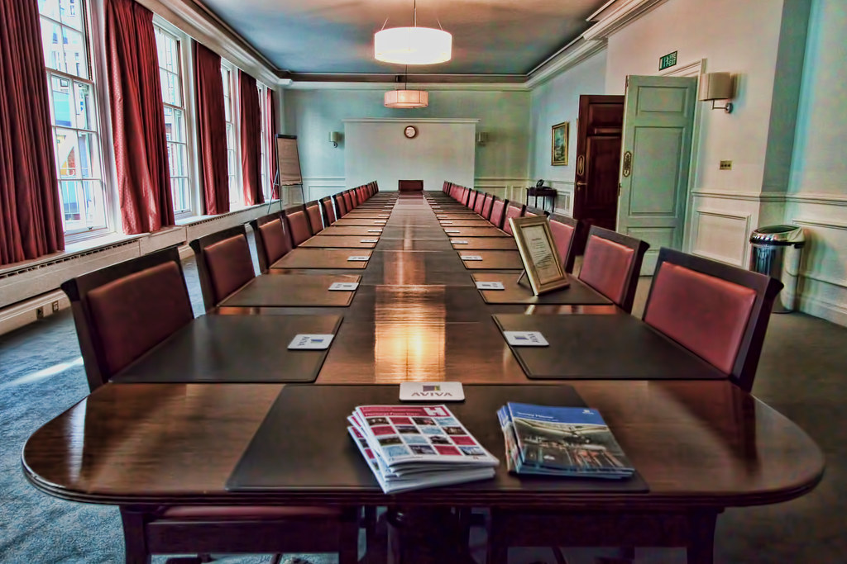
Who Prepares the Service?
Celebrant ?
Parish Team?
Liturgy Group?
Combination?

Slide 4
Opening Song: You Are The Centre (Margaret Rizza)
All sing:
You are the centre, you are my life,
You are the centre, O Lord, of my life.
Come, Lord, and heal me, Lord of my life,
Come, Lord, and teach me, Lord of my life.
You are the centre, Lord of my life.

Slide 5

You Are The Centre

Slide 6
WELCOME
Welcome/Fáilte/Bienvenue/Croeso/
Bienvenidos/Bem-Vinda/Benvenuta/
Herzlich Willkommen/Welcom/
Dobro Pozhalovat/ ???

Slide 7
WELCOME
Who welcomes?
  Liturgy Team member?
  Priest?
How many languages?
  Irish/English?
  African/Indian?
What is said?
  Is it a roadmap?
  Is it a prayer?

Slide 8
What About This?
Dear sisters and brothers in Christ – Welcome.
You have answered the call of Jesus:
  To open up to the grace of forgiveness
  To listen to his healing words
  To accept the cup of compassion offered
  To allow mercy to flow in turn from us
  To embrace the mission of peace
May you blessed with the power of God’s Spirit
every step of the way.

Slide 9
Opening Song: You Are The Centre (Margaret Rizza)
All sing:
You are the centre, you are the life,
You are the centre, O Lord, of our life.
Come, Lord, and heal us, Lord of our life,
Come, Lord, and teach us, Lord of our life.
You are the centre, Lord of our life.

Slide 10
Reading Luke 13:6-9
Jesus told this parable: ‘A man had a fig tree planted in his vineyard and he came looking for fruit on it but found none.
He said to the man who looked after the vineyard, “Look here, for three years now I have been coming to look for fruit on this fig tree and finding none. Cut it down: why should it be taking up the ground?”
“Sir,” the man replied “leave it one more year and give me time to dig round it and manure it: it may bear fruit next year; if not, then you can cut it down.”

Slide 11
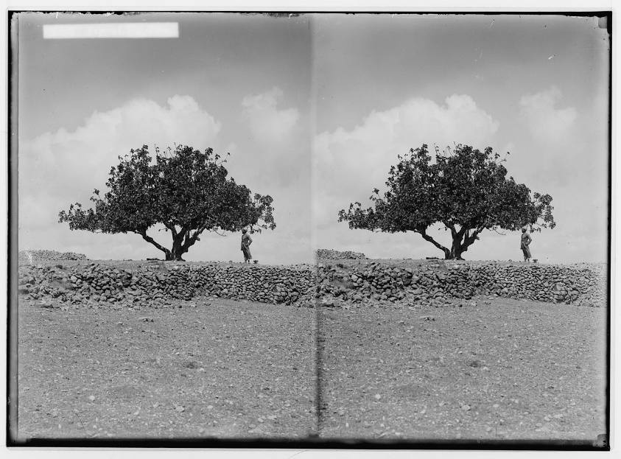
Time for Reflection

Slide 12
A Thought
‘When a Chinese bamboo tree is planted in its first year it is watered and fertilised but there is no sign of growth.
In its second year it is watered and fertilised and there is still no sign of growth. The same happens in its third and fourth year.
The fifth year is different. In the space of six weeks it grows to roughly ninety feet. The Chinese bamboo is a real lesson in patience for us all.

Slide 13


Bamboo Trees

Slide 14
Prayer/Intercessions
We pray for the patience of the vineyard keeper … to wait for God’s growth in our lives … for the gift of more time to realise God’s plan for each of us.
We pray for the grace to walk the road of reconciliation together this Lent. We know Jesus forgives our sins. We pray for the courage to forgive ourselves.
?
?
?

Slide 15
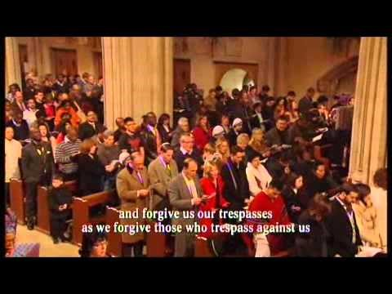
Our Father
(Rimsky Korsakov)

Slide 16
Communal Act of Sorrow
O M G
Children’s Prayer

Slide 17
Individual Confession and Absolution
Reflective Music?
Litany of Reconciliation?
Silence?

Slide 18
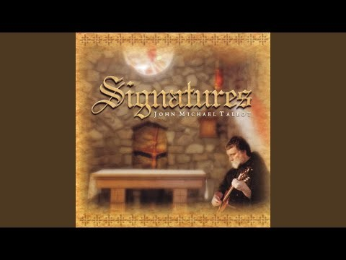
Healer of My Soul
(John Michael Talbot)

Slide 19
Make Me An Instrument of Your Peace
Lord, make us instruments of Your peace
Where there is hatred, let Your love increase
Lord, make us instruments of Your peace
Walls of pride and prejudice shall cease
When we are Your instruments of peace
Where there is hatred, we will show His love
Where there is injury, we will never judge
Where there is striving, we will speak His peace
To the millions crying for release
We will be His instruments of peace

Slide 20
Resolution/Mission
Where there is blindness, we will pray for sight
Where there is darkness, we will shine His light
Where there is sadness, we will bear their grief
To the millions crying for relief
We will be Your instruments of peace
Lord, make us instruments of Your peace
Where there is hatred, let Your love increase
Lord, make us instruments of Your peace
Walls of pride and prejudice shall cease
When we are Your instruments of peace

