Slide 1
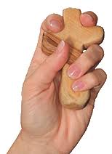

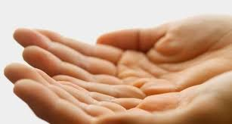
Session Three: Growing into leading
Leading prayer moments

Slide 2
Moments you may be asked to lead in pairs or alone
Visiting the home in the presence of the deceased with family
At the Funeral Home leading prayer for the deceased with the family
At the Crematorium
At the Grave Side
FOR YOURSELF REFLECT
How comfortable am I with leading prayers?
What experience do I have of leading any prayer activity?
What do I think a family might need at this time?

Slide 3
Scenario One: Visiting the home
In your group have a conversation about what you think will be helpful?
Note it down in a post – it
How might you introduce the idea of prayer to the family?
How will the prayer connect with the life of the person?
How might the family be included as part of the prayer?
What will you need to bring with you?

Slide 4
Scenario Two: Funeral Home
In your group have a conversation about what you think will be helpful?
Note it down in a post – it
How might you begin the prayer moment with the family?
How will the prayer connect with the life of the person?
How might the family be included as part of the prayer?
What will you need to bring with you?

Slide 5
Scenario Three: At the Crematorium
How might you begin the prayer moment with the family?
How will the prayer connect with the life of the person?
How might the family be included as part of the prayer?
What will you need to bring with you?
In your group have a conversation about what you think will be helpful?
Note it down in a post – it

Slide 6
Scenario Four: At the Graveside
How might you begin the prayer moment with the family?
How will the prayer connect with the life of the person?
How might the family be included as part of the prayer?
What will you need to bring with you?
In your group have a conversation about what you think will be helpful?
Note it down in a post – it

