Slide 1
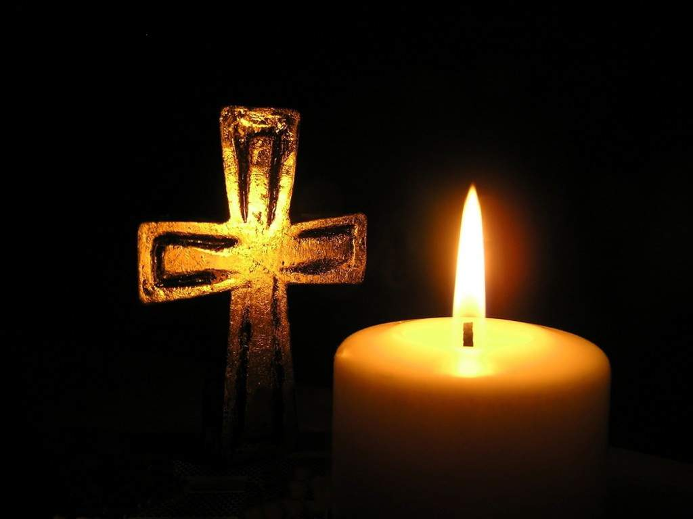
Session Three Module Two
Specific Roles
WHAT DOES FUNERAL MINISTRY LOOK LIKE IN YOUR PARISH?

Slide 2
Different ways of accompanying the family
ACCOMPANY
Praying
Welcoming
Listening
Being with
Celebrating
Remembering
FOR YOURSELF:
Which of these aspects are you most comfortable with?
Which of these would you need more time to grow into?

Slide 3
What might a parish team do?
Who is the first point of contact for a family who want to arrange a funeral?
How are the family resourced in making choices?
When and how are roles assigned?
What approach is there to leading prayer?
Who organises what needs to be set up?
How does the team reflect afterwards about what worked well and not so well?

Slide 4
Implications for Team Planning
Need to develop a local resource pack
Need to practise leading prayer
Develop shared templates for working together:
  E.g., Prayer cards for various lead roles
  Important to update information on parish website so that it is not only helpful but very simple for families to understand

Slide 5
REFLECT
What does your Team need to do now ?
How will this connect with Diocesan Policy?

