Slide 1

Session Two: Forming a Funeral Ministry team
Clarity of roles makes for a good team

Slide 2
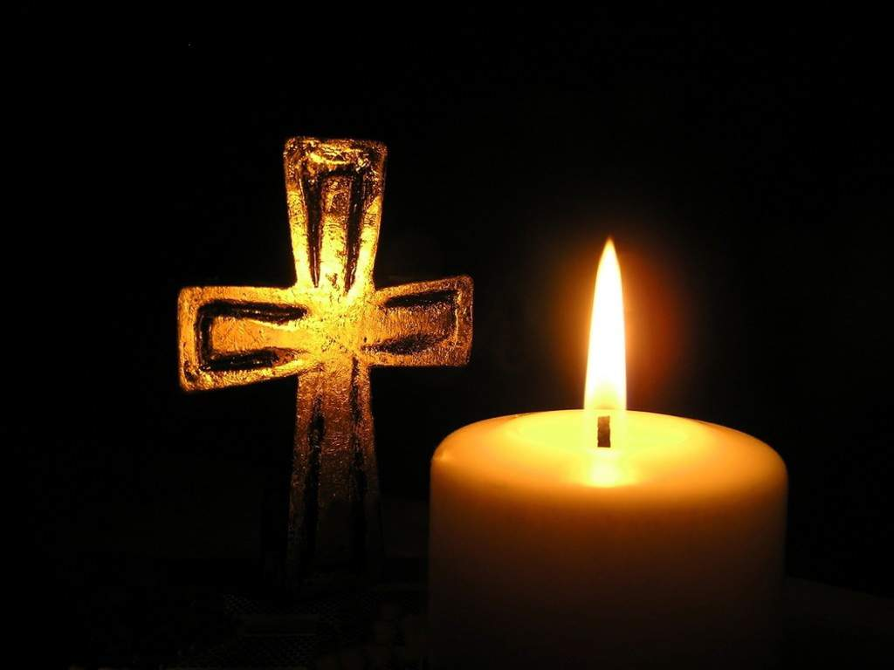
Range of Ministries OCF
Funeral Ministry
Praying
Reading
Listening
Supporting
Serving
Planning

Slide 3
Roles for Lay People
Visiting the home to console with prayer
Helping the family to plan and take their part
Supporting in making choices
Praying the Rites and leading them in the absence of an ordained minister
Preparing a Funeral Service
Leading the Rite of Committal
In a variety of locations
Family Home
Funeral Home
Church
Parish Centre
Graveside
Crematorium
THIS REQUIRES A TEAM APPROACH

Slide 4
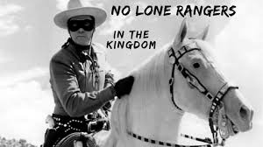
Avoid Lone Ranger ministry
The Lone Ranger is a hero
He doesn’t need other people
Features of Lone Ranger ministry
  LR’s do not share information
  LR’s are self-sufficient
  LR’s do not need any care
  LR’s do not check out with others
  LR’s get exhausted
  LR’s are not vulnerable
But remember the Lord sent them out in two’s for a reason!!

Slide 5

Funeral Ministry is a Team Ministry
Team members care for each other
Team members share concerns
Team members regularly check in with each other
Team members communicate with each other
Team members grow together
Team members work through problems
Team members put the interests of the group first
Team members affirm each others strengths
Team members pray with and for each other
ALL of this highlights the importance of ROLE descriptions
These will help the group to cooperate and collaborate

Slide 6

Sample Ministry Description
Name what this ministry is and why it is important
What the role in the team is
Who you are responsible to
What tasks you are required to do
What support will be provided
What time is required for this role
What gifts you bring to the role
All of this helps clarity of role and team collaboration

Slide 7
What gifts do you bring?
Compassionate
Organiser
Good Listener
Prayerful
Sensitive
Musical
Planner
Write on the white card the gifts you think you could bring to this ministry……

