Slide 1
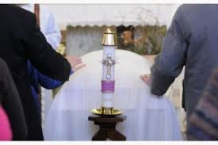
SESSION TWO MODULE TWO The CATHOLIC FUNERAL Liturgies to Accompany
LEADING DIFFERENT Prayer MOMENTS

Slide 2
RITES to ACCOMPANY MOMENTS
After death
Gathering
VIGIL
Transfer of body
Reception
FUNERAL
COMMITTAL

Slide 3
The shape of the Rites
Opening
Symbolic actions
Scripture
Conclusion

Slide 4
Exploring the Rites
Gathering in the Presence of the body
Introductory
 | Sign of the Cross
The word
 | Scripture verse
The water
 | Sprinkling with Holy water
Prayer
 | A psalm
 | The Lord’s Prayer
 | Concluding Prayer
Blessing
 | Invoking God’s blessing

Slide 5
Exploring the Rites
Rite of Committal
Introduction | Invitation to pray
 | Scripture verse
Committal and actions | Prayer over the place of committal
 | Committal
Prayer | Intercessions
 | The Lord’s Prayer
 | Concluding Prayer
 | Prayer over the people

Slide 6
Two groups: How would you lead these Rites?
Gathering in the Presence of the body
Pat
Academy Room
Rite of Committal
Patricia
Theology Room

