Slide 1
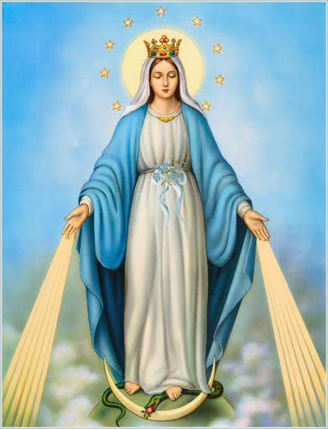
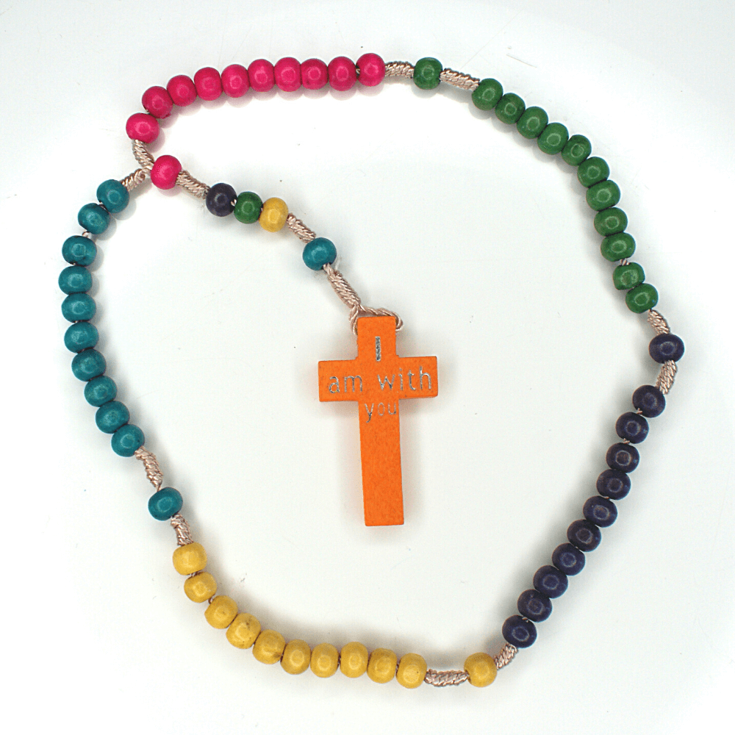
Solemnity of the Immaculate Conception
8-12-20

Slide 2
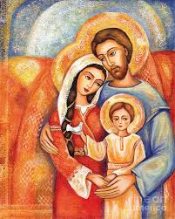
The Holy Family in Nazareth
Can you think about your family? Who is in your family?
Jesus, Mary and Joseph are known as the Holy Family
We can learn about this family in our Grow in Love Religious Education programme

Slide 3
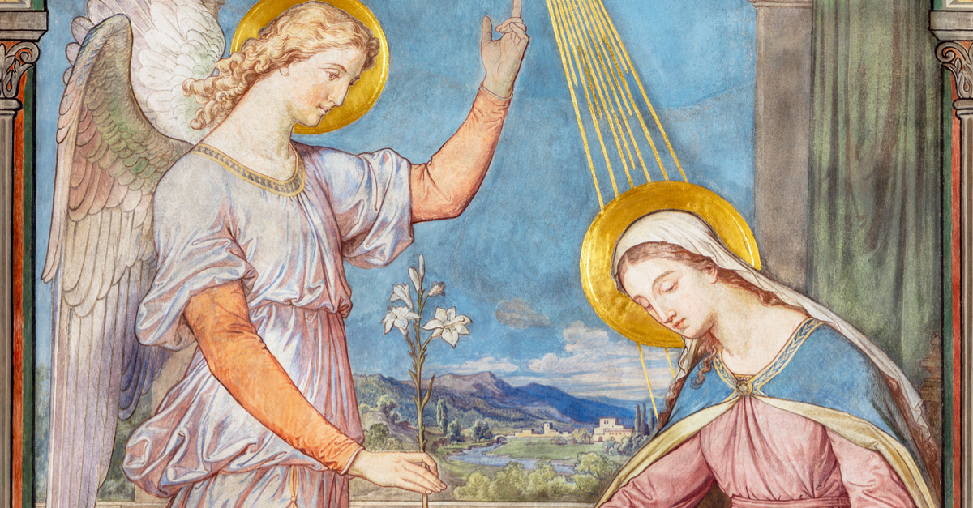

Mary Mother of God
Mary was chosen by God to be Mother of his SON Jesus.
We can read the story in the Bible of how Angel Gabriel came to Mary at the Annunciation in St Luke’s Gospel.
(Luke 1:26-38)

Slide 4
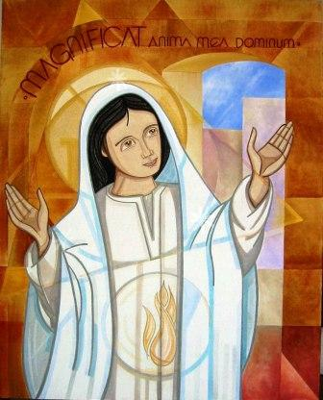
Magnificat
Mary said ‘yes’ to what GOD asked of her
She trusted God
She praised God for the great favour he asked of her by saying yes to God to be the Mother of Jesus
This prayer is called the Magnifcat.

Slide 5
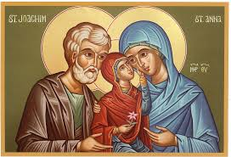
Why was Mary chosen?
God chose Mary because she was conceived without sin in the womb of her mother Anne
Mary’s body was a “worthy dwelling place” for Jesus
Mary lived her life in “peace, gentleness and charity.” She was a humble person and always recognised what God did for her
This is Joachim, Anne and Mary as a young girl. St Joachim and St Anne are Jesus’ grandparents.

Slide 6
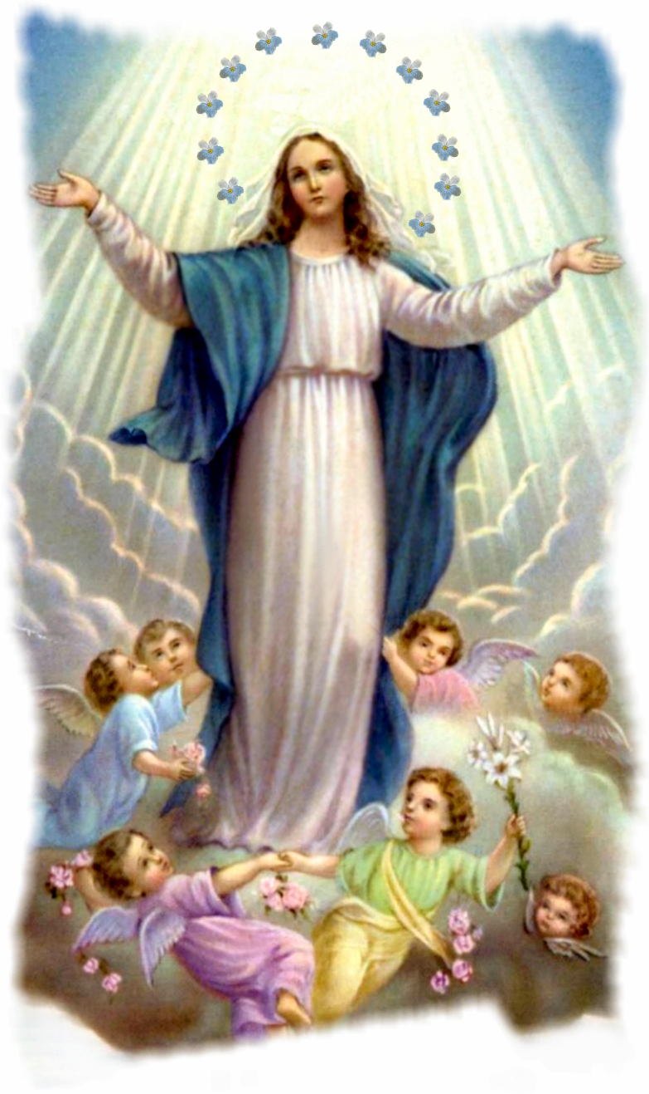
We can celebrate the Feast of the Immaculate Conception by:
Saying thanks to God for choosing Mary
By thanking God for enlightening Mary’s mind and strengthening her ability to do what God asked of her
Living a loving life as Mary did
By praying to Mary

Slide 7

Pray and Sing to Mary
Hail Mary
The Rosary
The Magnificat
Hail Holy Queen
A Mhuire Máthair
The Bells of the Angelus
When Creation was Begun

Slide 8
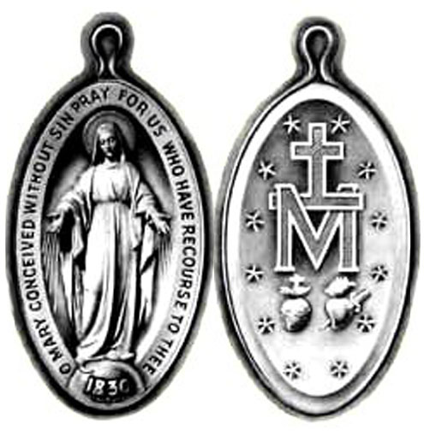
THE MIRACULOUS MEDAL
We can honour Mary by wearing a miraculous medal
We can say the prayer inscribed on the medal.
“O Mary conceived without sin pray for us who have recourse to Thee.”

