Slide 1
Thomas Aquinas was born in 1225 on the 28th of January..

Slide 2
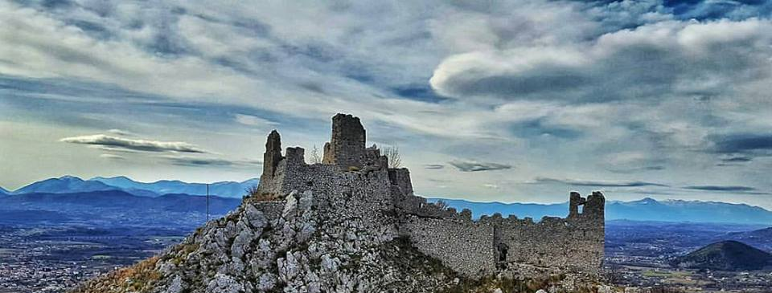
He was born in Roccasecca, near Naples in the kingdom of Sicily, Italy.
His father was known as Count Landulf of Aquino and his mother’s name was Theodora. He had three brothers and two sistersThey lived in a family castle in Roccasecca.

Slide 3

From the age of five Thomas was at school at the Benedictine Monastery of Cassino. There he stayed until he was in his teens.

Slide 4
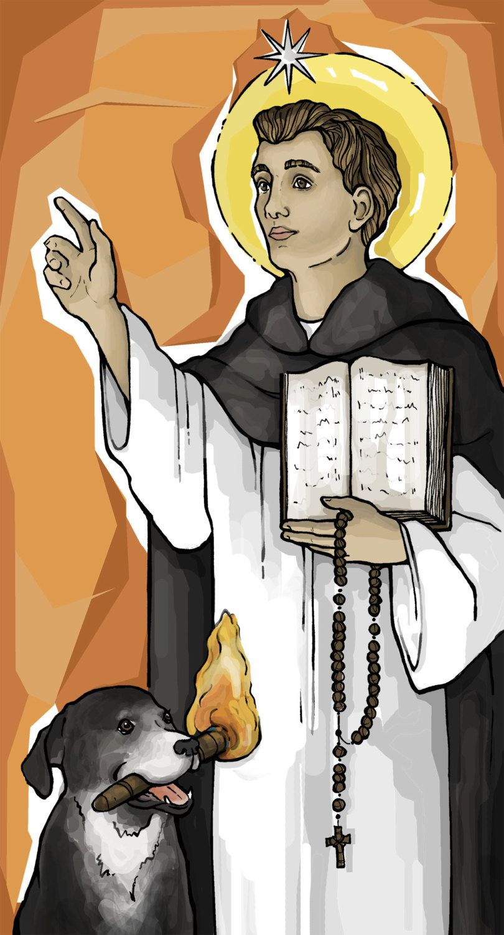
During this time a religious order called the Dominicans had begun. It was founded in 1216 by a Spaniard called Dominic de Guzman. Dominic saw the need to preach the truth of the message of Jesus Christ. In order to do this Dominic encouraged the need to study so the members of the Order would be properly informed. He also emphasised Prayer, seeing the necessity to reflect and contemplate so as to be aware of the mercy of God in our lives. To contemplate means to think thoughtfully about something for a length of time and to spend the time thinking about something in a meaningful way.

Slide 5
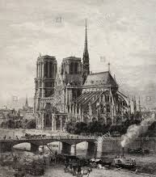
This new Order, Dominicans, attracted Thomas’ attention and he wanted to join them. His parents were not happy. So while Thomas was travelling on the road to Paris he was captured. His parents planned for that to happen and Thomas was kept captured for a year, his parents hoping that Thomas would turn away from the Dominicans.

Slide 6
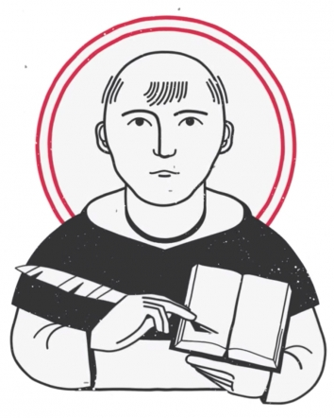
Thomas then entered the Dominicans. He was not afraid of new ideas, rather he engaged with them through study, listening, talking with others and by praying.

Slide 7
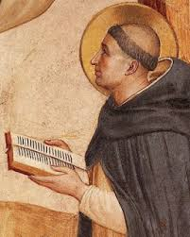
Thomas was concerned with understanding how people would know what was right and what was wrong.
He was also a student of the great Dominican Saint, Albert the Great.

Slide 8
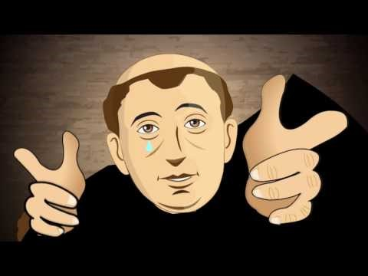
https://www.youtube.com/watch?v=N5fFicWP4vI
Double click for video

