Slide 1

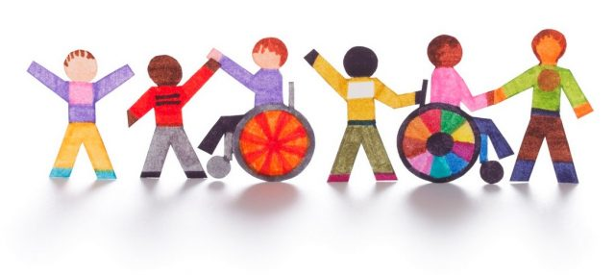

Delivering the RE Curriculum to Pupils With Special Educational Needs
This ppt was shared by a teacher teaching in the area of special ed. She has agreed to allow it to be on our web and is sharing some samples of work she does with the children in teaching RE

Slide 2

St Joseph's Primary
At present we have 18 Teachers supported by Classroom Assistants
The age range of the pupils are between 4-11 years. We have 2 Autism specific classes and 2 Learning support classes.

Slide 3


Overview of the School System
Primary school System
Foundation Stage- Year 1 and Year 2 the children are 4–6 years old.
Key Stage 1-Year 3 and Year 4 the children are 6-8 years old
Key Stage 2-Year 5, 6 and Year 7 the children are 8-11 years old.
Pupils with SEN
Learning Support Class KS1 & KS2
Autism Specific Class Foudation and Key Stage 1 (only)
Notes:
Junior infants4-6-senior infants 6-7 First and second class ks1- third forth and fifth class KS2…. Sixth class high school…. Pupils with Special Educational needs in our school.

Slide 4

RE Curriculum
Quality of Care
Quality of Relationships
Prayer
Sacramental Preparation
Catechesis
Grow in Love
Notes:
As teachers the RE curriculum is Quality of care? Quality of relationships? Meeting the needs of the pupils, caring about the child having an excellent relationship with the pupils, especially the most challenging pupils, pupils with behaviour problems. Prayer, learning prayers, saying prayers throughout the day, prayer services. Preparing pupils for the Sacraments, Catechesis and Grow in love programme.

Slide 5


Pupils with Special Educational Needs
Notes:
Delivering the curriculum to pupils with Special educational needs, quality of care! Quality of relationships! Difficulties pupils have accessing are, moderate learning difficulties impact reading understanding, recall memory, taking things literally, (prayer after Holy Communion, I am a sinner….social anxiety big groups, sensory issues, what is happening next and attention span. Strengths, excellent with visuals, love stories, excellent sense of ceremony, love routine loving and caring nature…. Matthew non verbal, Oisin and the picture, Hannah and the priest garments.

Slide 6

What We Use
Visuals
Universal Symbols
Social Stories
Pages to Color
Simple Activities
Art
Notes:
Show items/ board describe resources

Slide 7
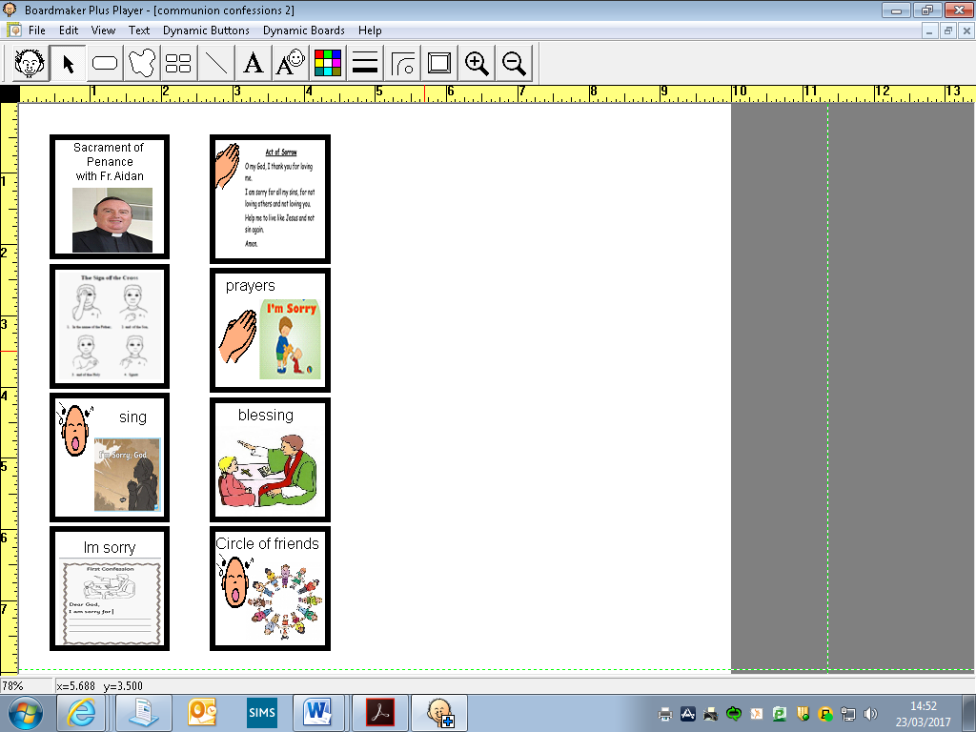
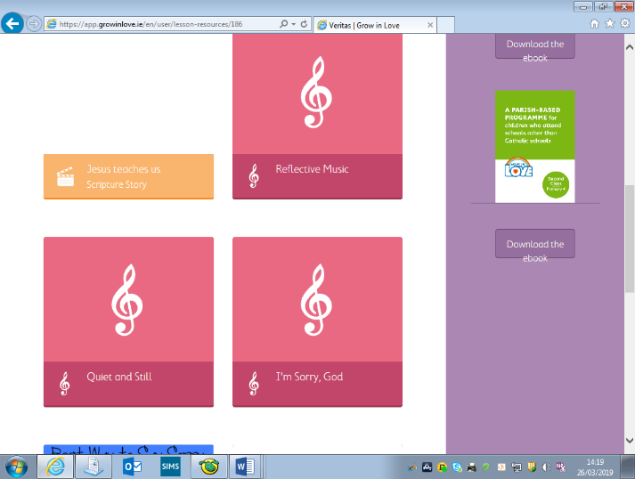
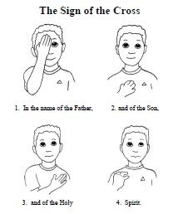

Song: Quiet and still
I stretch my hands above my head, I shake them all around
I let them fall down slowly, they wont make a sound
I rest them on my knees, I keep my body steady
My heart is beating quietly, I’m listening now I’m ready
I’m still, I’m still, I’m quiet and still
I’m still, I’m still, I’m quiet and still.
Sign of the cross

Slide 8


Listen to Fr Aidan
Priest: The grace of our Lord Jesus Christ and the love of God and the fellowship of the Holy Spirit be with you always
All: And with your spirit
Preparation of altar
Erin: We bring our candle: it reminds us that God lights the way for us
Erin: We bring a Bible: We listen to the word of God.
Corey: We bring our Primary 4 photograph: we come together as
children of God.
Corey: We bring our names given to us in Baptism: We know that Jesus loves us and our names are special to him.
Gifts

Slide 9
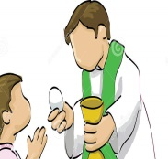
Prayer before Communion
All:
Lord Jesus, come to me.
Lord Jesus, give me your love.
Lord Jesus, come to me and give me yourself.
Lord Jesus, friend of children, come to me.
Lord Jesus, you are my Lord and my God.
Praise to you Lord Jesus Christ
Communion
Fr Aidan will give me Holy Communion and say:
Priest: The Body of Christ
I will say ‘Amen’ and put the Holy Communion in my mouth.
Prayer before Communion
Communion

Slide 10
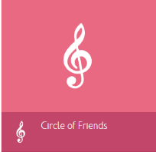
Song: Circle of Friends
You have friends, you are not alone
Thanks to them, you’re not on your own
You are strong even when you feel small
From the rain they will shelter you
In your pain they will comfort you
They will always pick you up when you fall
Circle of friends all around you
Circle of friends, strong and true
Circle of friends, always there for you
Even when you are far apart
To your friends, you’re joined heart to heart
Far away you are not on your own
You’re not there but they think of you
In their prayers they remember you
You are never ever truly alone.

Slide 11
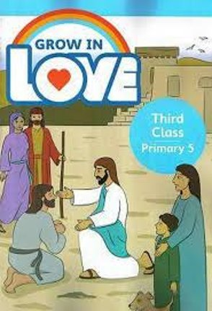
Component For Pupils with Special Educational Needs
Notes:
Moving forward what we need/like for our pupils would be a teacher tool box/ component built into grow in love for our pupils that would include all of these things to help us to deliver the RE curriculum affectively. For example theme of Jesus, Jesus the teacher, Jesus the healer pages to colour, parables and stories with visuals to match….

Slide 12

Delivering the RE Curriculum to Pupils With Special Educational Needs

Slide 13


Slide 14


Slide 15


