Slide 1

Synod Webinar 2023

Slide 2
Introductions and Welcome
We are in Synod
Synod is a way of being
We are now in a new phase – Continental Phase
1st phase – Diocesan delegates invited to do a circular reading of the Continental document, Diocesan document and National document
Notes:
Kieran to lead

Slide 3
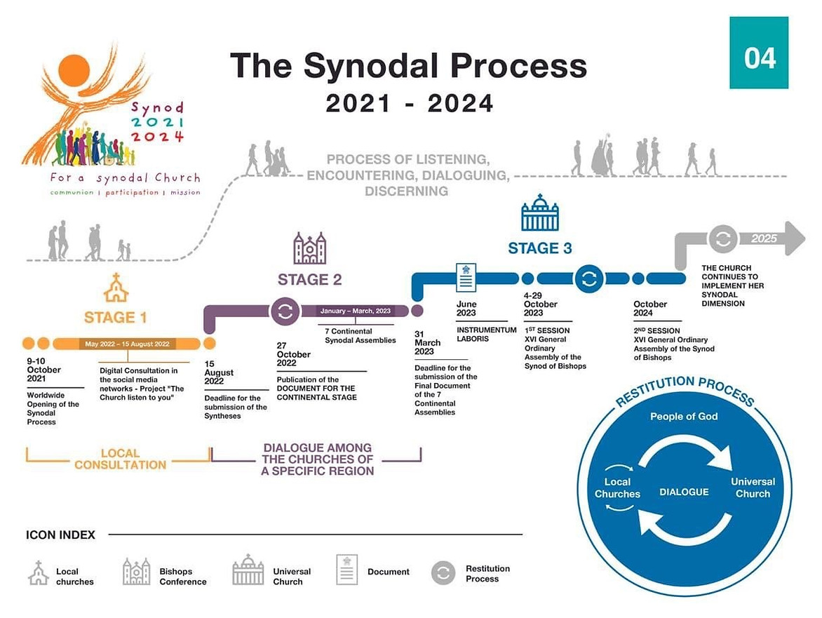
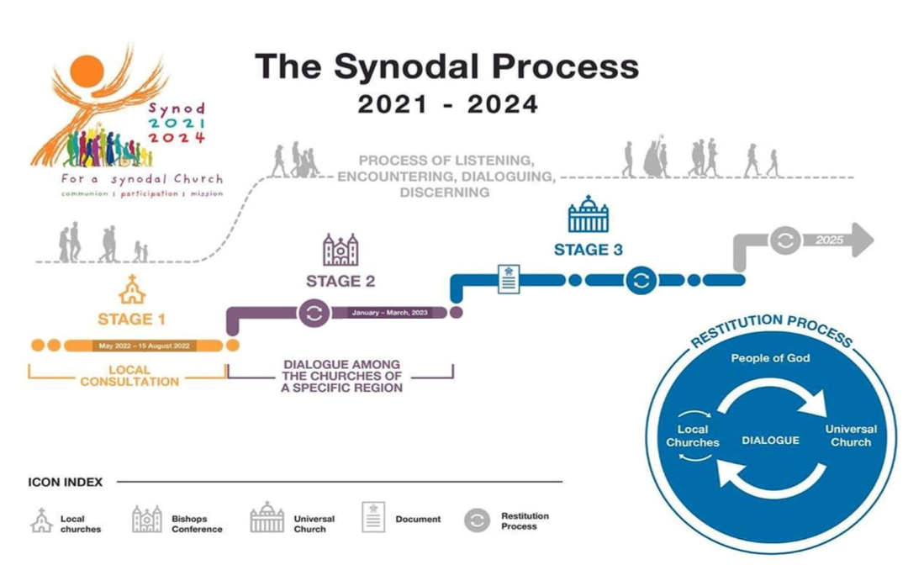
Notes:
Patricia to lead

Slide 4
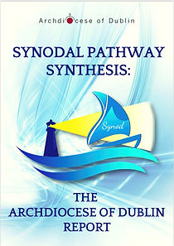
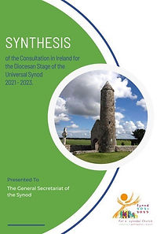
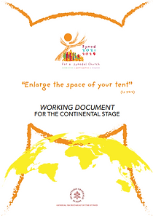
Three Reports
Continental Phase reading by the Diocesan Steering Committee:
  Experiences of the Churches
  Challenges to address
  Priorities and calls to action
Notes:
Kieran to lead

Slide 5
What we noticed
EXPERIENCES OF THE CHURCH
The abuse crisis in the Catholic Church was emphasised again and again, especially in the national synthesis (and somewhat less in the diocesan report)
Continuity in the emerging themes is a great surprise. There is a fundamental consistency between the documents.
There is a strong sense of the Spirit moving in this.
People affirmed their sense that the Holy Spirit was in the experience and process, even at this early stage.
Learning how to be co-responsible, two aspects to this based on our common Baptism:
1) the need for a deeper theoretical / theological understanding of this and
2) the need for an updating of Canon Law to permit / support it in practice.
Notes:
Peter to lead

Slide 6
What we noticed
EXPERIENCES OF THE CHURCH
The reports all highlight the need for formation, for both laity and clergy, as well as the need to become synodal in all that we undertake.
Synodality is named more explicitly as a new way of being Church in the Continental phase less so in the Diocesan phase
The Isaiah text (Continental document) reflects a generous Spirit and openness to all, the image of the tent is very accessible
The word ‘siblinghood’ is inclusive and the choice of this word is saying we are trying to put inclusivity into practice
Convergence
Clericalism is loudly named as a key issue with regard to growing in synodality
Notes:
Peter to lead

Slide 7
What we noticed
CHALLENGES TO ADDRESS
Abuse is mentioned across all reports but not just in regard to sexual abuse but abusive practices
Inclusion is called for at all levels, expanding our horizons about who is in the tent and how we can reach out to all
Young people’s voices are often not heard, their gifts not affirmed, a key challenge is to reach out to them.
The equality of the Baptised and the role of women in the Church are deeply felt and critical in all reports
Priests participating in the process, some clergy do not see themselves as part of this, there is a real challenge to enable priests to see their role alongside others in this.
Notes:
Kieran to lead

Slide 8

“Enlarge the space of your tent, spread out your tent cloths unsparingly, lengthen your ropes and make firm your pegs”
A reading from the prophet Isaiah 15:4
Notes:
Peter to lead

Slide 9
Enlarge
The image of a tent reminds us of presence and protection
A tent is a place of gathering and meeting
A place protecting us from harsh weather
A place where we can feel safe
How can we create a bigger space for others to take part in the synodal journey?
Notes:
Peter and Patricia to lead

Slide 10
Spread
In the desert still today tents are extended by opening the sides and adding more cloth
The cloths stretch out like curtains creating more space
Who is feeling included and who is wanting to get in now that the journey has begun?
Notes:
Peter and Patricia to lead

Slide 11
Lengthen
When the ropes of the tent are lengthened they are held in a strong tension
This balances the tent and keeps it stable
What tensions are we now aware of and how can we hold these in balance?
Notes:
Peter and Patricia to lead

Slide 12
Firm up
When the pegs of the tent are firmed they anchor it firmly
This holds it all together
The pegs can always be moved when the tent needs to go to a new area
How do we value the fundamentals of our faith while being open to new horizons?
Notes:
Peter and Patricia to lead

Slide 13
Enlarging the Tent
Enlarging the tent requires welcoming others into it,
making room for their diversity.
It entails a willingness to die to self out of love,
finding oneself again
in and through relationship
with Christ and one’s neighbour.
Notes:
Peter and Patricia to lead

Slide 14
A call to each of us
“Amen, amen, I say to you,
unless a grain of wheat falls to the ground and dies,
it remains just a grain of wheat;
but if it dies, it produces much fruit”
(Jn. 12:24).
Notes:
Peter and Patricia to lead

Slide 15
Letting go
What cherished ideas or values might I need to leave behind as we move forward in this synodal journey?
How am I continuing to allow myself to be changed by this synodal process?
Glory be to the Father, and to the Son and to the Holy Spirit…
Notes:
Peter and Patricia to lead

Slide 16

Two threads in Dublin in 2020 -2022
One Way Ahead
Synodal Parish Gatherings 2022
Building Hope 2021/22
Connected directly to
Sharing our experience of Church
Connected directly to
Challenges to address
Notes:
Kieran to lead

Slide 17
What we noticed
Priorities and calls to action emerging
At all levels
Formation about Baptism for all
Making a commitment to think with the Church on synodality
Notes:
Kieran to lead

Slide 18
What we noticed
Priorities and calls to action emerging
CHURCH UNIVERSAL
The call to update of Canon Law in encouraging and supporting synodality.
Theological Formation about Baptism
Many people and groups feel excluded; we need to develop new approaches to include all
There is an urgent need to develop and promote meaningful roles and ministries for women in the Church; both pastoral roles and decision-making roles with authority and responsibility.
Notes:
Peter to lead

Slide 19
What we noticed
Priorities and calls to action emerging
CATHOLIC CHURCH IN IRELAND
Bishops Conference to act in a synodal way and develop synodal practices
Formation in leadership
Accountability at every level
Women to participate in the formation process for clergy.
Seek ways to introduce and adopt inclusive language in liturgies and all church documents (eg. early adoption of new lectionary).
Notes:
Patricia to lead

Slide 20
What we noticed
Priorities and calls to action emerging
ARCHDIOCESE OF DUBLIN
Energy around continuing the conversations that are synodal
Enrich the diocesan pastoral renewal project Building Hope by using and promoting synodal practices
Bring the mentality that is captured in the Tent image into every parish in the Diocese
Keep the momentum of synodality going
Develop Council structures and understanding of being Conciliar, for example Diocesan Pastoral Council
Notes:
Kieran to lead

Slide 21
Priorities and call to action
Keeping in mind the circular reading of the three reports
Exploring what can be pastorally actioned at parish level
Aware that we are already in the pastoral phase of Building Hope
Notes:
Peter to lead

Slide 22
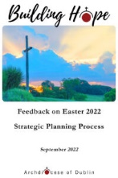

Keep in mind Synodal Principles
Synodal reading of Building Hope strategic plan
    Read in a group
    Listen to understand
    Notice where God is calling, in an atmosphere of prayer
    Share on what is practically emerging for you
    Name some practical steps that can be actioned at local level and who can do this
    See Simply Synod Booklet Pages 11, 14 – 16,
Notes:
Peter to lead

Slide 23
PARISH TASK
In light of Building Hope and our Synodal pathway, what priorities in parish are emerging for us?
What realistic pastoral actions can we name?
Notes:
Patricia to lead

