Slide 1
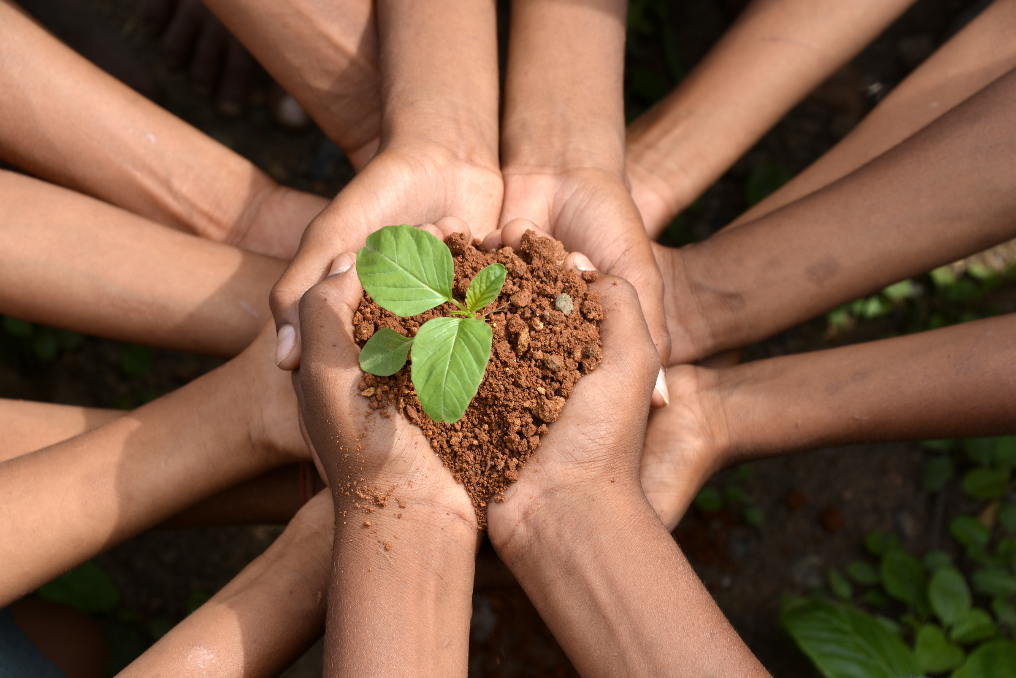
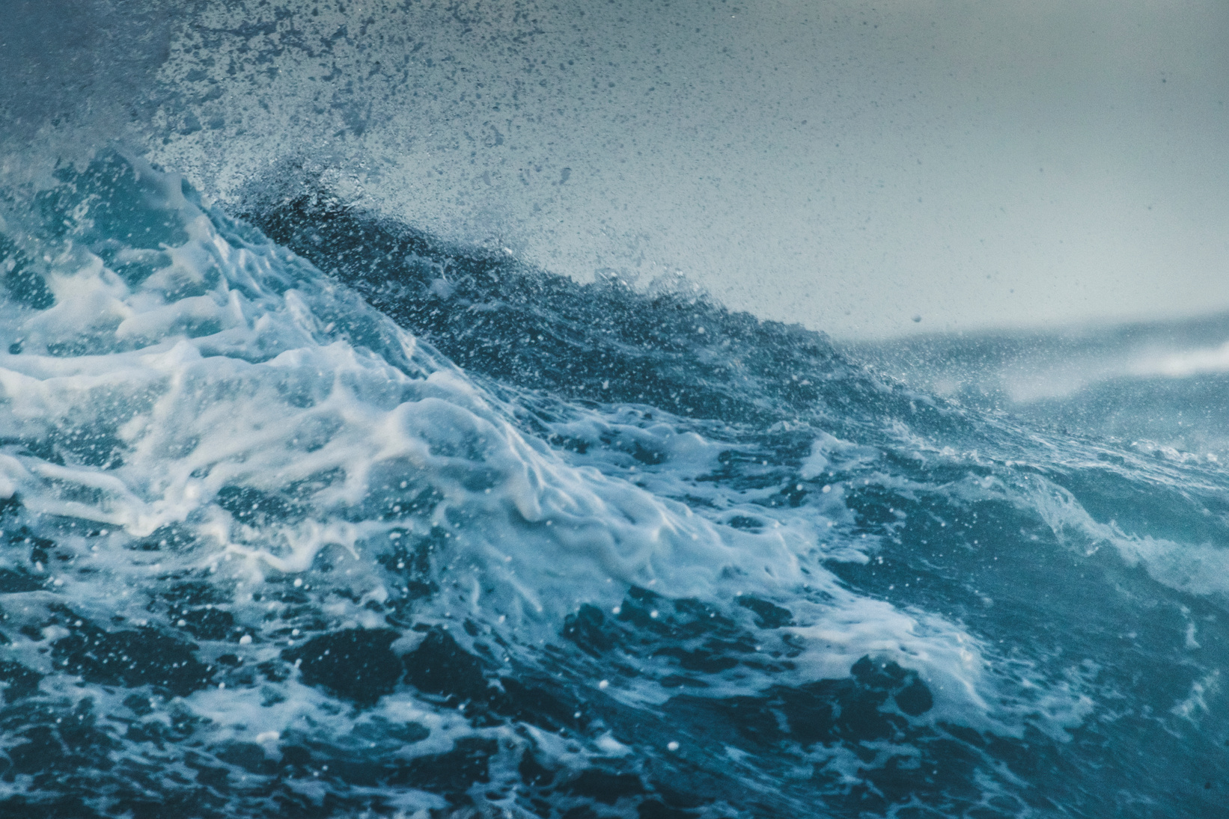
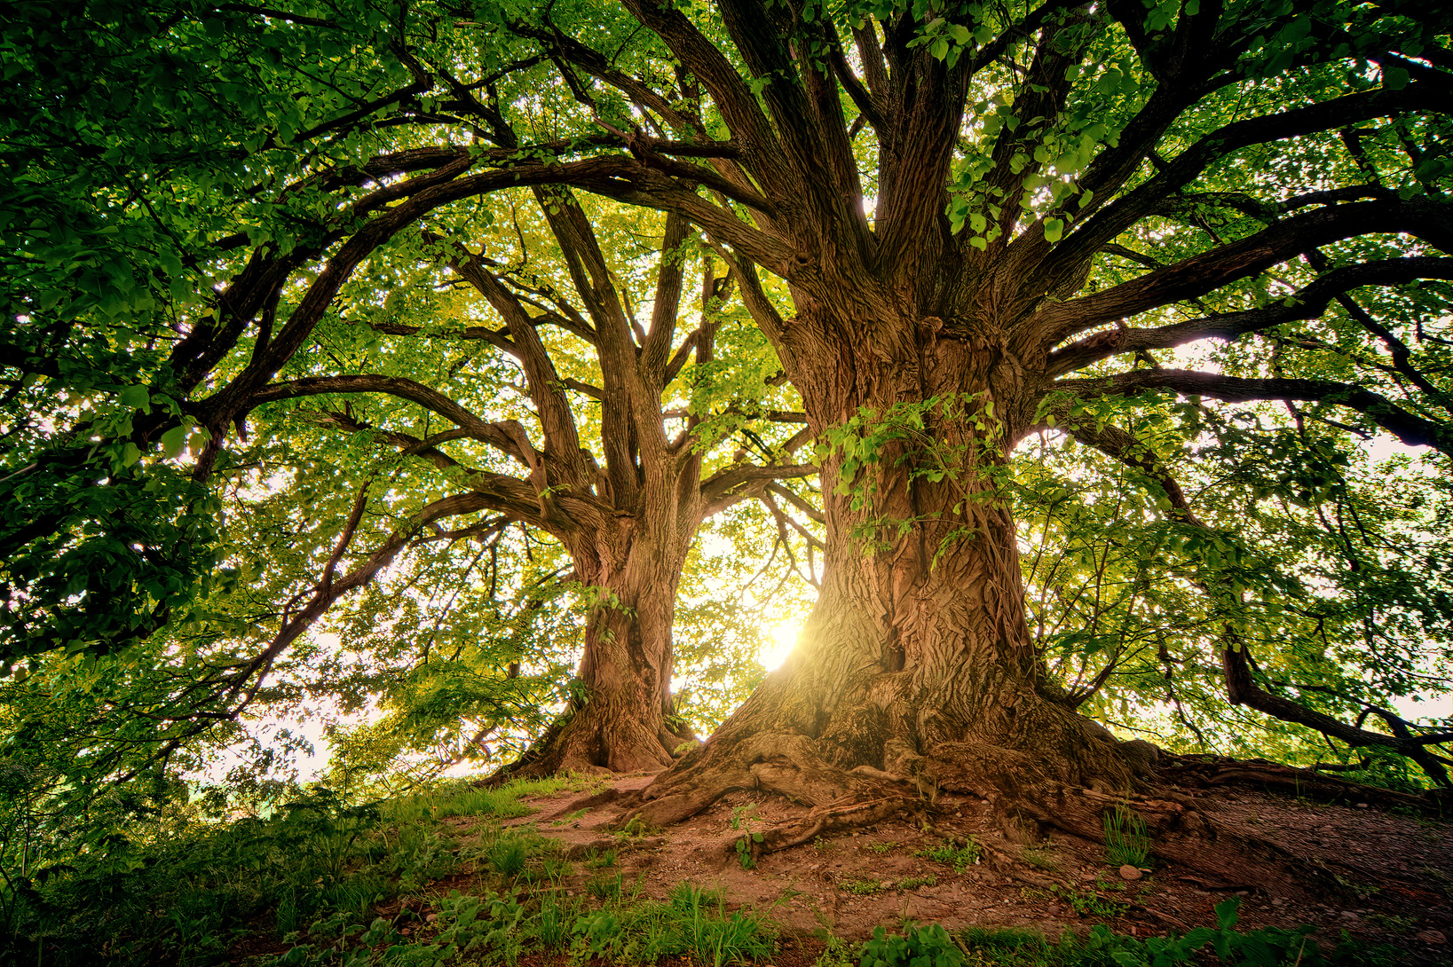
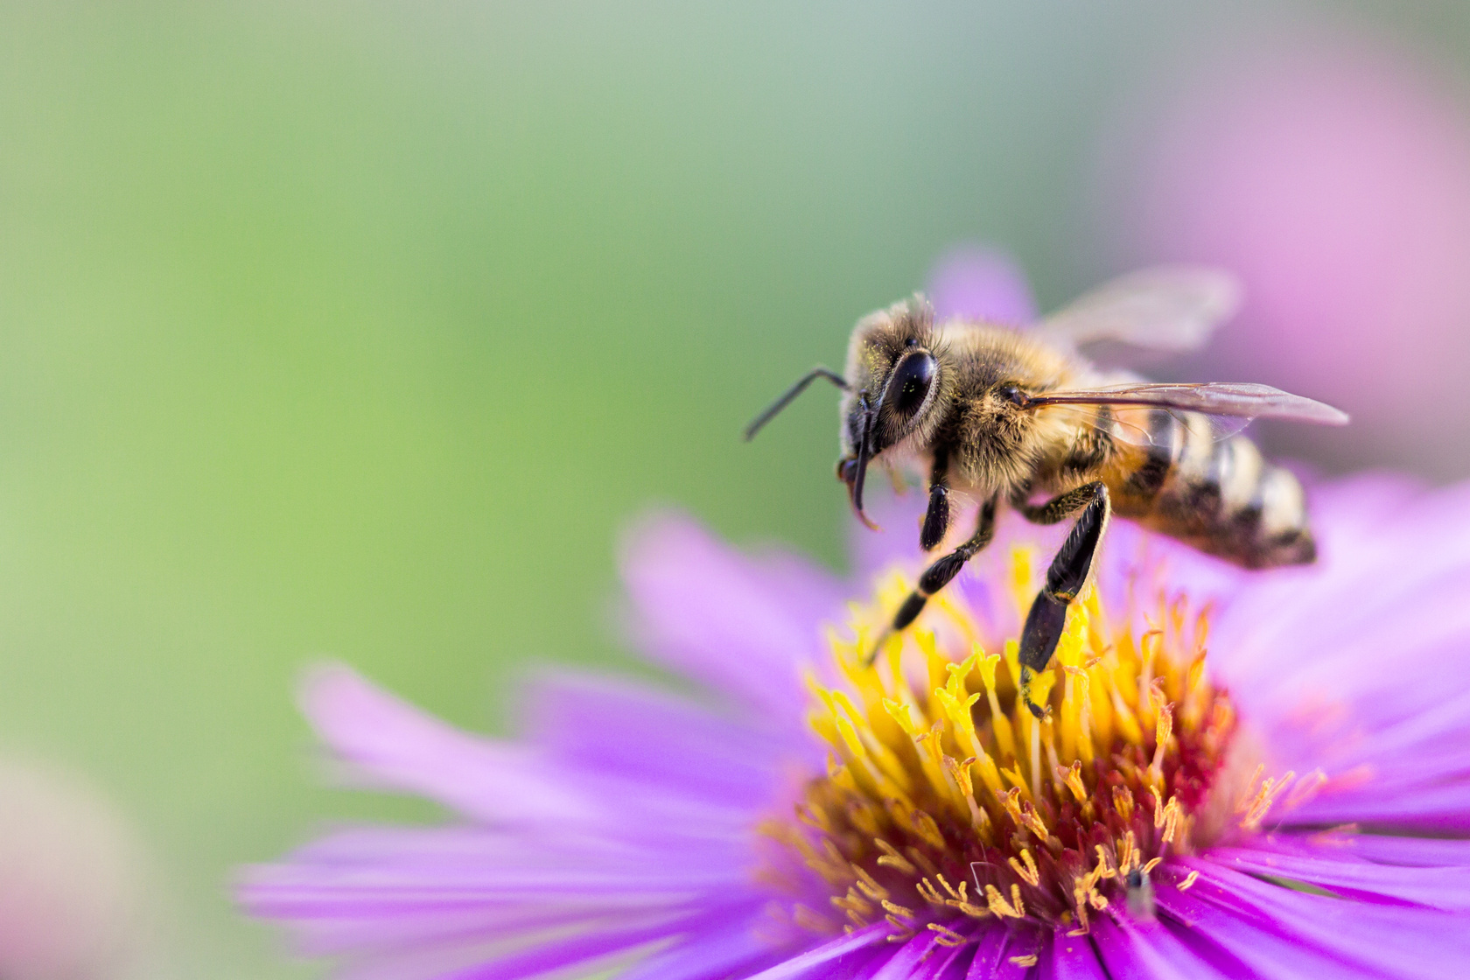




ARISE!
Laudato Si’
Bronze Award
Session 1
www.dublindiocese.ie

Slide 2


Slide 3
All-powerful God, you are present in the whole universe
and in the smallest of your creatures.
You embrace with your tenderness all that exists.
Pour out upon us the power of your love,
that we may protect life and beauty.
Fill us with peace, that we may live
as brothers and sisters, harming no one.
O God of the poor,
help us to rescue the abandoned and forgotten of this earth,
so precious in your eyes.
Bring healing to our lives,
that we may protect the world and not prey on it,
that we may sow beauty, not pollution and destruction.

Slide 4
Touch the hearts
of those who look only for gain
at the expense of the poor and the earth.
Teach us to discover the worth of each thing,
to be filled with awe and contemplation,
to recognize that we are profoundly united
with every creature
as we journey towards your infinite light.
We thank you for being with us each day.
Encourage us, we pray, in our struggle
for justice, love and peace.

Slide 5
  The Laudato Si’ Award is for youth and young adults who want to live out their Christian calling to protect and care for God’s Creation.
What is the
Laudato Si’
Award

Slide 6
  The Laudato Si’ Award is for youth and young adults who want to live out their Christian calling to protect and care for God’s Creation.
  The award builds from bronze to silver to gold level and can be completed in 3 consecutive years or when the time is right.
What is the
Laudato Si’
Award

Slide 7
  The Laudato Si’ Award is for youth and young adults who want to live out their Christian calling to protect and care for God’s Creation.
  The award builds from bronze to silver to gold level and can be completed in 3 consecutive years or when the time is right.
  It integrates and connects young people with the parish community and wider Diocesan family to work together to create an environment of care and protection in parishes.
What is the
Laudato Si’
Award

Slide 8
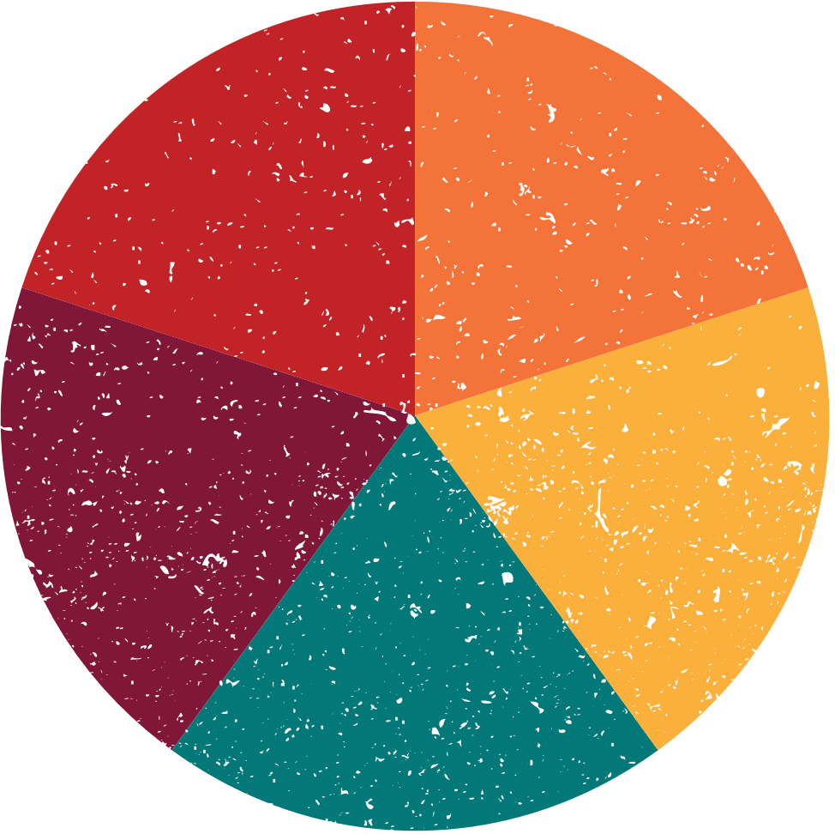
What has to be completed to get each award?
Laudato Si’
Award

Slide 9
What has to be completed to get each award?
3 Workshop Sessions
Laudato Si’
Award

Slide 10
What has to be completed to get each award?
3 Workshop Sessions
Action Project
in Parish
Laudato Si’
Award

Slide 11
What has to be completed to get each award?
3 Workshop Sessions
Action Project
in Parish
Action Project
Report
Laudato Si’
Award

Slide 12
What has to be completed to get each award?
3 Workshop Sessions
Action Project
in Parish
Action Project
Report
Laudato Si’
Award
Reflective Practice Journal

Slide 13
What has to be completed to get each award?
3 Workshop Sessions
Action Project
in Parish
Diocesan Retreat Day
Action Project
Report
Laudato Si’
Award
Reflective Practice Journal

Slide 14
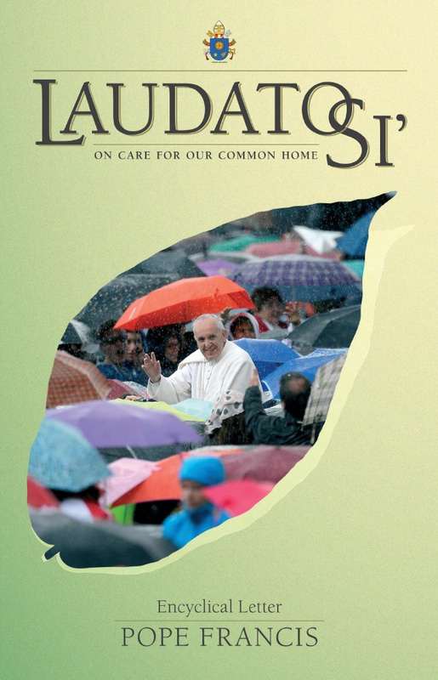
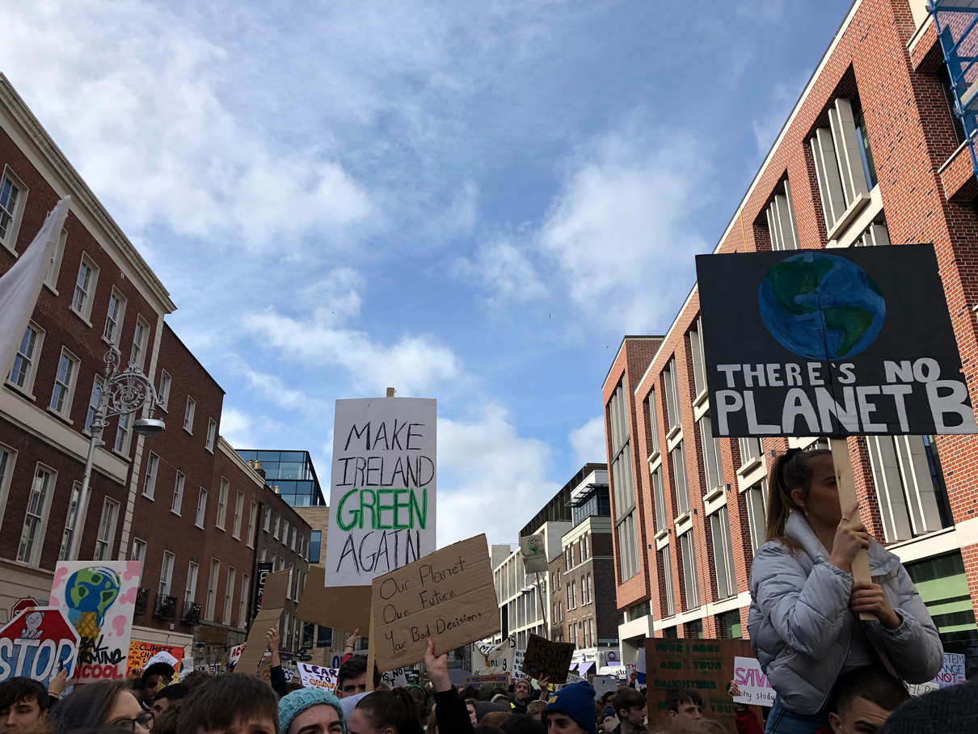
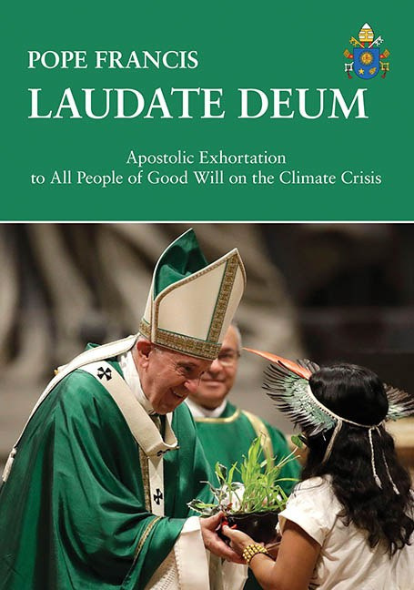
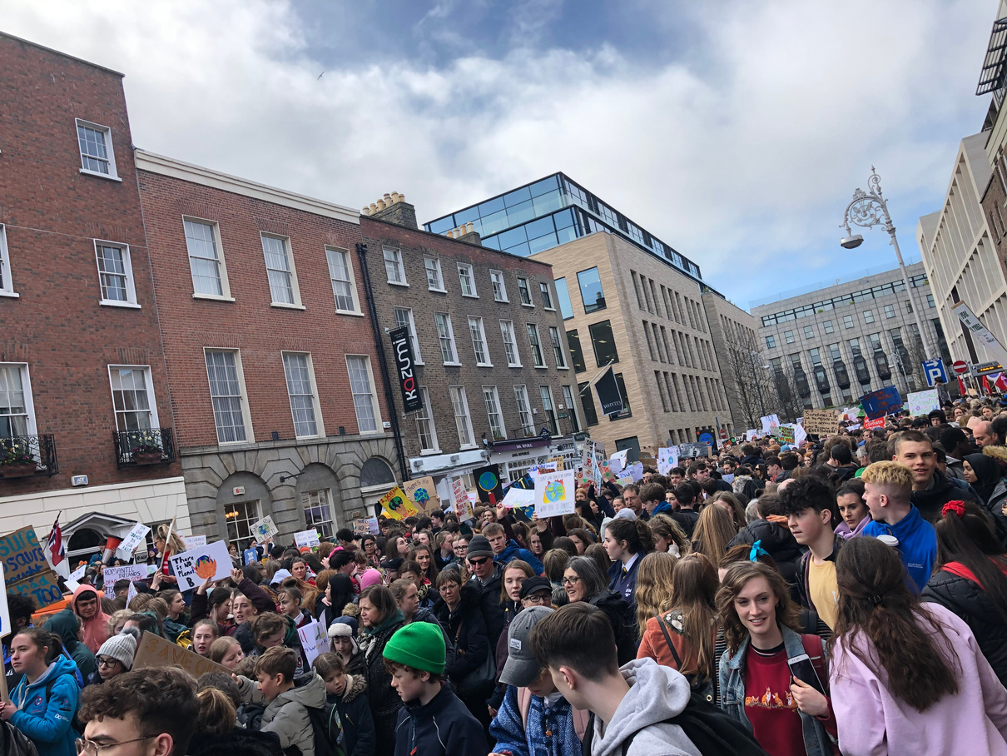
What is
Laudato Si’?

Slide 16
What makes this award different?
Laudato Si’
Award

Slide 17
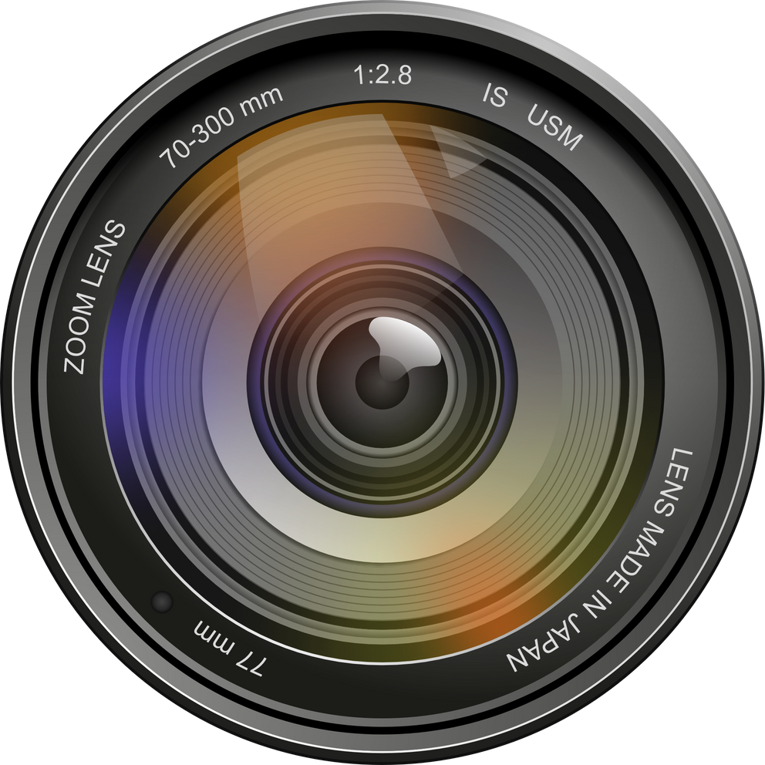
Looking at the world
What makes this award different?
Laudato Si’
Award

Slide 18
Looking at the world
What makes this award different?
Laudato Si’
Award
through the lens of faith

Slide 19
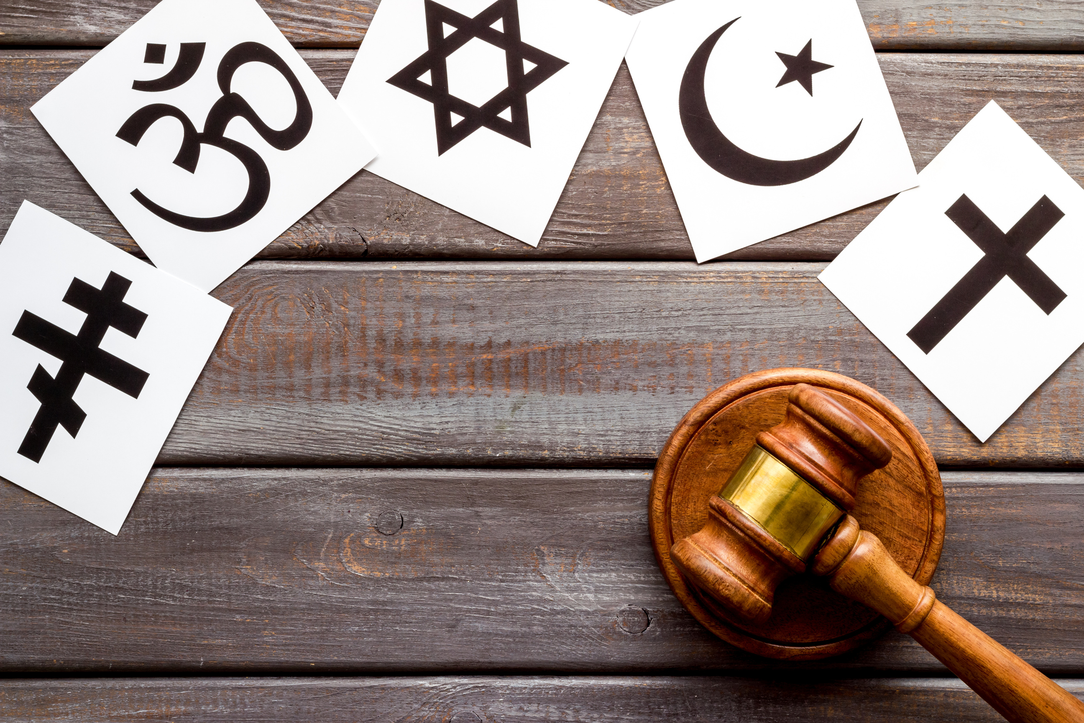
All World Religions have a view on how the earth was created

Slide 20
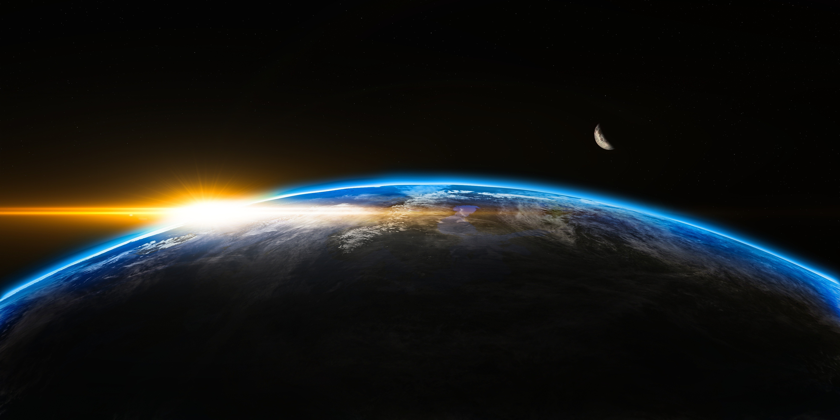
The Christian view is found in the
first chapter in the first book of the Bible: Genesis

Slide 22
What is the Lens of Faith?

Slide 23
What is the Lens of Faith?
The topic of the environment and caring for our planet is a hot one! Not only because of rising temperatures but because it is an issue affecting everyone on this earth. Not just every person but all life on the earth. Everyone is called to action and there are many ways to respond. Unfortunately, you can’t do everything (as much as you’d like to) and many people focus on one area at a time e.g. pollination, recycling, clean and safe water, and reducing carbon footprint, to name just a small few.
As people of faith, we are called to do the same. So what makes our approach any different to the people around us? As people of faith, we respond and see ‘Caring for Creation’ through the lens of faith. What is the Lens of Faith? We all see life through a certain lens. A lens is an object that allows us to see clearly. It is used to correct the defects in our vision. Spiritually, we need a lens of faith to help us have vision. Without faith, our vision gets lost, and we will find ourselves just trying to make it in life. When we look at the earth, creation and everything in it, we look at it and say that it is an act of God and should be carefully respected and cared for.

Slide 25
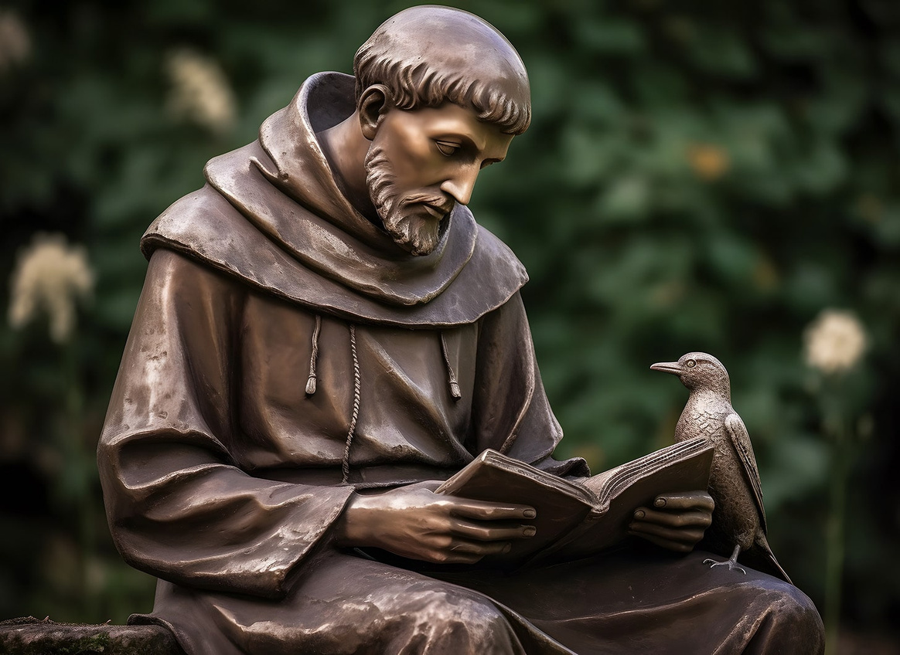

St Francis of Assisi
  St. Francis of Assisi spent much of his time preaching about animals, exhorting that all creatures are brothers and sisters under God.
  Born in 1181 in Italy
  Throughout most of his youth, he served as a soldier, but after a “conversion experience,” he renounced his family’s wealth and devote his life to God.
  He was a popular preacher at the time.
  His death in 1226 brought three million people together for his funeral.
  In 1979, Pope John Paul II declared St. Francis the Patron Saint of Ecologists.
  In some ways, St. Francis of Assisi could be viewed as the original Earth Day advocate.
  Not only did he care for the poor and sick, but he preached multiple sermons on animals, and wanted all creatures on Earth, including humans, to be treated as equals under God.
  Some of his sermons included stories about birds, fish, and rabbits.
  Through the lens of faith, we are called to walk in the footsteps of St Francis in caring for the earth today.

Slide 27
LORD, MAKE ME AN INSTRUMENT OF YOUR PEACE.
WHERE THERE IS HATRED, LET ME SOW LOVE;
WHERE THERE IS INJURY, PARDON;
WHERE THERE IS DOUBT, FAITH;
WHERE THERE IS DESPAIR, HOPE;
WHERE THERE IS DARKNESS, LIGHT;
AND WHERE THERE IS SADNESS, JOY.
DIVINE MASTER, GRANT THAT I MAY NOT SO MUCH SEEK
TO BE CONSOLED AS TO CONSOLE;
TO BE UNDERSTOOD AS TO UNDERSTAND;
TO BE LOVED AS TO LOVE.
FOR IT IS IN GIVING THAT WE RECEIVE;
IT IS IN PARDONING THAT WE ARE PARDONED;
AND IT IS IN DYING THAT WE ARE BORN TO ETERNAL LIFE.
AMEN.

Slide 28
ARISE!
natalie.doherty@dublindiocese.ie
www.dublindiocese.ie

